Slide 1
Unit 12 – Reagan and the March to the Present
Lesson 6 – The Obama Presidency
4/18/13

Slide 2
Unit 12 Lesson 6: 4/18/13
Warm-Up:
Download this Power Point from mrvandsburger.weebly.com
Respond to the prompt below in the Notes section of your Power Point
What are the most important issues facing America today?
34 Days Left Until the AP Exam!!!

Slide 3
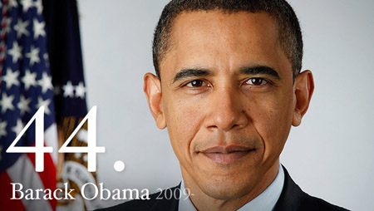
Objective
Unit 12 Lesson 6. SWBAT determine which major issues are likely to impact the United States during the Obama Administration and in the future.

Slide 4
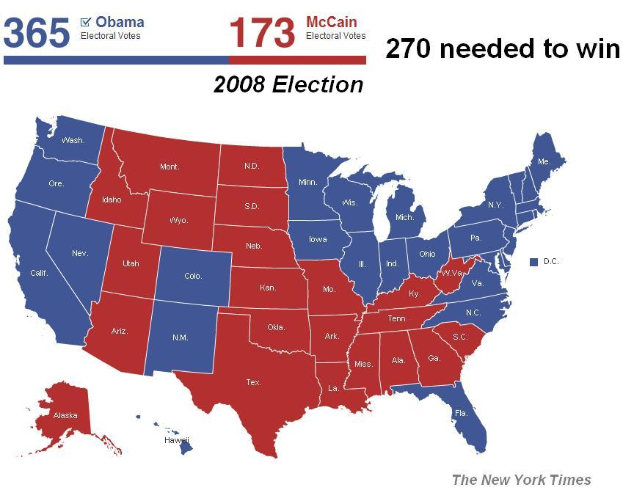
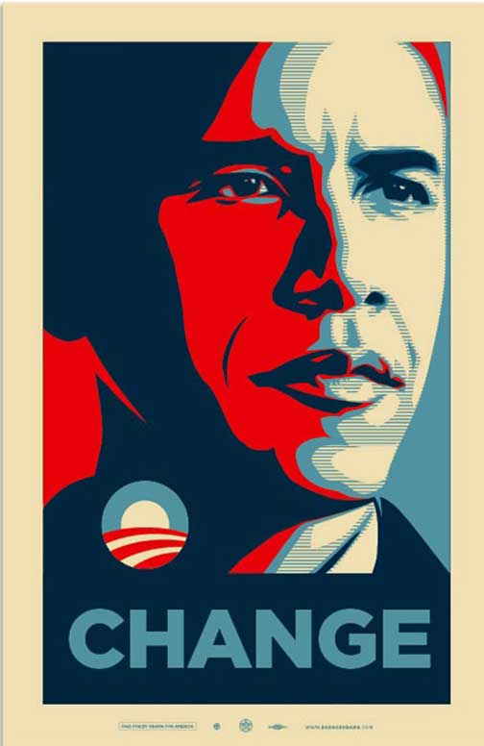
Notes: The Obama Presidency
Election of 2008
Close contest between Senator Hillary Clinton and Senator Barack Obama for Democratic nomination
Senator John McCain nominated by Republicans in response to Bush’s plummeting approval rating
Sarah Palin becomes second woman nominated to run for VP
McCain-Palin squander early lead
Obama Revolution uses grassroots campaigning with social media to capture easy victory
Raised significantly more campaign funds
Democrats take swing states of Florida, Ohio, Virginia, and North Carolina
Increase majority in both houses of Congress

Slide 5
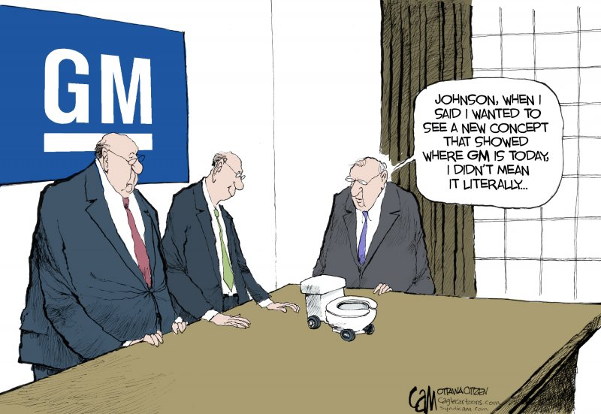
Notes: The Obama Presidency
Transitioning to Obama
Bush and Obama collaborate on asking Congress to continue TARP bailouts
Support automakers Chrysler and GM
Cabinet Changes
Clinton becomes Secretary of State
Eric Holder is first African American Attorney General
Robert Gates kept on as Secretary of Defense
Largest crowd in American history attends Obama’s inauguration
Continues messages of “change”, “responsibility”, and “reform”

Slide 6
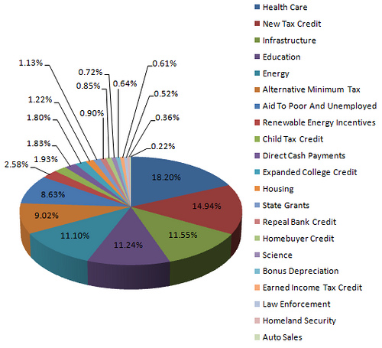
Notes: The Obama Presidency
First “100 Days”
Immediately sought to overturn many Bush-era policies
Closed Guantanamo Bay prison
Banned torture in questioning terror suspects
Expanded stem-cell research
Supported overseas health organizations
Promoted actions to stabilize the economy
American Recovery and Reinvestment Act of 2009 created “tax relief”, state and local aid, and construction projects, education, health care, and renewable energy programs
Modeled after “Recovery” programs of New Deal
Public-Private Investment Program for Legacv Assets used TARP funds and private investment to buy “toxic assets” or bad loans from banks
Helped restore credit flow and confidence in banks
Increased regulation of large financial institutions by measuring risk levels and allowing government takeover of financial bodies
Bailout of automakers to promote industrial recovery
Republican opposition limited recovery efforts but Democratic control of Congress allowed most initiatives to pass

Slide 7
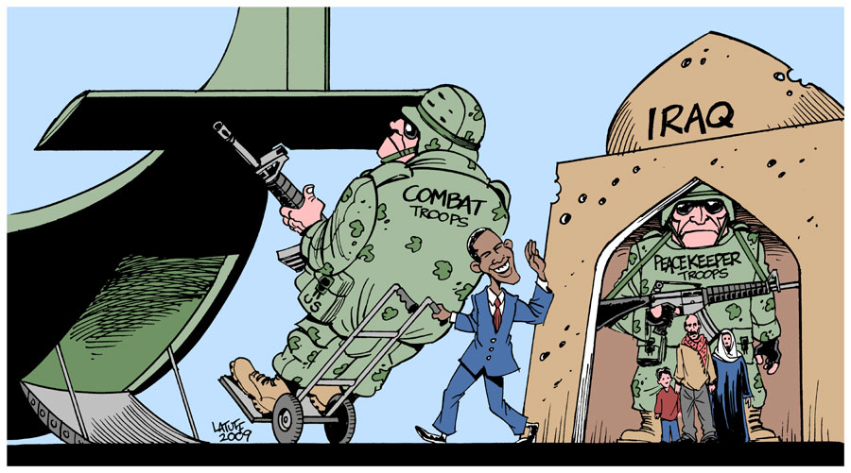
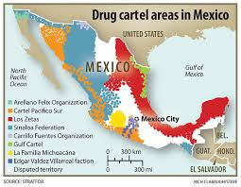
Notes: The Obama Presidency
Changing Foreign Policy
Oversaw withdrawal of all American troops from Iraq and instituted “transitional force” of Iraqis
Afghanistan policy
Initial surge of 17,000 troops to address issues neglected due to Iraq invasion
Timetable set for withdrawal by 2014
Mexican-American Relations
Obama cooperates with Meixcan President Felipe Calderon to limit influence of Mexican drug cartels
Make money by selling weapons and drugs to Americans

Slide 8
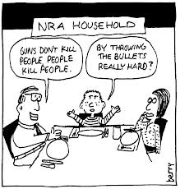
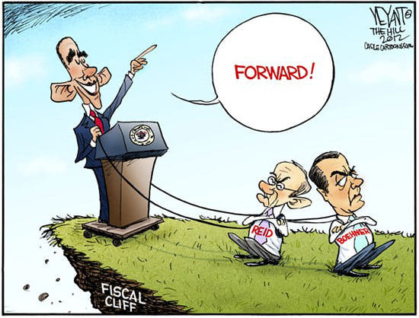
Notes: The Obama Presidency
Election of 2012 and Major Issues in America’s Future
Mitt Rommney runs as Republican nominee
Close campaign turns into decisive victory for Obama and VP Joe Biden
Republicans captured the House of Representatives in 2010 and hold onto majority in 2012
Major issues of Obama’s second term
Party “Polarization” – Lack of compromise among Democrats and Republicans has led to gridlock on many issues
The “Fiscal Cliff” – Congress struggles to pass a budget as Republicans want tax and program cuts while Democrats want to maintain programs and raise taxes on wealthy
Immigration Reform – Pathways to citizenship and college access for children of illegal immigrants
Gun Control – Hotly contested debate especially following Newtown Shooting of 2012
Iran and North Korean Aggression – Both nations continue development of nuclear technologies while North Korea threatens America and South Korea
Gay Marriage Rights – Major Supreme Court cases being heard on the Defense of Marriage Act

Slide 9
Independent Work: The Obama Presidency
Homework:
Literal and Analytical Notes p. 1078 - 1107
Save Power Point as “Your Name Lesson 6” and email to Mr. Vandsburger (will count as class work grade)
Finish “Iraq War DBQ” by Sunday at 8 pm
Buy Princeton Review AP US History Review Book and bring to class on Monday (will count as class work grade)
Bring all AP US History Materials for Class on Monday

