Slide 1
Unit 12 – Reagan and the March to the Present
Lesson 5 – The Bush Presidency
4/17/13

Slide 2
Unit 12 Lesson 4: 4/17/13
Warm-Up:
Download this Power Point from mrvandsburger.weebly.com
Submit your Bush and Clinton Quiz by 11:12
35 Days Left Until the AP Exam!!!

Slide 3
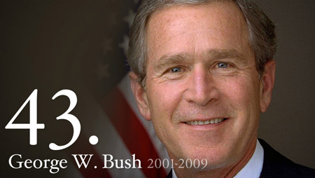
Objective
Unit 12 Lesson 5. SWBAT judge whether George W. Bush’s administration promoted or set back America as a global power.

Slide 4
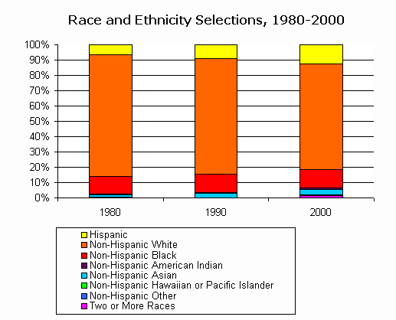
Notes: The Bush Presidency
American Society in 2000
Over 80% of Americans live in metropolitan areas
White-Americans growing at a slower rate while Hispanic-Americans are largest minority group
“Graying” of the Baby Boom generation causes concerns in paying for Social Security, housing, and health care
Growing number of “single mother” homes across all races
Alarming distribution of wealth despite growth overall
Whites earning average of ~$20,000 more
Top 20% of earners account for over 60% of wealth

Slide 5
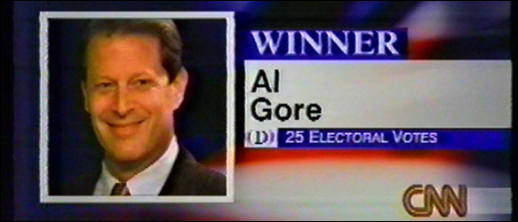
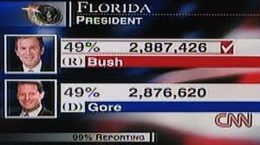
Notes: The Bush Presidency
The Election of 2000
Al Gore nominated by Democrats with Joseph Lieberman first Jewish candidate for VP
George W. Bush and Dick Cheney nominated by Republicans
Gore runs as “champion of families” while Bush runs as the “compassionate conservative”
Ralph Nader runs for the Green Party most influential in taking votes away from Gore
Gore received ~ 500,000 votes more than Bush but election came down to Florida’s electoral votes
534 votes separated the candidates
Supreme Court of Florida orders re-count of “hanging chad” ballots
Supreme Court overturns recount in case of Bush v. Gore
Bush defeats Gore 271 – 266 in closest election of modern era
Northeast and West Coast solidified as Democrat territory while South and Mid-West solidly Republican
Republican leadership emphasizes conservative values and partisanship
Gerrymandered Congressional districts emphasize party loyalty harming compromise in Congress

Slide 6
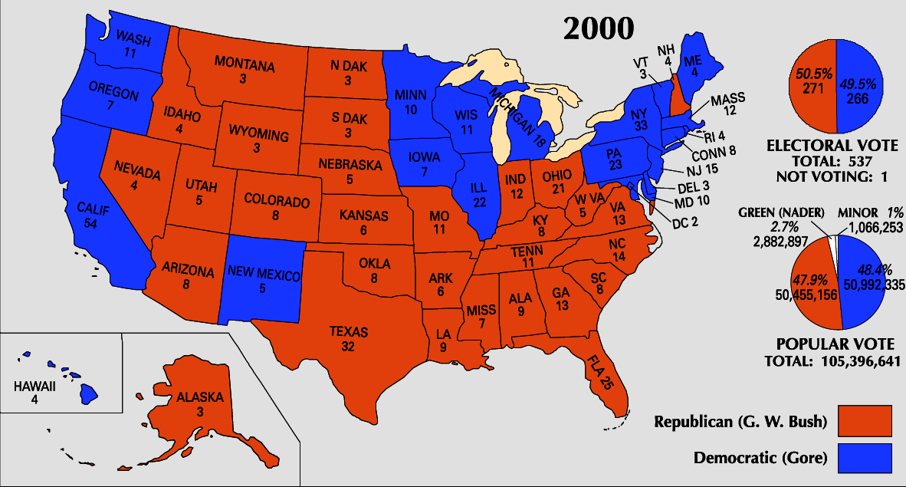
Notes: The Bush Presidency

Slide 7
Notes: The Bush Presidency

Slide 8
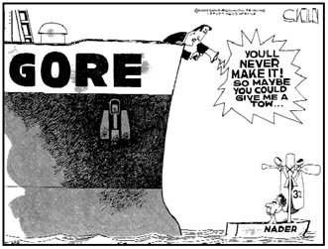
Notes: The Bush Presidency

Slide 9
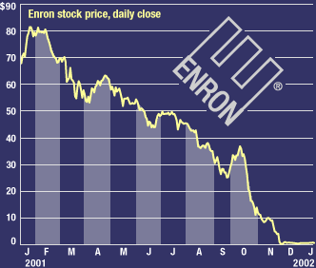
Notes: The Bush Presidency
Bush’s Domestic Policies
Pushes a strictly conservative agenda
Congress approves $1.35 trillion Bush Tax Cuts to stimulate economic growth
Criticized for benefiting wealthy the most and bringing back deficit
Develops No Child Left Behind Act to improve performance of all schools
Gave private option to Medicare recipients and prescription drug coverage to seniors
E-Commerce bubble bursts with end of the Dot Com Boom
Companies either fall short of speculator’s predictions or…
Enron and World Com fraudulently over report earnings
Many investors move into real estate

Slide 10
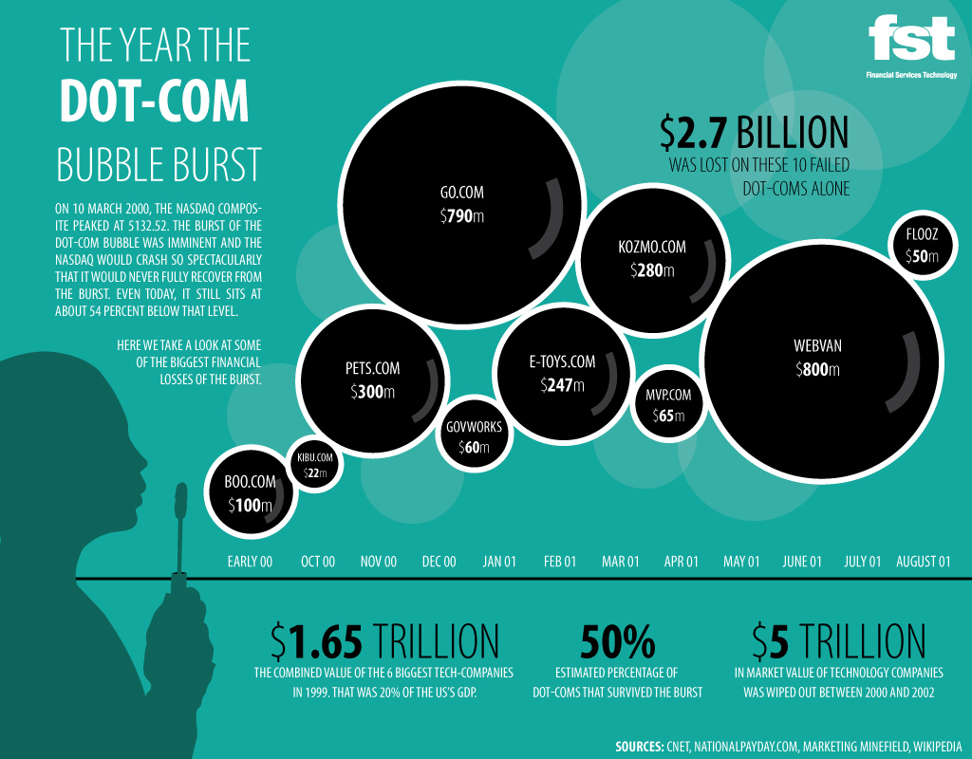
Notes: The Bush Presidency

Slide 11
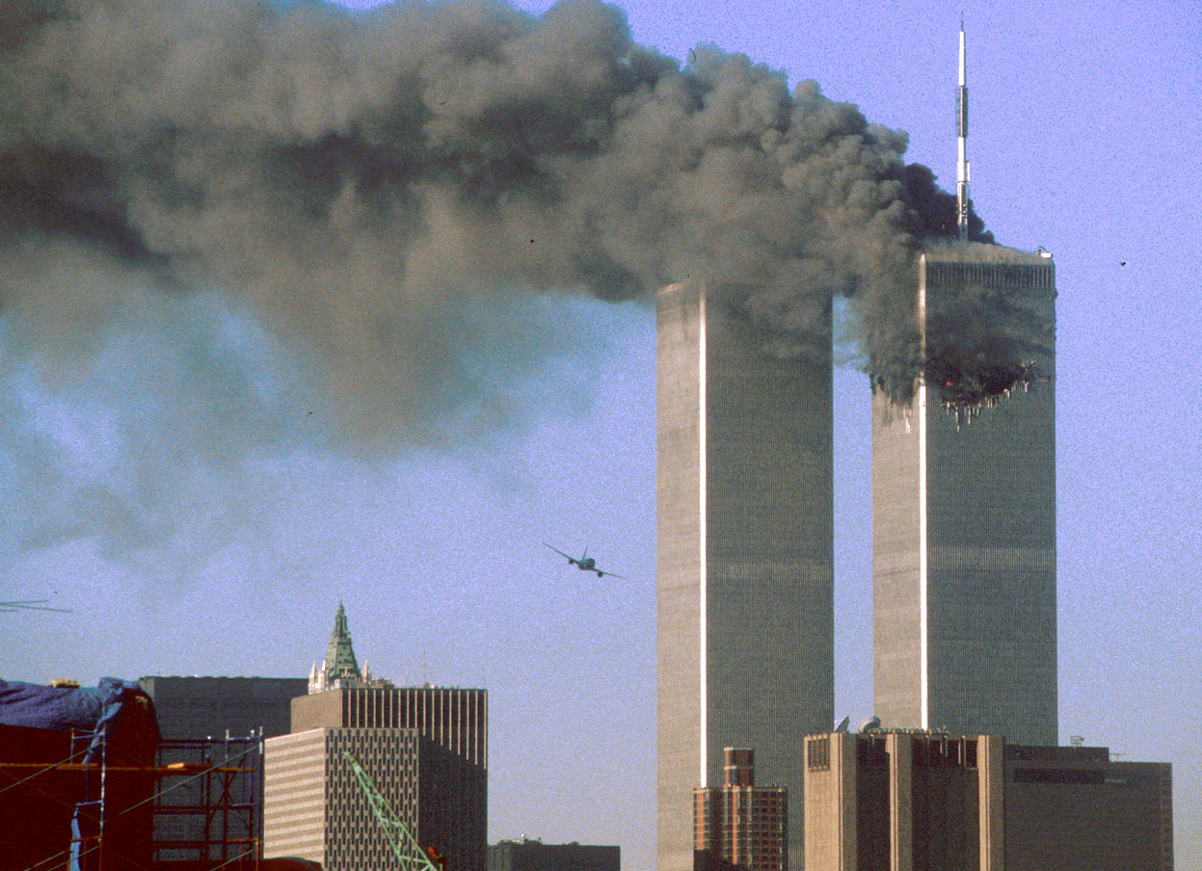
Notes: The Bush Presidency
The War on Terrorism
Bush nominates General Colin Powell to be first African American Secretary of State
Promotes a Unilateral approach to foreign policy
USA acts quickly and independently
Alienates many of America’s allies
Resentment against US fuels terrorism in the Middle East through groups such as Al Qaeda led by Osama Bin Laden
1993 World Trade Center bombing led US to bomb Al Qaeda bases
Bin Laden allies himself with Taliban government in Afghanistan
September 11th Attacks shock nation and rally support behind American war on terror
Search for Bin Laden leads America to declare war on Afghanistan
US helped overthrown Taliban and establish a shaky democracy led by Hamid Karzai
Establishes Department of Homeland Security to address threats at home
Patriot Acts of 2001 and 2003 give new surveillance powers to government
Guantanamo Bay Prison in Cuba allowed to hold suspected terrorist indefinitely without charge
Director of National Intelligence position created to communicate between DHS, CIA, and FBI

Slide 12
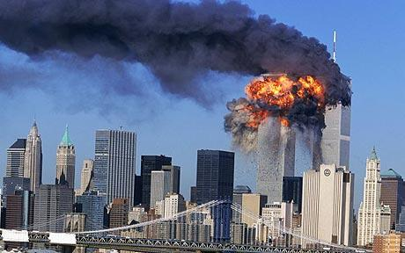
Notes: The Bush Presidency

Slide 13
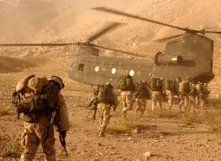
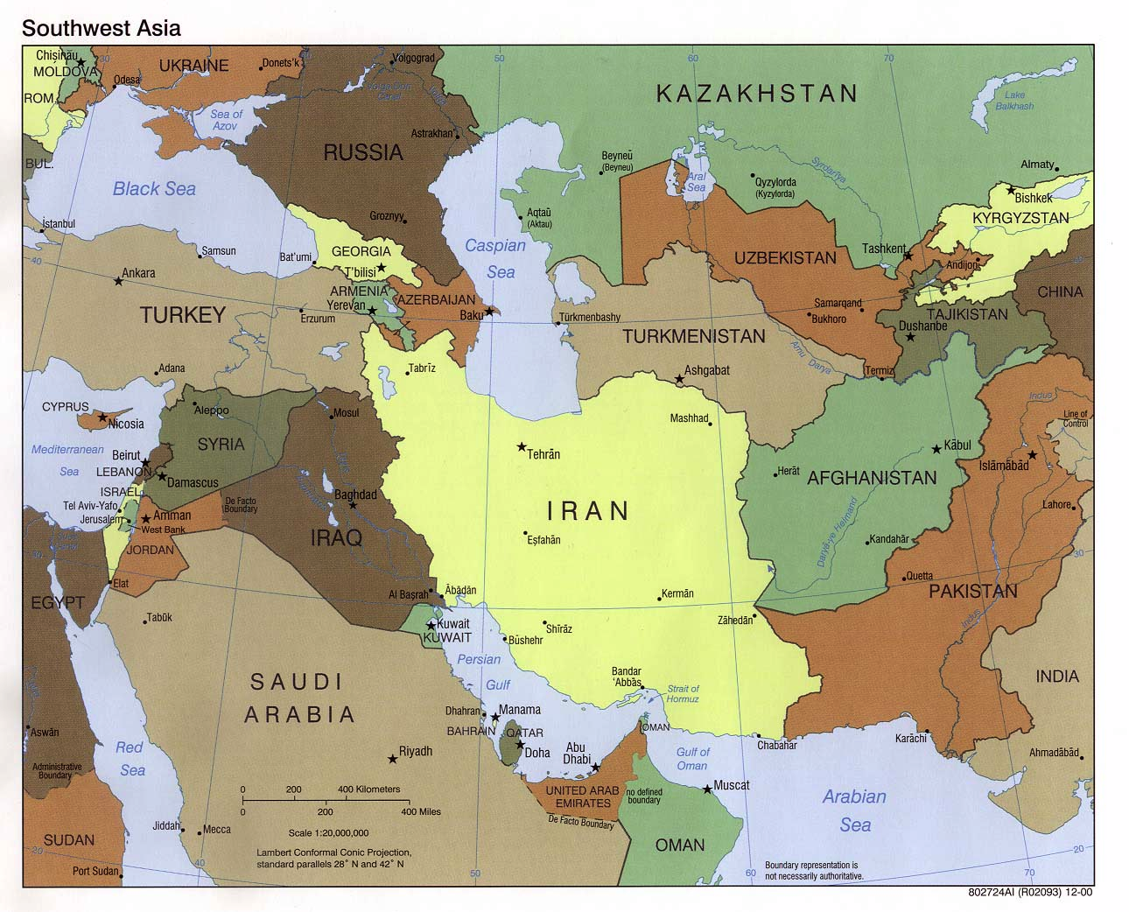
Notes: The Bush Presidency

Slide 14
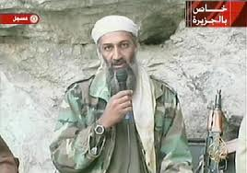
Notes: The Bush Presidency

Slide 15
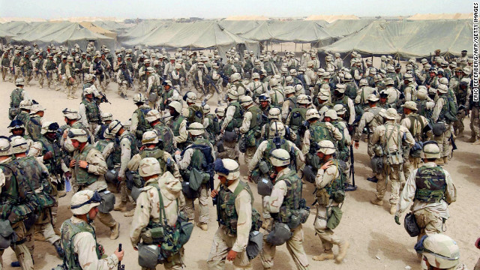
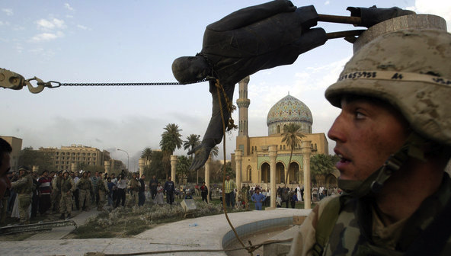
Notes: The Bush Presidency
Bush “II” Foreign Policy
Supports expansion of NATO, EU, and WTO (China admitted)
Continues “Unilateralism”
Refuses to sign Kyoto Protocol on climate change
Walks out on UN Conference on Racism and Anti-Ballistic Missile Treaty
Refused to negotiate with Iran or North Korea
Efforts to act alone known as Bush Doctrine to stop terrorism and WMD proliferation
Iraq War rooted in Bush’s “Axis of Evil” speech
Pre-emptive strike needed to prevent Iraq from gaining nuclear weapons
Air strikes begin without approval of UN Security Council known as Operation Iraqi Freedom
Hussein’s regime overthrown by April 2003 (just four weeks later)
Violence continues in fight for control of nation by different religious and ethnic groups
Bush widely criticized when no WMDs are found and leaving Iraq unstable
Further criticized for torture of Iraqi prisoner in Abu Ghraib Prison
America’s international reputation greatly damaged

Slide 16
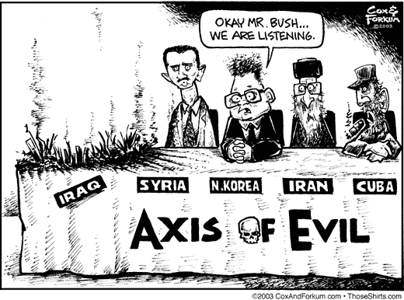
Notes: The Bush Presidency

Slide 17
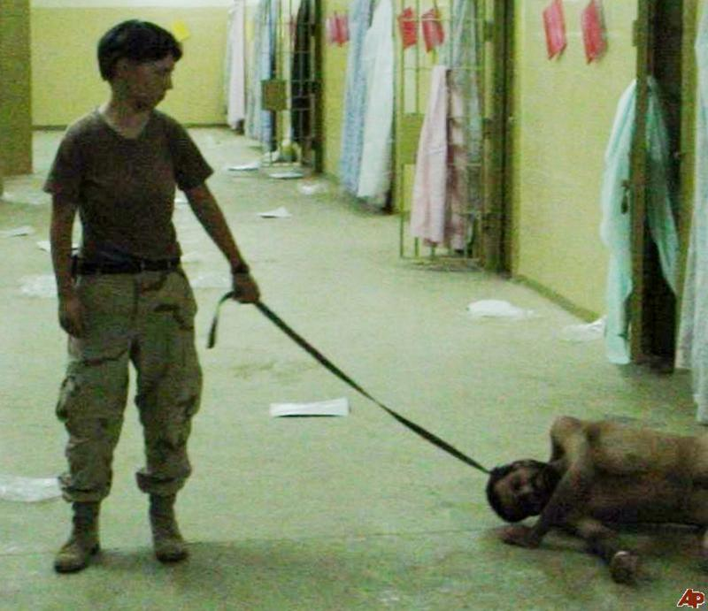
Notes: The Bush Presidency

Slide 18
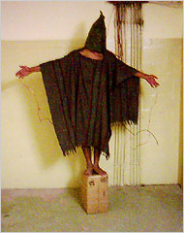
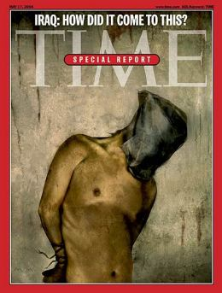
Notes: The Bush Presidency

Slide 19
Notes: The Bush Presidency
Election of 2004
Economic struggles and loss of popularity leaves Bush weak
Democrats nominate Senator John Kerry
Republicans rally around war on terror, tax cuts, and opposition to gay marriage and abortion
Portray Kerry as a “flip-flopper” and damage him with “Swiftboat Ads”
Bush wins a close but comfortable race
Republicans add to their majority in Congress

Slide 20
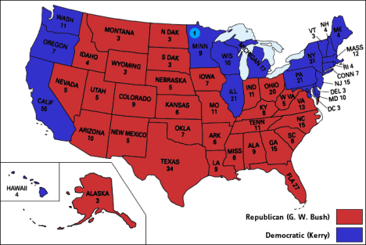
Notes: The Bush Presidency

Slide 21
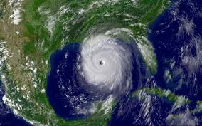
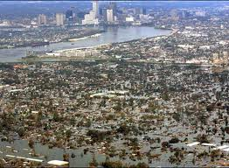
Notes: The Bush Presidency
Bush’s Second Term
Bush ignores Iraqi Study Group recommendation to increase Iraqi control over reconstruction
Troop “Surge” sends 30,000 additional troops
Left wars in Iraq, Afghanistan, and issue of a nuclear Iran and North Korean to next president
Pushes to privatize Social Security but fails to reform immigration laws
Hurricane Katrina kills 1,000 and leaves thousands devastated
FEMA and Bush blamed for lack of a response
Republicans harmed by scandals including bribes, improper sexual conduct, and gerrymandering schemes
Democrats regain control of Congress in 2006 Midterm Election
Bush appoints John Roberts as Chief Justice and conservative Samuel Alito to the court

Slide 22
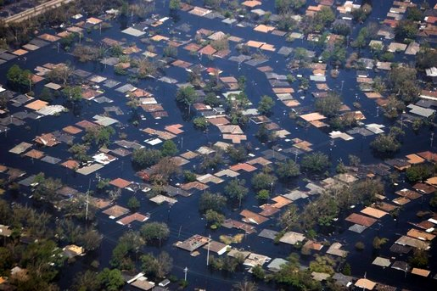
Notes: The Bush Presidency

Slide 23
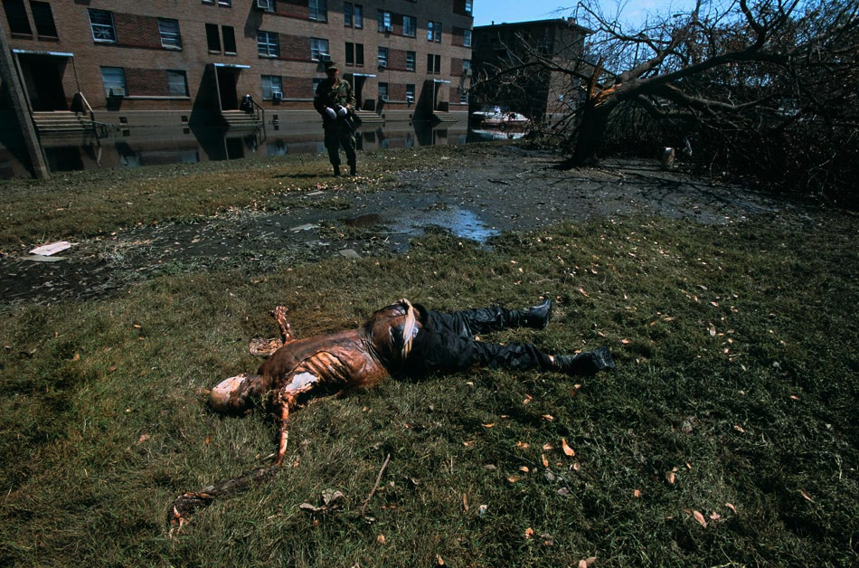
Notes: The Bush Presidency

Slide 24
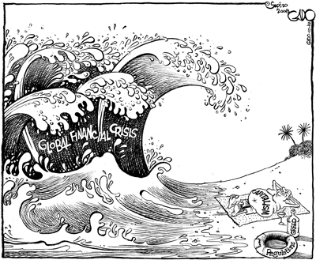
Notes: The Bush Presidency
2008 Financial Crisis
Subprime loans allow investors to purchase property at low interest rates and “flip” real estate for a quick profit
Similar to speculation during the 1920’s
Real estate “bubble” bursts when investors stop buying homes
Cannot pay back loans
Banks fail and investors panic
“Liquidity Crisis” occurs when consumers don’t have enough money for day to day life
Gas prices soar to $4 a gallon
Stock market declines by 40%
Bush reluctantly asks Congress for support in taking control and supporting credit lending institutions
Troubled Assets Relief Program (TARP) supports $700 billion in loans to banking institutions
Conservatives criticize this action as “socialist”
Liberals criticize it as a “bailout” of companies who failed due to lack of regulation by the government

Slide 25
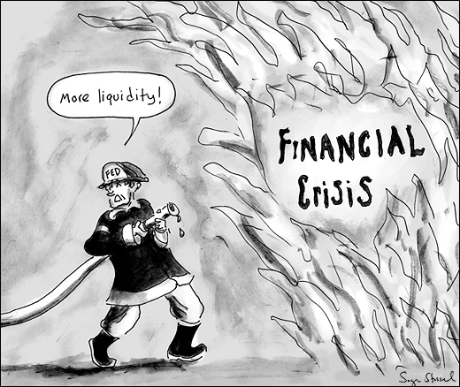
Notes: The Bush Presidency

Slide 26
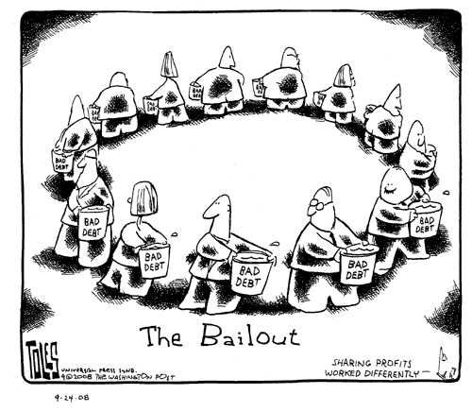
Notes: The Bush Presidency

Slide 27
Independent Work: The Bush Presidency
Steps:
Go to mrvandsburger.weebly.com
Download the files:
Iraq War Mini-DBQ
Email to Mr. Vandsburger when you are finished.
Homework:
Literal and Analytical Notes p. 1064 - 1078
Save Power Point as “Your Name Lesson 5” and email to Mr. Vandsburger (will count as class work grade)
Finish “Iraq War DBQ” by Sunday at 8 pm

