Slide 1
Unit 12 – Reagan and the March to the Present
Lesson 4 – The Clinton Presidency
4/16/13

Slide 2
Unit 12 Lesson 4: 4/16/13
Warm-Up:
Download this Power Point from mrvandsburger.weebly.com
Respond to the prompt below in the NOTES section of your Power Point
Do you believe that personal scandals get in the way of a person’s ability to be a strong leader?
36 Days Left Until the AP Exam!!!

Slide 3
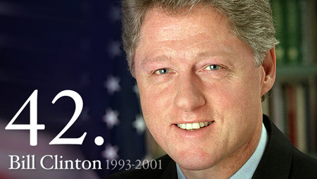
Objective
Unit 12 Lesson 4. SWBAT debate if Clinton’s scandals unfairly overshadowed the successes of his administration.

Slide 4
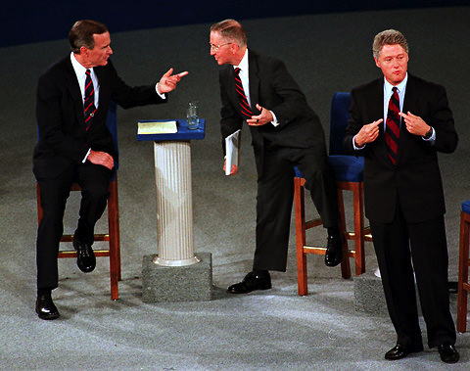
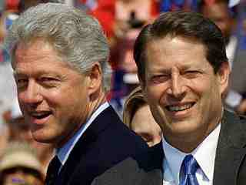
Notes: The Clinton Presidency
The Election of 1992
Focused on economy and no longer foreign policy
William Jefferson “Bill” Clinton nominated by Democrats to challenge Bush
Runs as a “New Democrat” focusing on jobs, education, health care
“It’s about the economy, stupid!”
Democratic Leadership Council shifted away from leftist policies
H. Ross Perot enters race as an independent
Earns 20% of the vote
Best third-party candidate showing since Teddy Roosevelt with the Bull Moose Party (1912)
Clinton and VP Al Gore win the election by re-capturing the South from Republicans
43% of popular vote, 85% of electoral vote
Democrats win control of Congress
66 minority and 48 women elected to Congress
27th Amendment approved prohibiting members of Congress from raising salaries

Slide 5
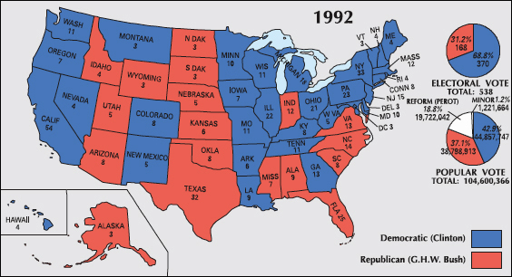
Notes: The Clinton Presidency

Slide 6
Notes: The Clinton Presidency
Early Years of Clinton’s Presidency
Republicans use the filibuster to block meaningful Clinton reforms in Congress
Block economic stimulus plan, campaign-finance reform, environmental bills, and health care reform
First lady Hillary Rodham Clinton head of health care reform proposal
Major successes of Clinton’s early years
Family and Medical Leave Act, “Motor Voter” Law, Brady Handgun Bill
Anti-Crime Bill provides $30 billion for more police
Welfare Reform Bill requires recipients to work or look for a job
Promoted a more balanced budget which included education funding
$255 billion in spending cuts, $241 billion in tax increases
Approval of North American Free Trade Agreement (NAFTA)
Don’t Ask Don’t Tell policy considered failure as an attempt to support gays in the military
Republicans portray Clinton as “Sick Willie”

Slide 7
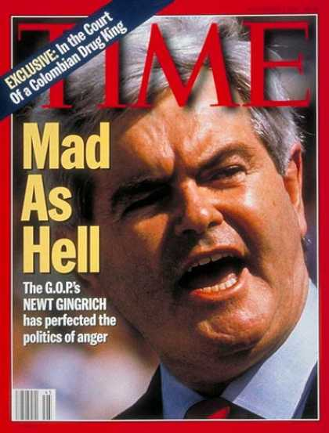
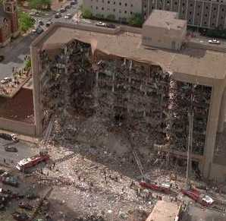
Notes: The Clinton Presidency
Republican Control of Congress
1994 Midterm Elections dominated by Republicans
Gain control of both houses of Congress for first time since Eisenhower’s term
Americans frustrated with tax increases
Newt Gingrich attacks federal programs and spending in his “Contract with America”
Government shuts down twice in 1995 when President and Congress disagree over how to trim the budget
Oklahoma City Bombings further worry Americans about government’s ability to lead
Agreement on Balanced Budget reached in 1996
Maintained Medicare and Social Security
Strict limits set by Personal Responsibility and Work Opportunity Act
Increased the minimum wage
Tax increases followed by spending cuts eliminates the deficit for first time since 1969
Economy also adds 10 million new jobs

Slide 8
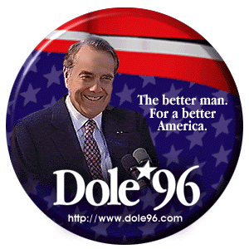
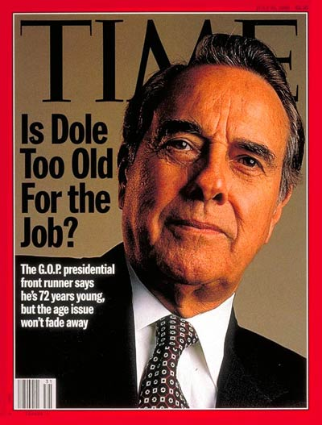
Notes: The Clinton Presidency
Election of 1996
Robert “Bob” Dole nominated by Republicans
Campaigns on platform of a 15% tax cut
Voter turnout dropped below 50%
Clinton and Gore re-elected easily with 71% of electoral vote
Perot ran without any success
Clinton becomes first democrat to win re-election since FDR
Republicans retain control of Congress

Slide 9
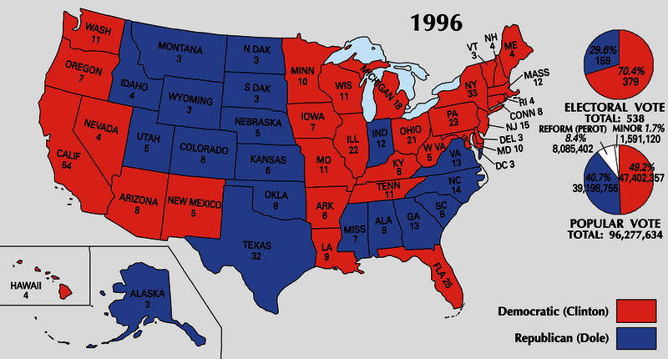
Notes: The Clinton Presidency

Slide 10
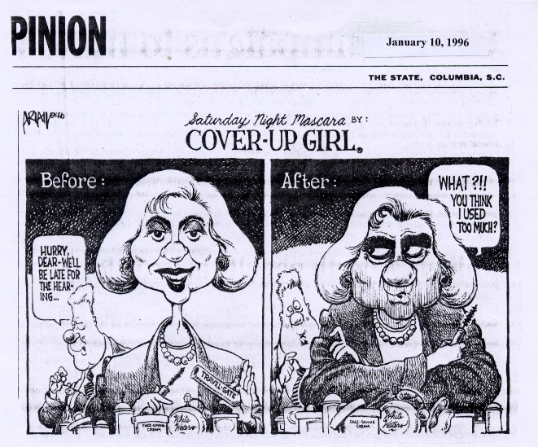
Notes: The Clinton Presidency
Clinton’s Second Term
Economic growth reaches new heights
Annual growth 4%, inflation 2-3% annually, unemployment down to 4%, stock market growth of 22% annually
Internet fuels business growth known as E-Commerce
Both wealth and working class experience benefits of economic growth
Major disputes between Republicans and Democrats over how to spend surplus and whether to cut taxes
Surplus reaches $4.6 trillion, Clinton wants to spend this on social programs
Scandals of Clinton’s Presidency
Whitewater Scandal charges but fails to find guilt in Clinton’s fraudulent real-estate deal
Clinton is first to become impeached since Grant due to Monica Lewinsky Affair
Congress does not remove Clinton from office

Slide 11
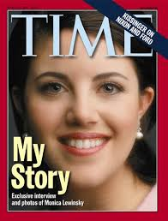
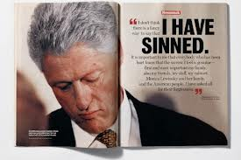
Notes: The Clinton Presidency

Slide 12
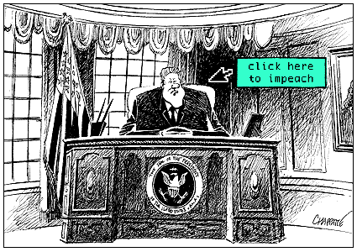
Notes: The Clinton Presidency

Slide 13
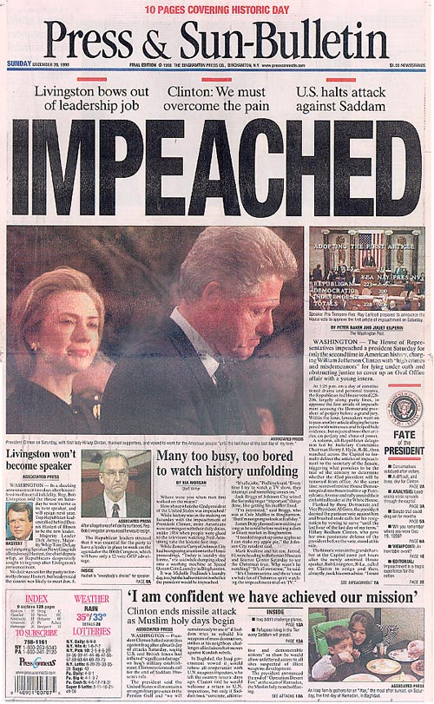
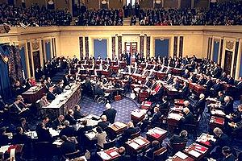
Notes: The Clinton Presidency

Slide 14
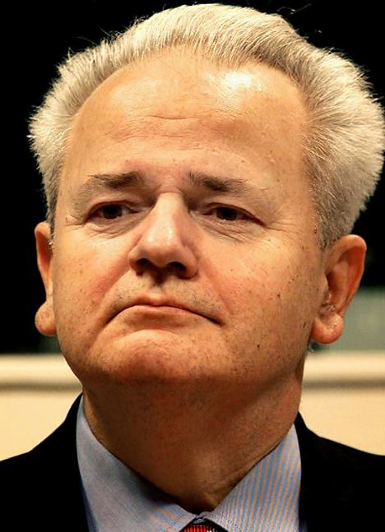
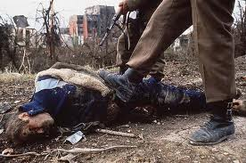
Notes: The Clinton Presidency
Clinton’s Foreign Policy
Madeline K. Albright became first woman to serve as Secretary of State
United States conducts peacekeeping missions around the world
1993 – Civil war in Somalia
1994 – Haiti to prevent military coup
1998 – Negotiated end of British rule in Northern Ireland
US-Russian relations strained by Russian military action in Chechnya, admission of former Soviet Republics to NATO, and Russia’s support of Serbia in Balkan Wars
Serbian dictator Slobodan Milosevic tried to prevent independent in republics of former Yugoslavia
Hundreds of thousands killed in “Ethnic Cleansing” of religious and ethnic minorities
US intervenes in Bosnia while Serbians overthrown Milosevic
Milosevic convicted by the International Criminal Court of crimes against humanity
US worries about nuclear proliferation in Asia
China, India, Pakistan, and North Korea begin nuclear testing
US reaches agreement with North Korea to end testing of Weapons of Mass Destruction
Opens relations with Vietnam and develops trade ties with China

Slide 15
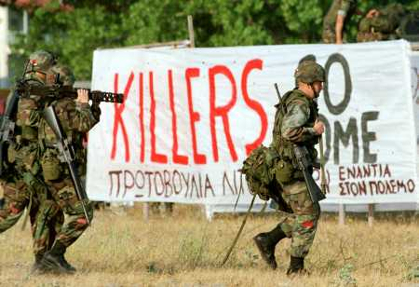
Notes: The Clinton Presidency

Slide 16
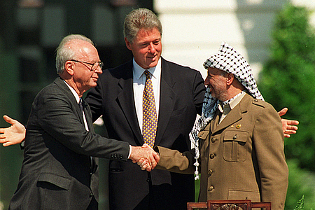
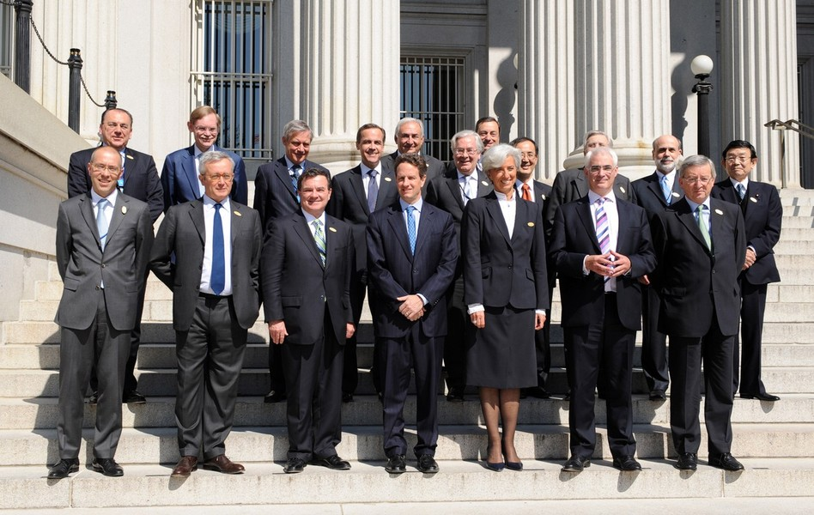
Notes: The Clinton Presidency
Clinton orders airstrikes over Iraq when Saddam Hussein continues weapons testing
Clinton promotes Israeli-Palestinian relations
Negotiates return of West Bank and Gaza strip to Palestinians
Oversaw treaty between Israel and King Hussein of Jordan
Negotiated peace treaty between Israeli PM Yitzhak Rabin and PLO leader Yassir Arafat
Rabin assassinated by an anti-peace Israeli
Global development in the 1990’s
World Trade Organization (1994) enforced and settled trade agreements around the world
European Union brought together markets of 15 nations and created a common currency
Group of 7 (G-7) remained worlds leading economic powers
China, Russia, Brazil and India close behind
Globalization led to outsourcing of jobs to developing nations

Slide 17
Independent Work: Bush and the End of the Cold War
Steps:
Go to mrvandsburger.weebly.com
Download the files:
Clinton Worksheet
Email to Mr. Vandsburger when you are finished.
Homework:
Literal and Analytical Notes p. 1056 - 1064
Save Power Point as “Your Name Lesson 4” and email to Mr. Vandsburger (will count as class work grade)
Finish “Clinton Worksheet” by Wednesday at 8 pm

