Slide 1
Unit 12 – Reagan and the March to the Present
Lesson 3 – Bush and the End of the Cold War
4/15/13

Slide 2
Unit 12 Lesson 3: 4/15/13
Warm-Up:
Download this Power Point from mrvandsburger.weebly.com
Send your answers to the Reagan’s Second Term Quiz by 11:20

Slide 3
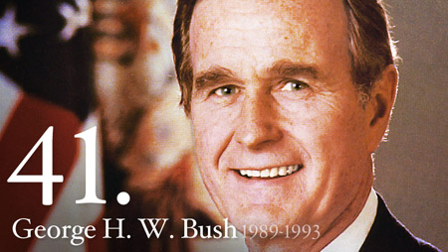
Objective
Unit 12 Lesson 3. SWBAT evaluate whether George HW Bush was successful in promoting America’s position in the world following the end of the Cold War.

Slide 4
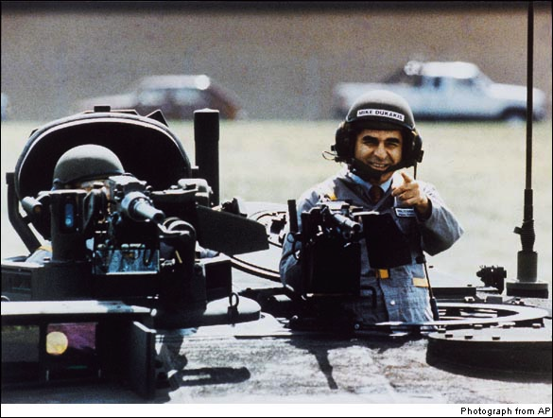
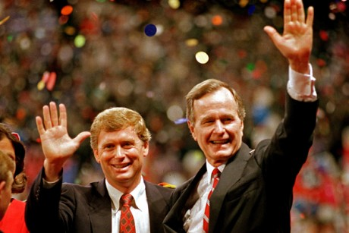
Notes: Bush and the End of the Cold War
The Election of 1988
Democrats regained control of Senate in 1986
Iran-Contra still weakened Republicans
Democrats nominate Michael Dukakis (Governor of Massachusetts)
Balance ticket with VP from Texas
Republicans have to choose between George H.W. Bush (Reagan’s VP) or Dan Quayle
Quayle ends up running as Bush’s VP
Bush wins clear victory
Attacks Dukakis for being soft on crime, weak on national defense
Dukakis “Tank” Ad and “Weekend Furloughs” Ad
“Read my lips…no new taxes”
Democrats win majority in both House and Senate
Results in gridlock in Washington

Slide 5
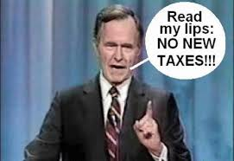
Notes: Bush and the End of the Cold War

Slide 6
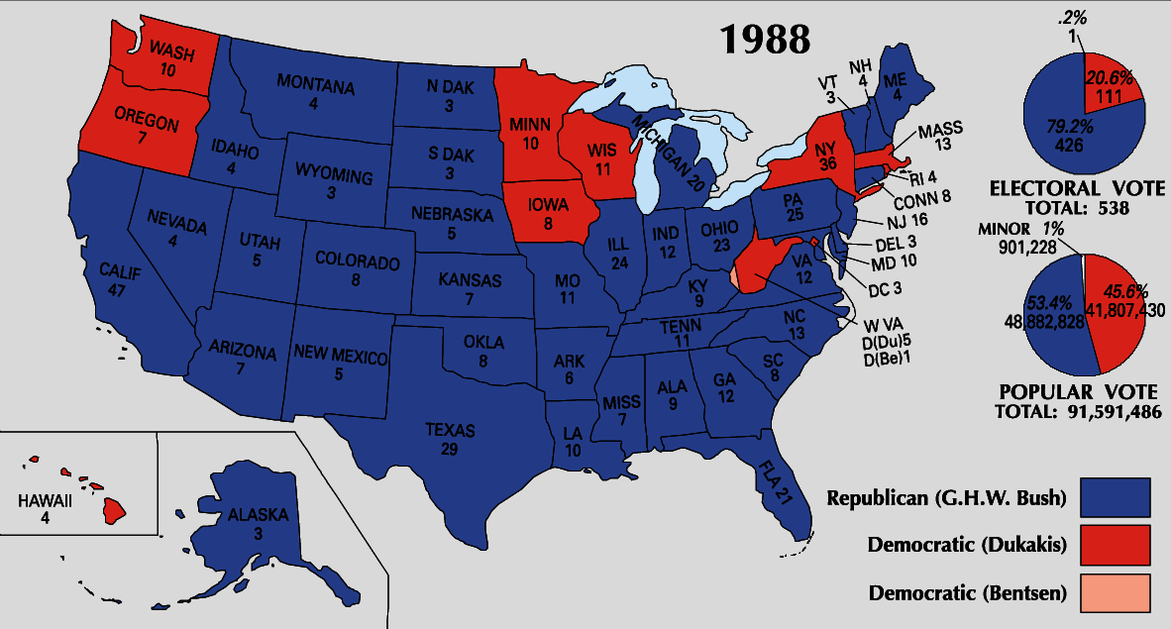
Notes: Bush and the End of the Cold War

Slide 7
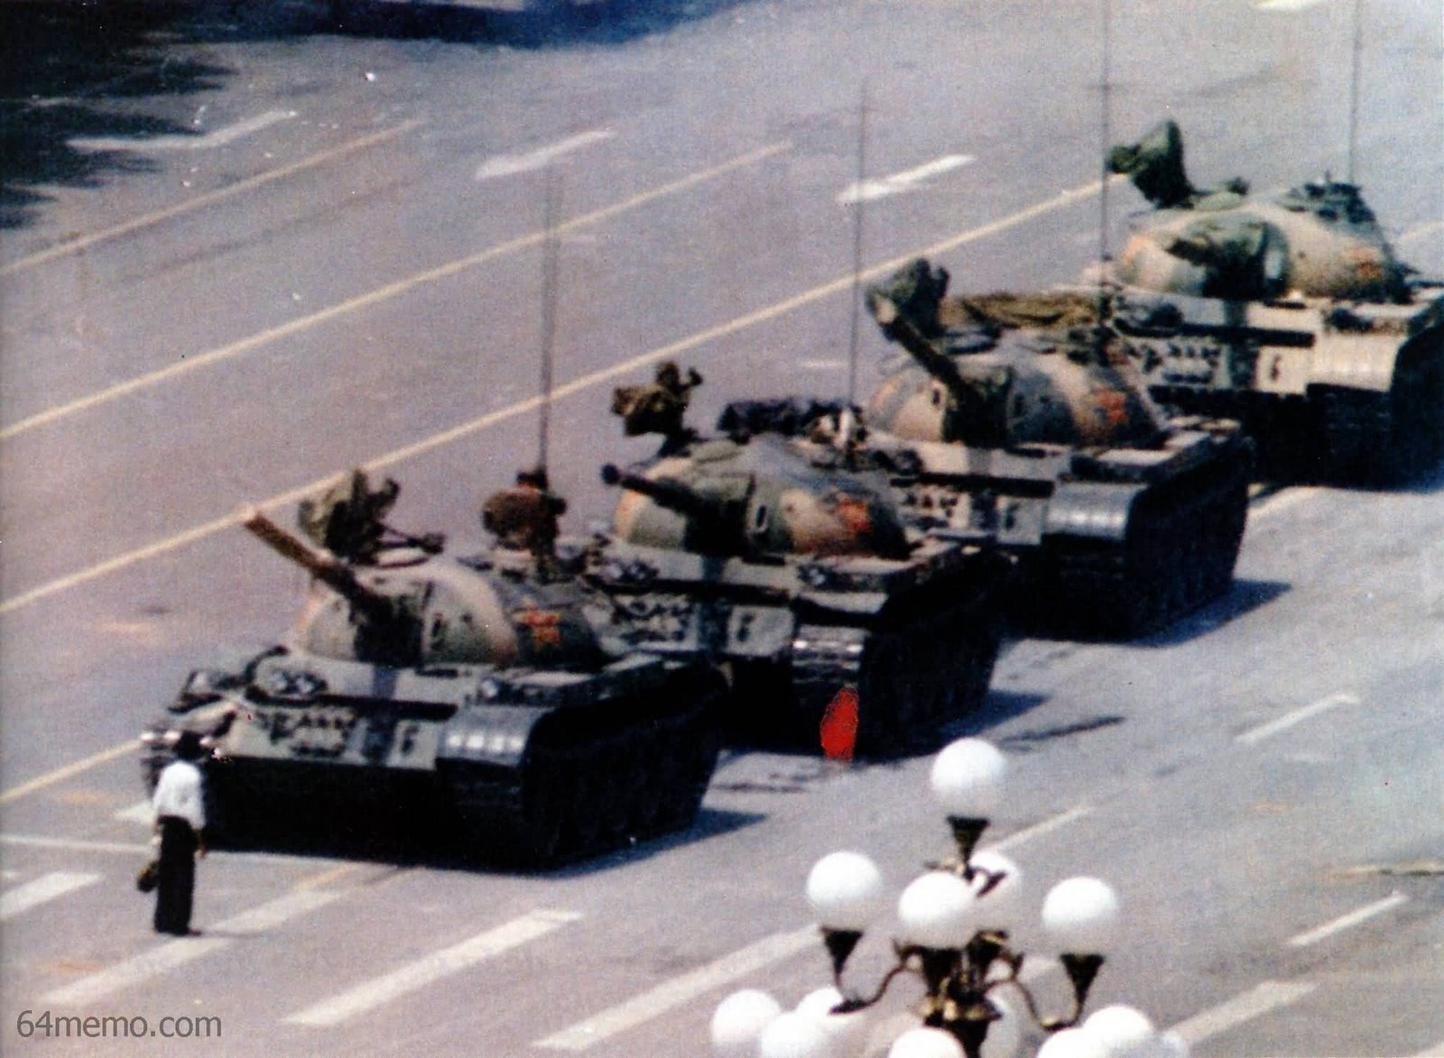
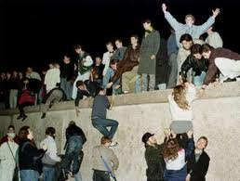
Notes: Bush and the End of the Cold War
Collapse of the Soviet Communism
Tiananmen Square student protest in China briefly open politics in China
Violently crushed by Chinese government
Gorbachev declares the USSR will no longer support satellite nations
Communist governments overthrown in Poland, Hungary, Czechoslovakia, Bulgaria, and Romania
Berlin Wall torn down by East Germans (1989)
Germany re-united in 1990
Soviet Union dissolved in 1991 after Baltic Republics declare independence
Boris Yeltsin forms Commonwealth of Independent States
Disbands communism in Russia and establishes democratic and free-market systems
Cold War comes to an end with arms reduction
START I (1991) – limited both sides to 10,000 nuclear warheads
START II (1992) – reduced nuclear weapons to 3,000 per side
US provides economic assistance to Russia

Slide 8
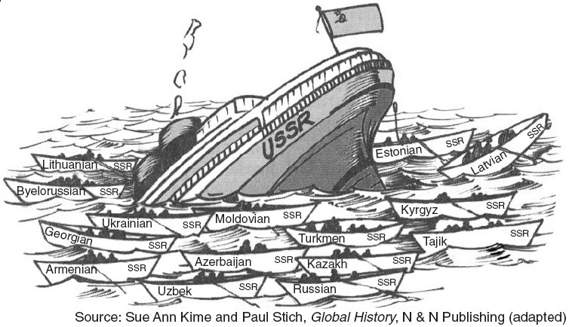
Notes: Bush and the End of the Cold War

Slide 9
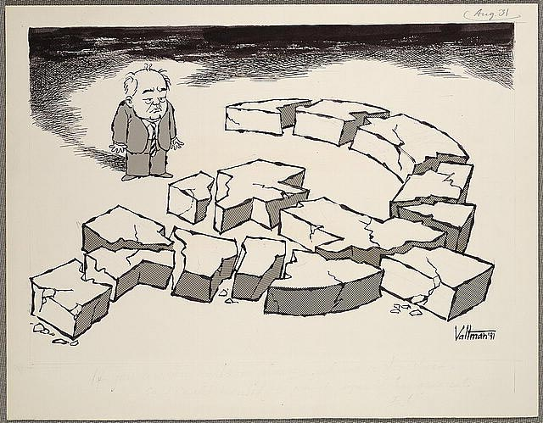
Notes: Bush and the End of the Cold War

Slide 10
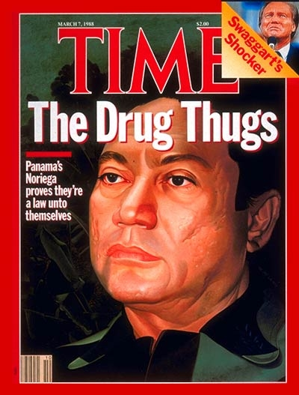
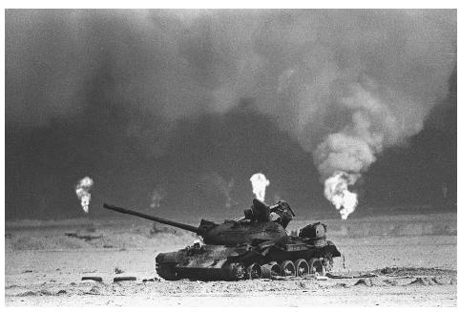
Notes: Bush and the End of the Cold War
Foreign Policy in Bush’s Term
Concern about violence in post-Soviet republics
Americans question need for heavy defense spending
Bush orders 1989 Invasion of Panama to remove General Manuel Noriega from power
Oil production threatened when Saddam Hussein leads Iraqi invasion of Kuwait (1990)
UN warning does not stop Hussein
Congress approves Operation Desert Storm
US forces led by General Norman “Stormin’ Norman” Schwarzkopf along with air strikes force Hussein to surrender after 100 hours of fighting in Persian Gulf War
Victory boosts Bush’s approval rating to 90%

Slide 11
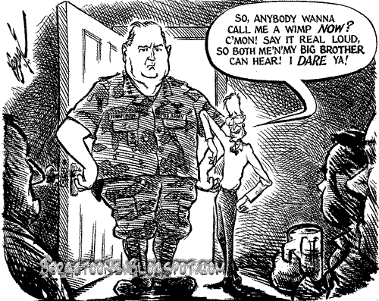
Notes: Bush and the End of the Cold War

Slide 12
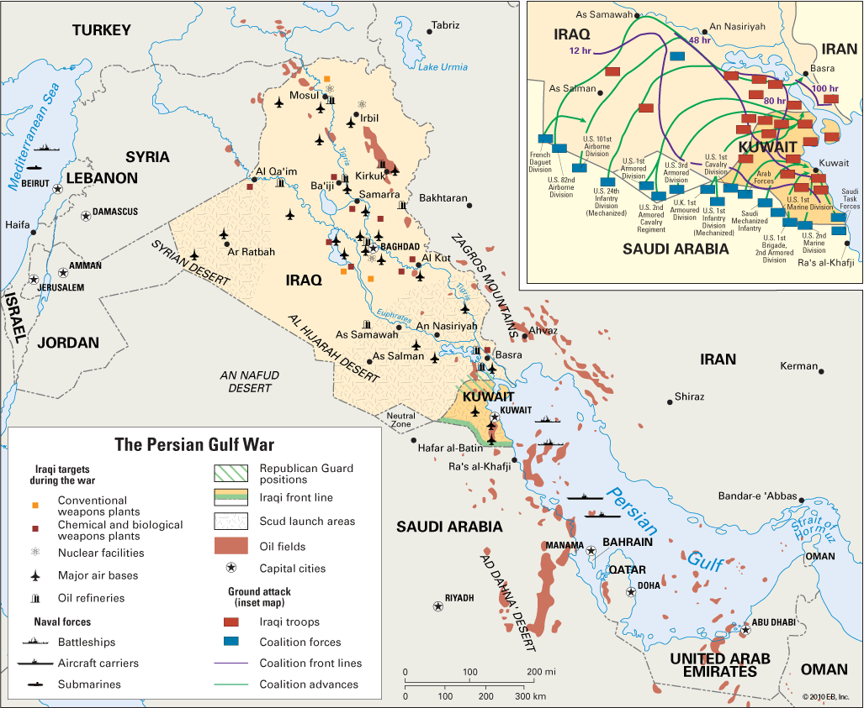
Notes: Bush and the End of the Cold War

Slide 13
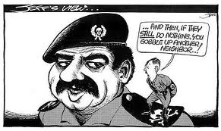
Notes: Bush and the End of the Cold War

Slide 14
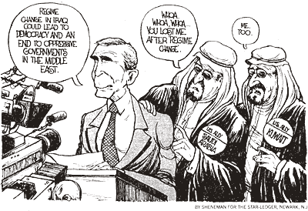
Notes: Bush and the End of the Cold War

Slide 15
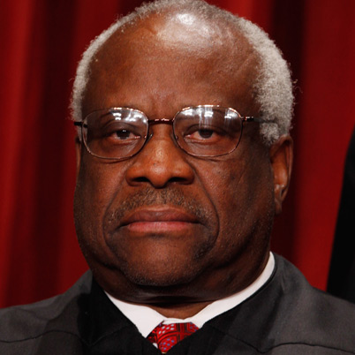
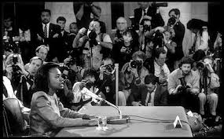
Notes: Bush and the End of the Cold War
Domestic Struggles in Bush’s Term
Faces criticism for nominating Clarence Thomas to replace retiring Supreme Court justice Thurgood Marshall
Thomas’ extreme conservative views opposed by African-American organizations
Anita Hill accused Thomas of sexual harassment
Thomas eventually approved by the Senate
Known best for going years without speaking at Court hearings
Government intervention to save failing Savings and Loans Institutions cost taxpayers $250 billion
Bush agreed to accept $133 billion in new taxes
Raised excise taxes on alcohol, cigarettes, gasoline, and luxury cars
Increased income tax for wealthiest Americans to 31%
1990 recession brings end to Reagan era of prosperity
Bush looks to “soften” America and focus on domestic programs
Americans with Disabilities Act passed to prohibit discrimination and promote accommodation
Promotes more cuts than new programs
Loses support of those who did not benefit from the “Reagan Revolution”

Slide 16
Independent Work: Bush and the End of the Cold War
Steps:
Go to mrvandsburger.weebly.com
Download the files:
End of the Cold War Worksheet
End of the Cold War Readings
Email to Mr. Vandsburger when you are finished.
Homework:
Literal and Analytical Notes p. 1046 - 1054
Save Power Point as “Your Name Lesson 3” and email to Mr. Vandsburger (will count as class work grade)
Finish “End of the Cold War Worksheet” by Tuesday at 8 pm

