Slide 1
Unit 12 – Reagan and the March to the Present
Lesson 2 –Reagan’s Second Term
4/12/13

Slide 2
Unit 12 Lesson 2: 4/12/13
Warm-Up:
Download this Power Point from mrvandsburger.weebly.com
Send your answers to the Ford, Carter, Reagan Quiz by 11:20

Slide 3
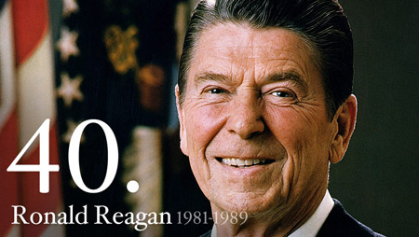
Objective
Unit 12 Lesson 2. SWBAT analyze the impact of Reaganomics and Reagan’s approach to the Cold War on American stability in the 1980’s.

Slide 4
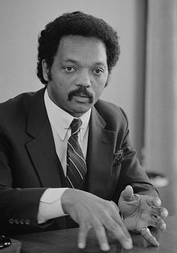
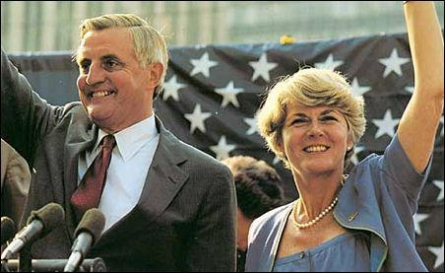
Notes: Reagan’s Second Term
The Election of 1984
Limited prosperity enough to guarantee Reagan the Republican nomination
Democratic party is divided
Rainbow Coalition supports Jesse Jackson to become first African American nominee
Eventually nominate Walter Mondale and Geraldine Ferraro
Ferraro is first woman to be VP nominee
Reagan wins landslide victory
Mondale gets support from African Americans, those in extreme poverty, and Minnesota

Slide 5
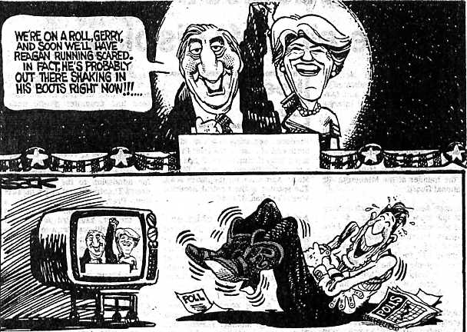
Notes: Reagan’s Second Term

Slide 6
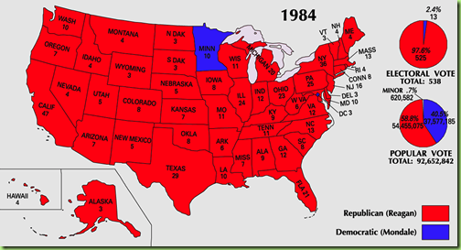
Notes: Reagan’s Second Term

Slide 7
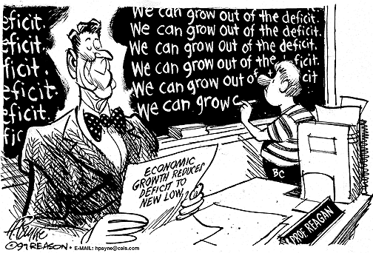
Notes: Reagan’s Second Term
Economic Policies in Reagan’s Second Term
Tax cuts and military spending create enormous Budget Deficits
Americans used tax cuts to buy foreign goods
Trade Deficit = $150 billion, Budget Deficit = $2.7 trillion
Congress passes the Gramm-Rudman-Hollings Balanced Budget Act
Creates across the board spending cuts of $66 billion
Black Monday stock market crashed (1987) by 22%
Computer Program Trading blamed
Reaganomics gave more authority to individual consumers and reduced the Welfare State
Changed debate from which programs should be created, to which ones needed to be cut

Slide 8
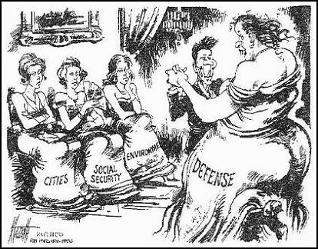
Notes: Reagan’s Second Term

Slide 9
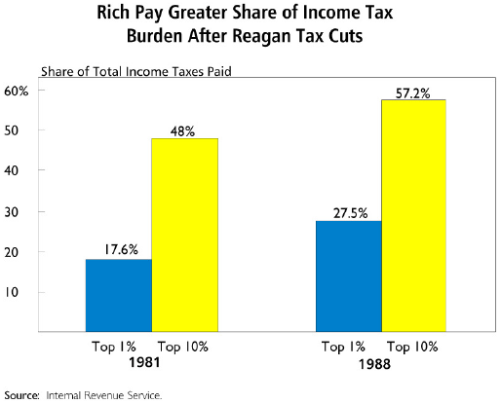
Notes: Reagan’s Second Term

Slide 10
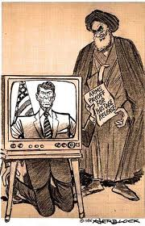
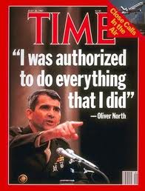
Notes: Reagan’s Second Term
Foreign Policy in Reagan’s Second Term
Iran-Contra Affair damages Reagan’s reputation
Sell missiles to Iran’s government
Use profits to fund Contras in Nicaragua
Reagan denied knowledge making him look clueless
Pressured PLO leader Yassir Arafat to formally recognize Israel

Slide 11
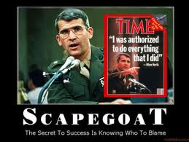
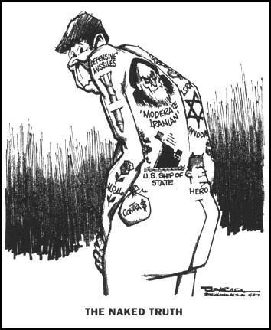
Notes: Reagan’s Second Term

Slide 12
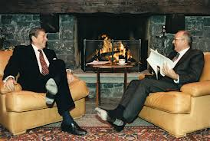
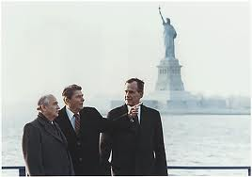
Notes: Reagan’s Second Term
Entered new phase of US-Soviet Relations with rise of Mikhail Gorbachev (1985)
Gorbachev introduced glasnost – openness and freedom, and perestroika – introducing free-market ideas
Chose to end arms race in order to save Soviet economy
Reagan and Gorbachev agree on Intermediate Range Nuclear Forces Treaty
Margaret Thatcher plays key role in bringing leaders together
Gorbachev withdrew troops from Afghanistan
Joint effort by US/SU to pressure Iran and Iraq to end their war
End of Cold War seemed near boosting Reagan’s legacy

Slide 13
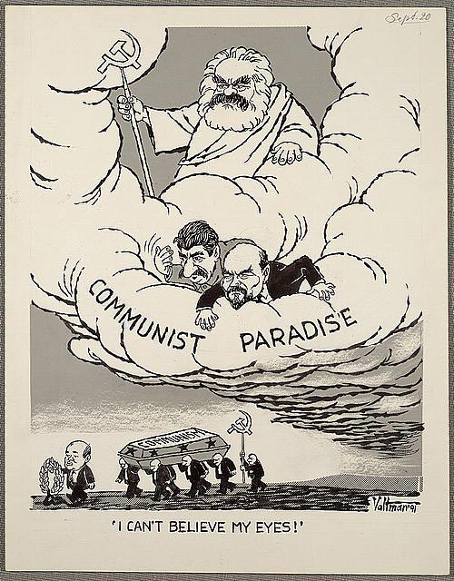
Notes: Reagan’s Second Term

Slide 14
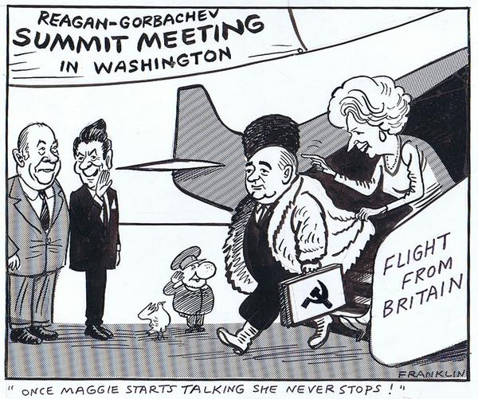
Notes: Reagan’s Second Term

Slide 15
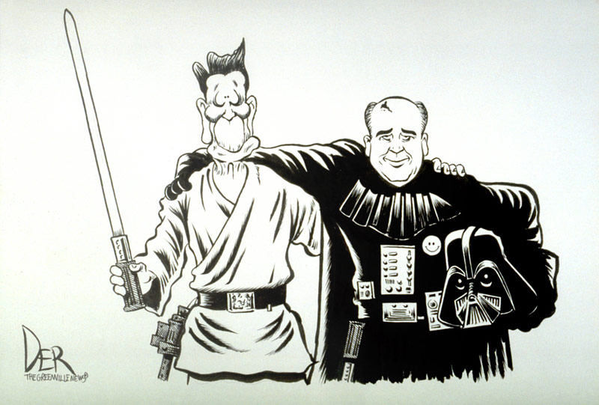
Notes: Reagan’s Second Term

Slide 16
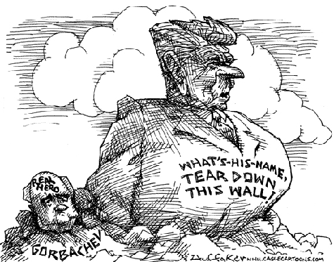
Notes: Reagan’s Second Term

Slide 17
Independent Work: Reagan’s Second Term
Steps:
Go to mrvandsburger.weebly.com
Download the files:
Reagan’s Policies
The Reagan Legacy
Email to Mr. Vandsburger when you are finished.
Homework:
Literal and Analytical Notes p. 1037 - 1046
Save Power Point as “Your Name Lesson 2” and email to Mr. Vandsburger (will count as class work grade)
Finish “The Reagan Legacy” by Sunday at 8 pm

