Slide 1
Unit 12 – Reagan and the March to the Present
Lesson 1 – The Reagan Revolution
4/11/13

Slide 2
Unit 12 Lesson 1: 4/11/13
Warm-Up:
Download this Power Point from mrvandsburger.weebly.com
Respond to the prompt below in the “Notes” part of your Power Point
Prompt: Considering the crises, scandals, social movements, and foreign conflicts of the 1960’s and 1970’s, what kinds of policies or characteristics were Americans likely to support for a Presidential candidate in the election of 1980?

Slide 3
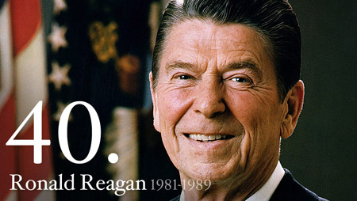
Objective
Unit 12 Lesson 1. SWBAT judge the extent to which Reagan’s policies succeeded in addressing economic and foreign crises left unresolved by his predecessor.

Slide 4
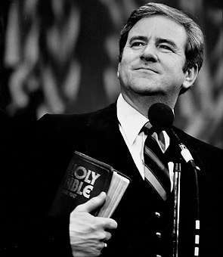
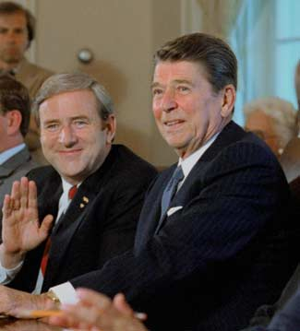
Notes: The Reagan Revolution
The Election of 1980
Steady shift to the “Right” since 1964
Conservatism, religious fundamentalists, and Political Action Committees support “Right” candidates
Opposed big government, New Deal liberalism, and social movements of 1960’s and 70’s
Key Issues
California Proposition 13 serves as model for cutting taxes to stimulate the economy
Reverend Jerry Falwell creates the Moral Majority to finance conservative candidates to defeat liberal members of Congress
Supported return to religious fundamentalism and reject secularism
Many blamed stagflation on “Reverse Discrimination” policies that “overly” helped African-Americans
Carter is weakened in the primaries by Edward Kennedy

Slide 5
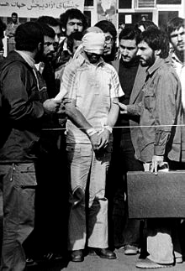
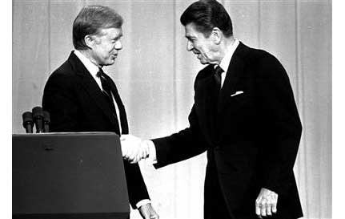
Notes: The Reagan Revolution
Ronald Reagan nominated by Republicans and challenges Democrat methods
Points out continued Iran Hostage Crisis
Speaks about the “Misery Index” at 28% (inflation + unemployment)
Rejected Carter’s ability to maintain the nation
Reagan wins with 51% of popular vote, 91% of electoral vote
Broke the “New Deal Coalition” by taking “blue collar” votes
Controlled the Senate and started coalition in House with conservative democrats

Slide 6
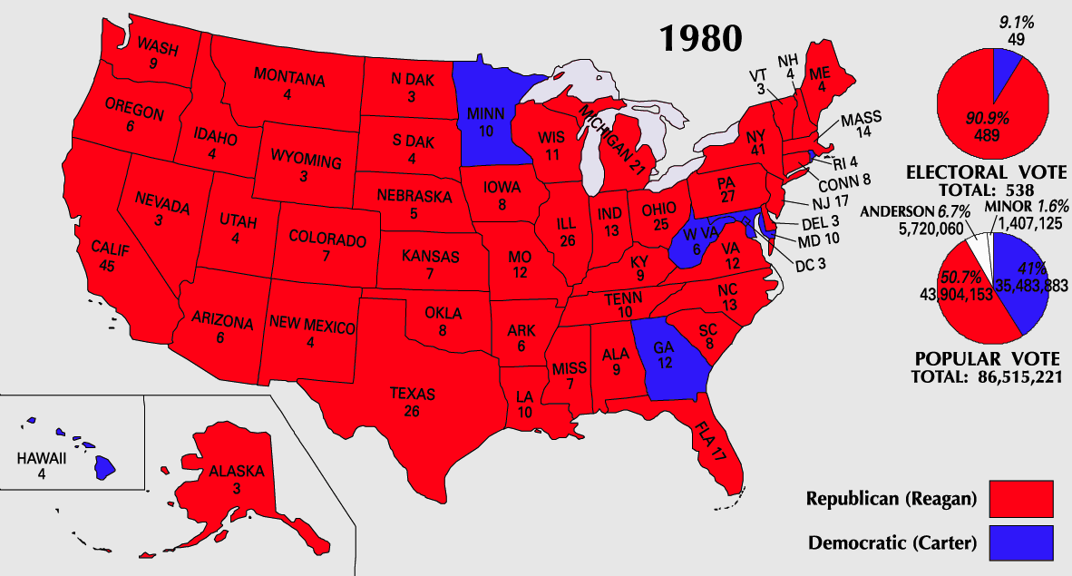
Notes: The Reagan Revolution

Slide 7
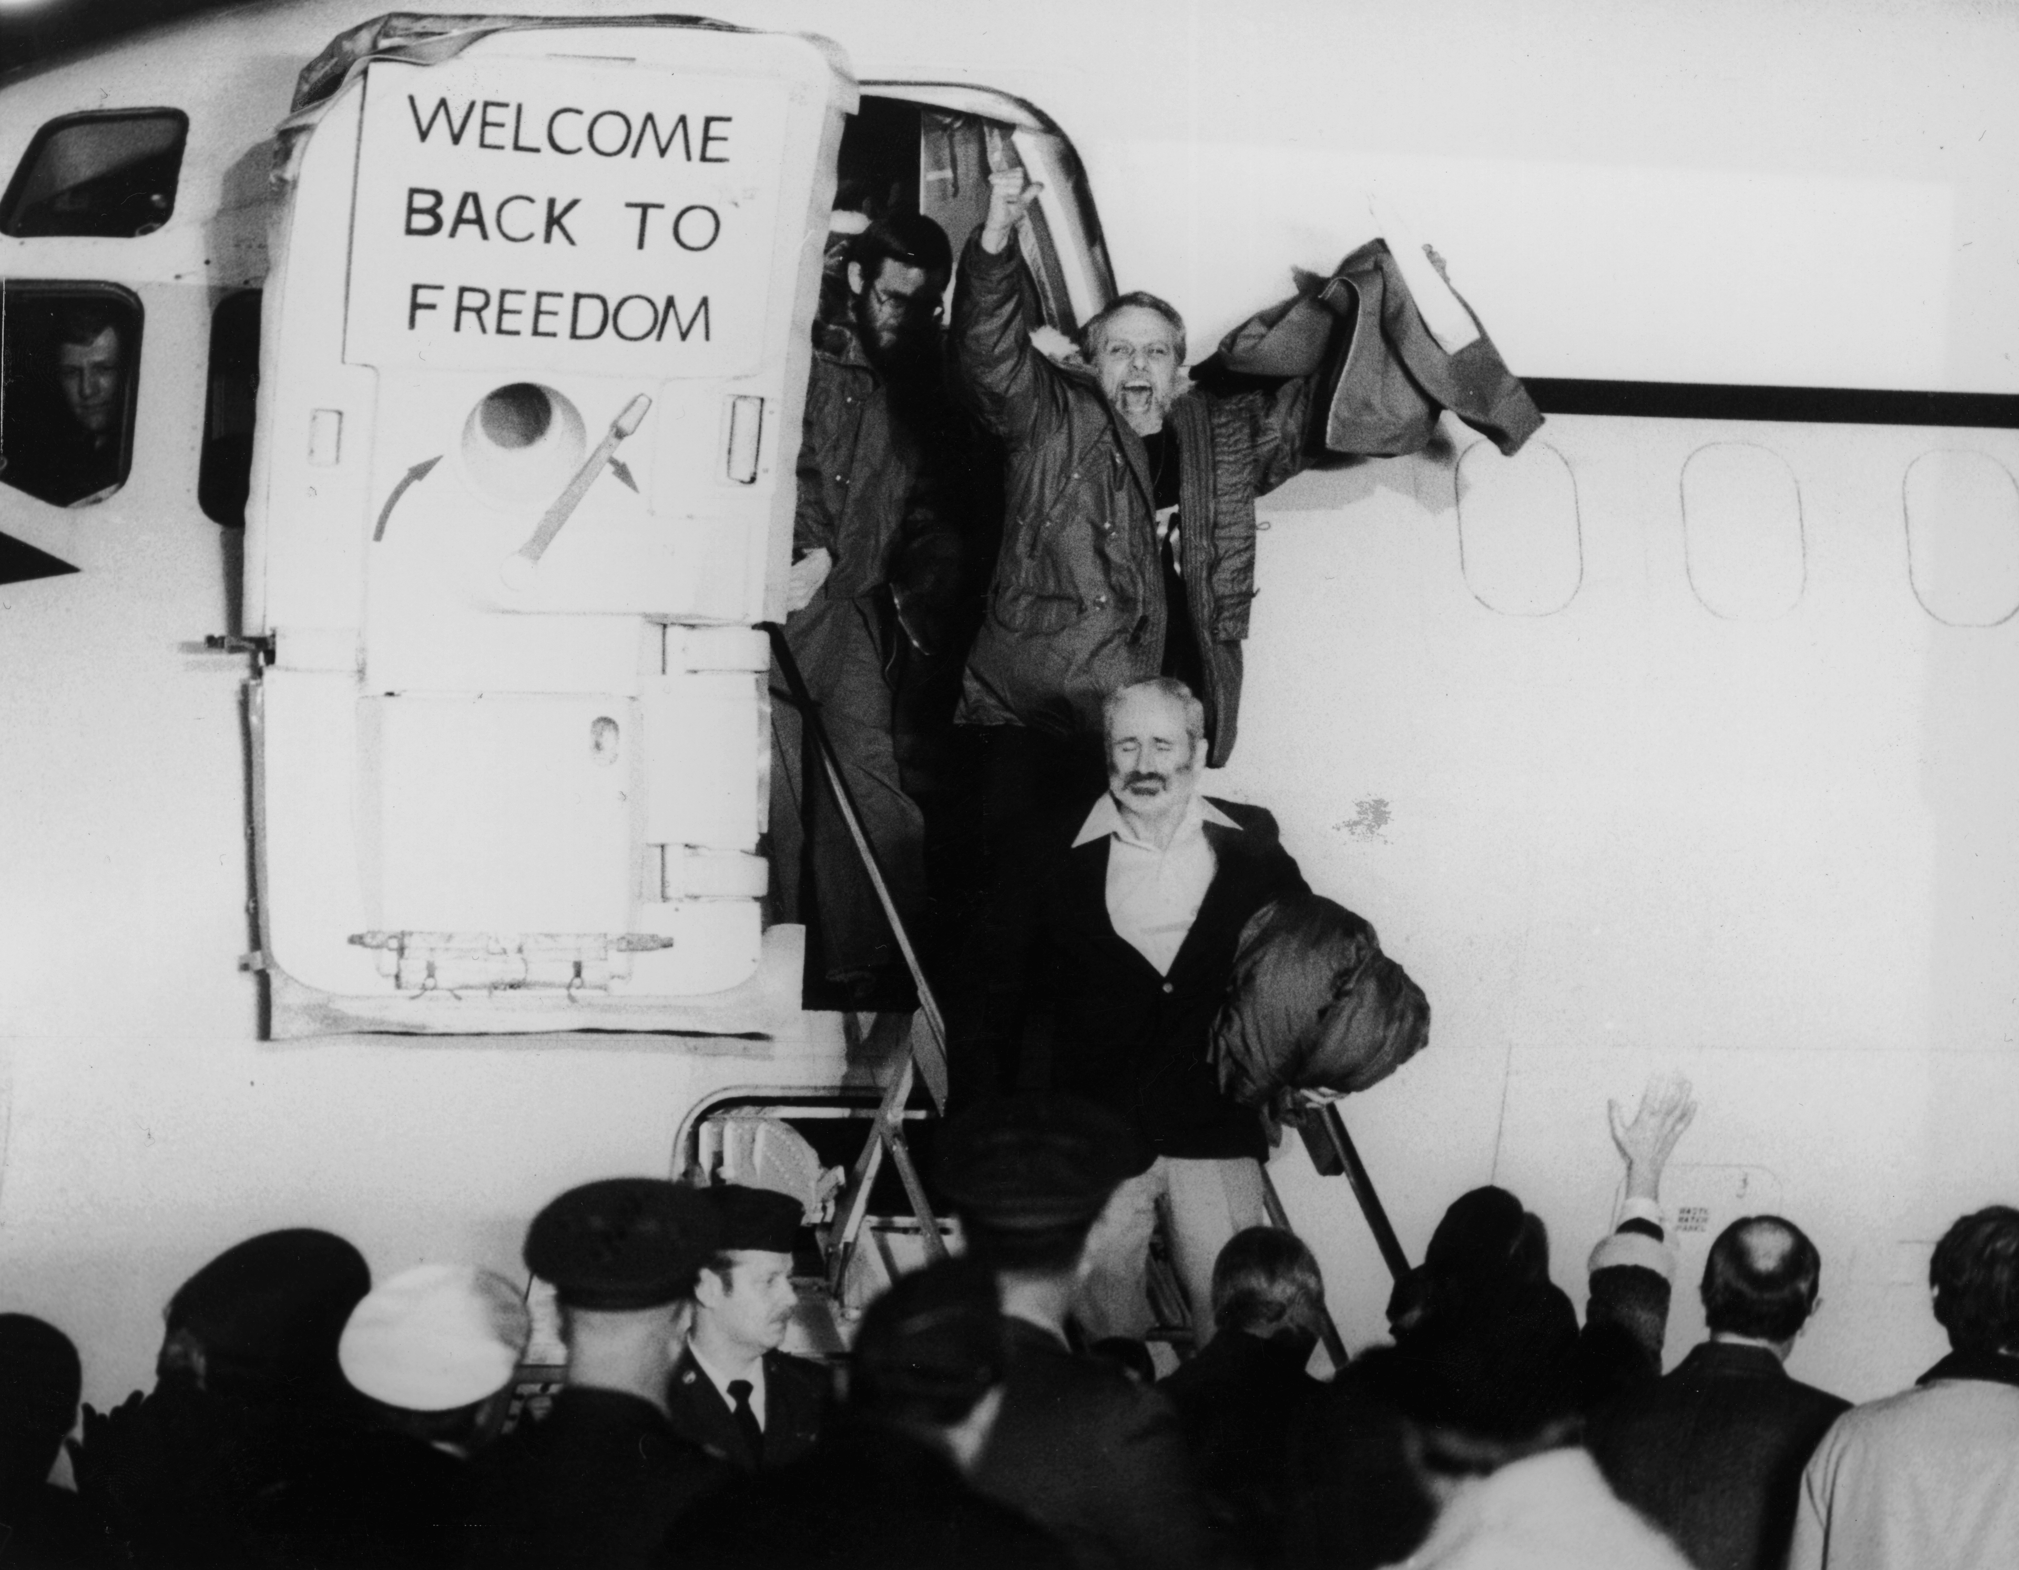
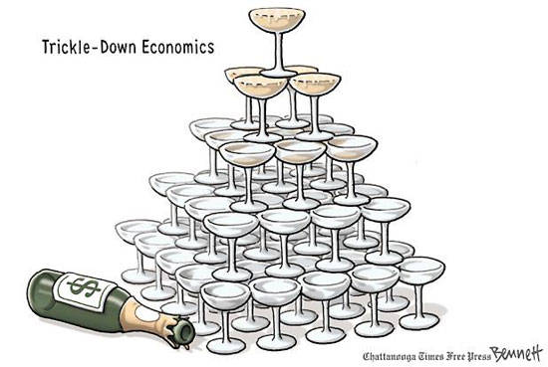
Notes: The Reagan Revolution
The Reagan Revolution
Hostages released in Iran on day of Reagan’s victory
Reagan survives assassination attempt
Promised to reduce size of government, increase size of the military, and reshape a more conservative federal court
Economics
Supported Supply-Side Economics – Cutting taxes leads to private industry growth thus growing the economy
Known as “Reaganomics”
Also called the “Trickle Down Theory” – Wealthy see increased profits and their spending benefits the poor
Similar to 1920’s Laissez Faire

Slide 8
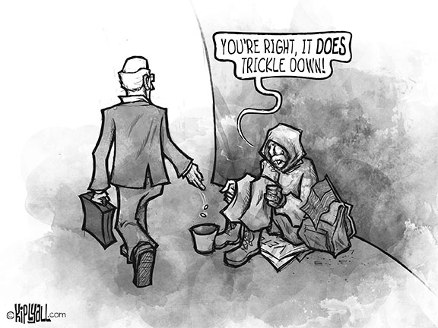
Notes: The Reagan Revolution

Slide 9
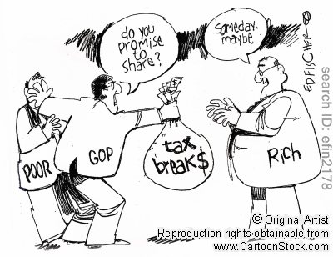
Notes: The Reagan Revolution

Slide 10
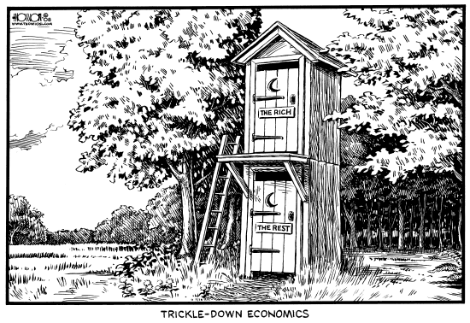
Notes: The Reagan Revolution

Slide 11
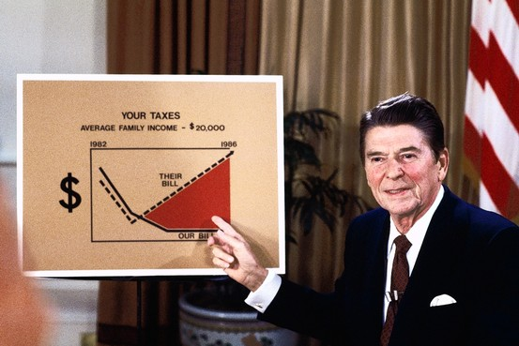
Notes: The Reagan Revolution
Cut income tax by 25% in first 3 years in office, and other cuts helped the wealthy
Set up Individual Retirement Accounts
With support of Southern Democrats known as “Boll Weevils” Republicans cut domestic spending by $40 billion
Cut food stamps, student loans, and transportation
Offset by military spending
Raised retirement age
Used deregulation of businesses to support industry and job growth
Fought to decertify unions for restricting growth

Slide 12
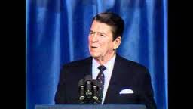
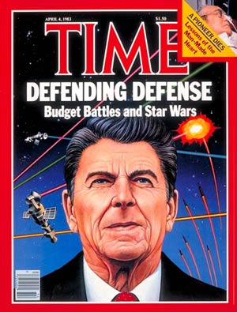
Notes: The Reagan Revolution
Foreign Policy in Reagan’s First Term
Intensifies arms race with Soviet Union calling them the “Evil Empire”
Increased spending on America’s army and anticommunist forces around the world
$171 billion in 1981 -> $300 billion in 1985
Built new weapons systems, missiles, and expanded the navy
Started the Strategic Defense Initiative know critically as “Star Wars”
US supports Nicaraguan “contras” and El Salvador’s government against “leftists”
Both groups used “death squads” to keep control
Marines called in to restore a pro-American government in Grenada (1983)
Approves Israeli invasion of Lebanon to prevent attack by Palestinian Liberation Organization
Results in several attacks on American embassy and army bases in Lebanon
U.S. Forces withdrawn in 1984

Slide 13
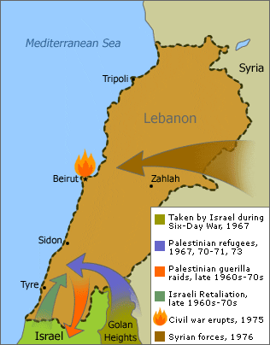
Notes: The Reagan Revolution

Slide 14
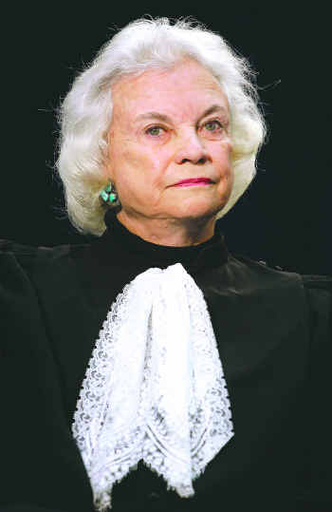
Notes: The Reagan Revolution
Results in Reagan’s First Term
Country faces worst recession since the Depression in 1982
Recession and falling oil prices bring inflation below 4%
Reaganomics results in recovery for wealth and “Yuppies” but not for middle or working-class
Nominates 3 conservative Supreme Court Justices including Sandra Day O’Connor as first woman on the Court
Scale back affirmative action, abortion, and other liberal changes of the Warren Court

Slide 15
Independent Work: The Reagan Revolution
Steps:
Go to mrvandsburger.weebly.com
Download the files:
Reagan’s Policies
The Reagan Legacy
Email to Mr. Vandsburger when you are finished.
Homework:
Literal and Analytical Notes p. 1031 - 1037
Save Power Point as “Your Name Lesson 1” and email to Mr. Vandsburger (will count as class work grade)
Finish “The Reagan Legacy” by Sunday at 8 pm
Vietnam War DBQ due Wednesday by end of Day

