Slide 1
Unit 11 – The Sixties and Seventies
Lesson 6 – Ford and Carter Administrations
4/10/13

Slide 2
Unit 11 Lesson 6: 4/10/13
Warm-Up:
Download this Power Point from mrvandsburger.weebly.com
Email responses to the Nixon Quiz by 11:12

Slide 3
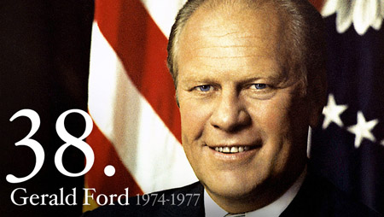
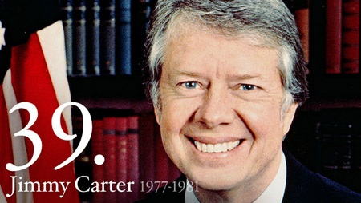
Objective
Unit 11 Lesson 6. SWBAT analyze the extent to which Ford and Carter led American policy or were merely reactions to scandals and crises of the Cold War era.

Slide 4
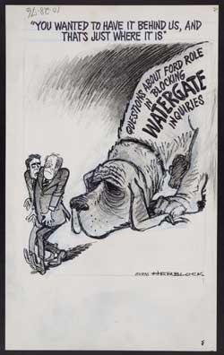
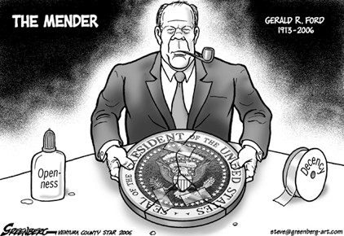
Notes: Ford and Carter Administrations
Gerald Ford Takes Office (1973)
25th Amendment sets order of succession
If President dies, resigns, or no confidence -> then Vice President
If no VP -> then chosen by Congress
Well liked but lacked strong leadership
Seen as a reaction to overbearing Nixon
Granted Nixon a full Pardon before charges occurred
Criticized as a “corrupt bargain”
Wanted to end the “national nightmare”
Conducted full investigation of CIA
Investigate US involvement in assassination of foreign leaders
Appointed George H.W. Bush to fix the agency

Slide 5
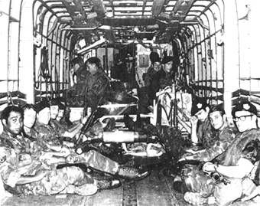
Notes: Ford and Carter Administrations
Foreign Policy
Ford failed to maintain support for Vietnam war
Fall of Saigon (April 1975) marks communist takeover of Vietnam
Cambodia fell to communist group Khmer Rouge
Ford orders attack on Cambodians to free U.S.S. Mayaguez
Frees crew, 38 marines killed
Growth of Little Tigers in Southeast Asia seen as success for Vietnam War
Singapore, Thailand, Malaysia emerge as trading partners
Domestic Policy
Focused on conservative measures to reduce inflation
Promotes Whip Inflation Now (WIN) campaign
Recession worsens leading Ford to accept Democrat proposed stimulus plan
Bicentennial Celebration (1976) helped forget failures of Vietnam and Watergate
Ford applauded for bringing “humility” back to Presidency

Slide 6
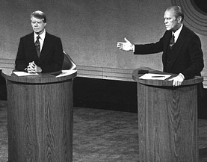
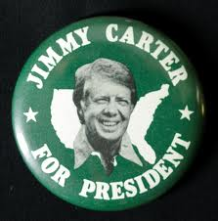
Notes: Ford and Carter Administrations
Election of 1976
Ford challenged for Republican nomination by Ronald Reagan (Governor of California)
Tough primary battle weakens Ford in general election
Democrat James Earl “Jimmy” Carter (Governor of Germany) emerges as an “anti-corruption” candidate
Carter wins close election by taking the South and with the support of African Americans
Democrats also win both houses of Congress
Carter seen as a “Washington Outsider”
Liked by average American, disliked by Congress
Known as a “leaf man”

Slide 7
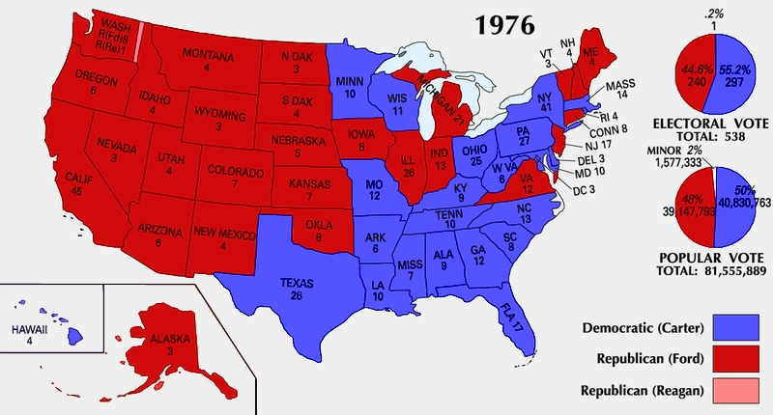
Notes: Ford and Carter Administrations

Slide 8
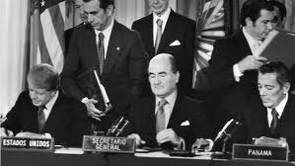
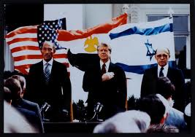
Notes: Ford and Carter Administrations
Carter ‘s Foreign Policy
Focused on human rights, connected to Wilsonian “Moral Diplomacy”
Appointed Andrew Young as ambassador to UN
Opposed oppression of blacks in South Africa and Rhodesia
Cut off financial support to Latin American nations led by military dictators
Renegotiated Panama Canal Treaty of 1903 to give canal back to Panama by 2000
Used against Carter in 1980 election
Arranged Camp David Accords (1978) peace settlement between Egypt and Israel
Menachem Begin (Israel) and Anwar Sadat (Egypt) invited to Camp David
Reach peace settlement officially recognizing Israel and withdrawing Israeli troops from Egyptian territory
Palestinian Liberation Organization infuriated

Slide 9
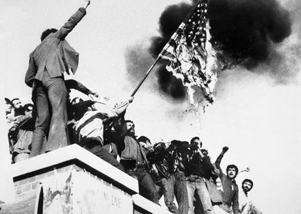
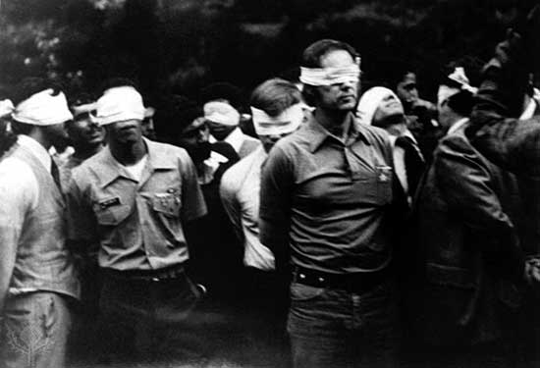
Notes: Ford and Carter Administrations
Iranian militants seized the U.S. embassy leading to the Iran Hostage Crisis (1979)
50 Americans remained captive for rest of Carter’s presidency
Symbol of Carter’s failure as President
Struggled to continue détente efforts in the Cold War
Ended recognition of nationalist government in Taiwan
Reached SALT II Treaty to end arms race (rejected by Congress)
Soviet invasion of Afghanistan forces Carter to embargo trade with USSR
Boycott of 1980 Olympics in Moscow
Reluctantly supported arms buildup

Slide 10
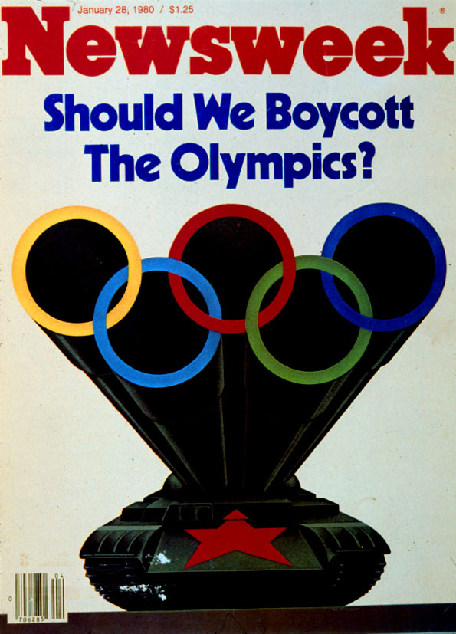
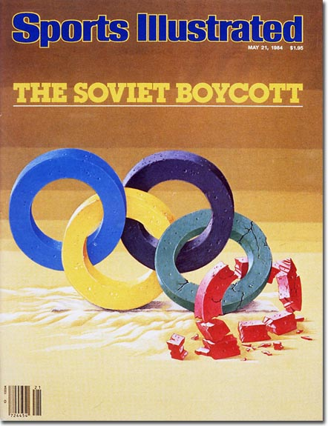
Notes: Ford and Carter Administrations

Slide 11
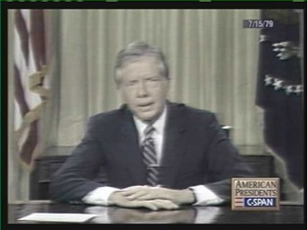
Notes: Ford and Carter Administrations
Carter’s Domestic Policy
Inflation reaches out of control rate of 13% annually
Federal Reserve Board raises interest rates to 20%
Harms auto-industry
Taxpayers pushed into higher income tax brackets
Deficit rises to $60 billion
With economy rapidly declining, Carter delivers the “National Malaise” Speech blaming the crisis on a “moral and spiritual crisis”
Americans blamed Carter’s weak leadership
Approval rate only 23%
Transformations of the 1970’s
Growth of elderly (65+) and minority groups
Immigration Act of 1965 ended quotas bringing in huge numbers from Latin America and Asia by those escaping communism
Immigration Reform and Control Act of 1986 tried to address growing numbers of illegal immigrants

Slide 12
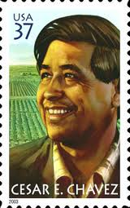
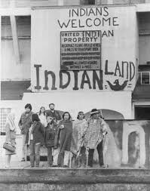
Notes: Ford and Carter Administrations
Rights Movements
Hispanic Americans: Cesar Chavez leads the United Farm Workers Organization to boycott unfair treatment of Hispanic Americans in agricultural work
Chicano Liberation Movement pushes requirement for bilingual education
Native Americans: American Indian Movement efforts including militant takeovers of Alcatraz and Wounded Knee
Indian Self-Determination Act (1975) gave greater autonomy to natives on reservations
Public support is sympathetic with natives
Dances with Wolves (1990) exposes struggle
Gay Liberation Movement: Stonewall Riot leads to movement to end abuse and discrimination
No longer classified as a mental illness by mid-1970’s

Slide 13
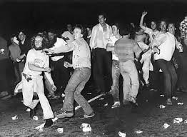
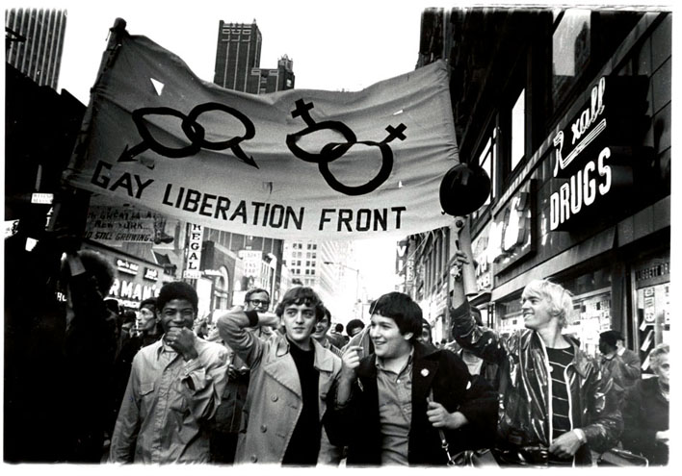
Notes: Ford and Carter Administrations

Slide 14
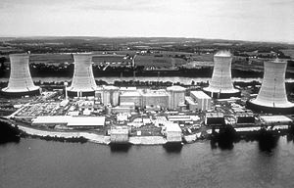
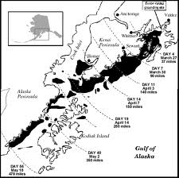
Notes: Ford and Carter Administrations
Environmental Movement
Three Mile Island Disaster turns public against nuclear power
Exxon Valdez oil spill leads many to question human impact on environment
Congress passes legislation to protect environment
Clean Air Act (1970), Clean Water Act (1972)
Superfund program created to clean up toxic waste dumps
Gowanus Canal is a superfund site

Slide 15
Independent Work: Unit 11 DBQ
Steps:
Go to mrvandsburger.weebly.com
Download the files:
Vietnam War DBQ
Hand in to Mr. Vandsburger when you are finished
Homework:
Literal and Analytical Notes p. 1016, 1021 - 1028
Save Power Point as “Your Name Lesson 6” and email to Mr. Vandsburger (will count as class work grade)
Unit 11 DBQ due Next Wednesday
Nixon Worksheets due tomorrow by 8 pm

