Slide 1
Unit 11 – The Sixties and Seventies
Lesson 5 – The Nixon Presidency
4/9/13

Slide 2
Unit 11 Lesson 5: 4/9/13
Warm-Up:
Download this Power Point from mrvandsburger.weebly.com
Email responses to the Vietnam and Protest Quiz by 11:12

Slide 3
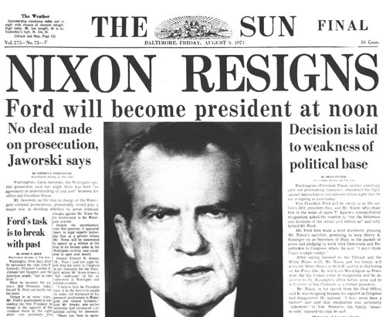
Objective
Unit 11 Lesson 5. SWBAT judge whether the tarnishing of Nixon’s legacy by the Watergate Scandal was fair or ignored progress made during his administration.

Slide 4
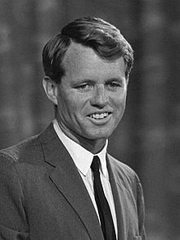
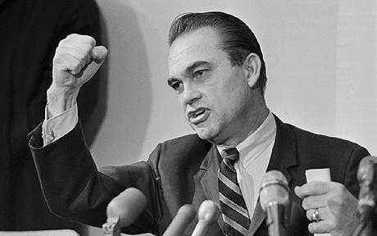
Notes: The Nixon Presidency
The Election of 1968
Robert Kennedy becomes front runner for Democratic nomination
Assassinated by Sirhan Sirhan because of Kennedy’s support for Israel
Race between Humphrey (was the VP), George Wallace (Governor of Alabama, and Richard Nixon (Republican
Protests at Democratic convention doomed Humphrey
Wallace was hoping to push election to House of Representatives
Nixon wins by close popular vote, large Electoral majority
Success of Nixon and Wallace indicated growing conservatism and rejection of New Deal ideologies

Slide 5
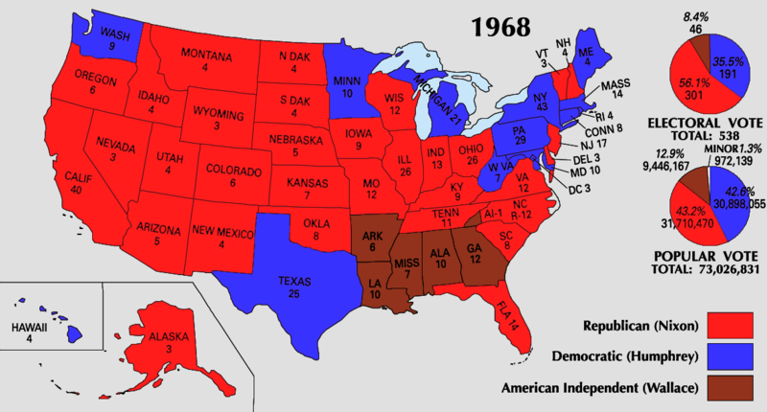
Notes: The Nixon Presidency

Slide 6
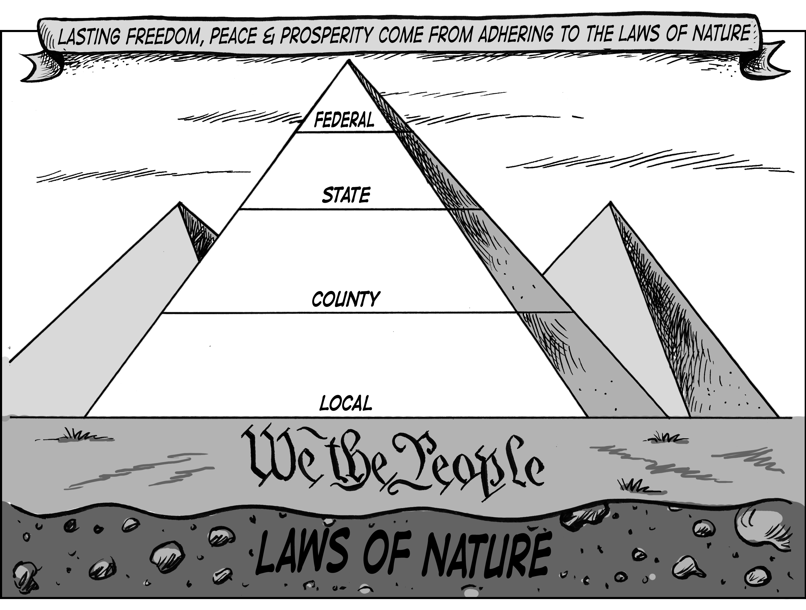
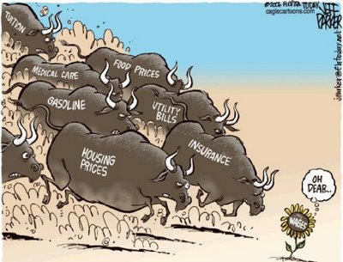
Notes: The Nixon Presidency
Nixon’s Domestic Policies
Needed to compromise with Democratic controlled Congress
Dismantled many Great Society programs with his New Federalism policy
Shifted responsibility for social programs to state and local levels
Funded initiatives with $30 billion in grants
Philadelphia Plan reinforced requirement to hire minority workers
Environmental efforts
Environmental Protection Agency protects environment and human health
First Earth Day occurs in 1970
Economy faced stagflation in 1970’s
Stagnation (slow down) + inflation (high prices)
Nixon responds by instituting:
Wage and price freeze
Took dollar off the gold standard
Taxed imports
Resulted in improved trade balance and restored growth

Slide 7
Notes: The Nixon Presidency
Nixon’s Foreign Policies
Focus on détente – gradual relaxation of tensions with communist nations
Nixon and Henry Kissinger re-opened relations with China with his China Visit in 1972
Led to official recognition of Communist system in 1979
Pressured Soviet Union to agree to Strategic Arms Limitation Talks to limit anti-ballistic missiles
Relaxed the Arms Race

Slide 8
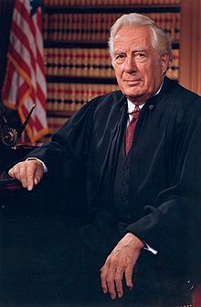
Notes: The Nixon Presidency
The Burger Court
Nixon nominates Warren Burger to replace Earl Warren as Chief Justice of the Supreme Court
Nominates 1 moderate to the court and 2 other conservatives
Seeks to create a pro-Nixon court
Key Cases
Milliken v. Bradley – Distinguished between de jure and de facto segregation
University of California v. Bakke – Quota systems of admission to universities was unconstitutional, Affirmative Action was not
Roe v. Wade – Protected right to privacy in abortion, but created the Balance Test
Developed the Miranda Warning in response to Warren court’s decision in Miranda v. Arizona

Slide 9
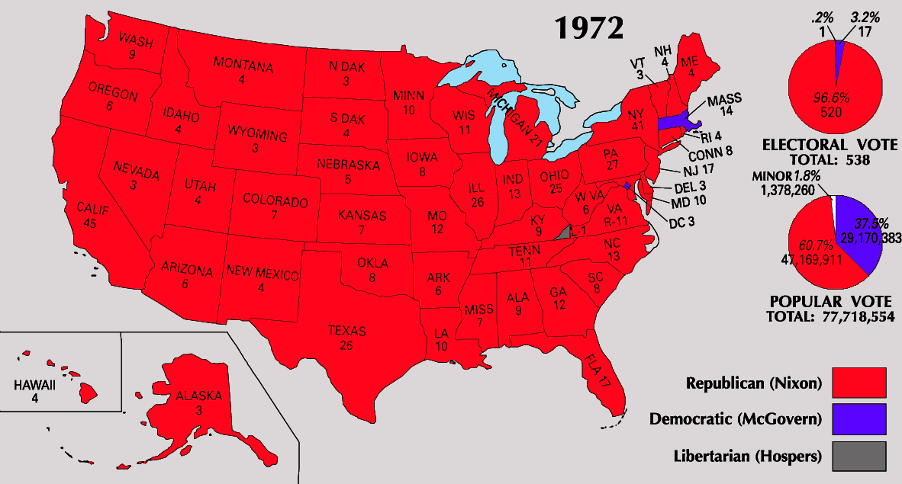
Notes: The Nixon Presidency
Election of 1972 and Scandal
Nixon uses his Southern Strategy to gain support from unhappy democrats known as the Silent Majority in the South
Asked courts to block integration and nominated Southern conservatives to Supreme Court (both rejected)
Nixon easily wins Election of 1972
George Wallace is assassinated
Democrat George McGovern is viewed as a radical liberal
Sunbelt and suburban voters favor growing conservatism

Slide 10
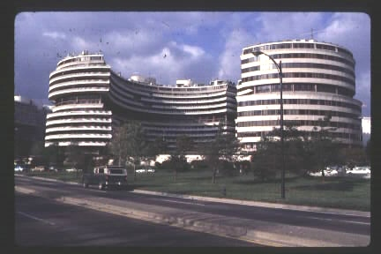
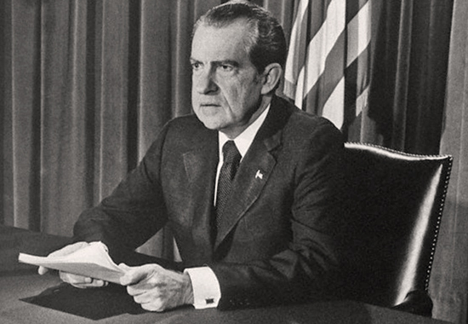
Notes: The Nixon Presidency
June, 1972 members of Nixon’s re-election campaign caught breaking into the Watergate building
Committee to Re-Elect the President (CREEP) uses wiretaps and burglary to protect Nixon’s interests
Watergate Scandal leads to investigation of Nixon
No proof he ordered the Watergate break in
Did order cover-up of break in
“Smoking Gun” Tapes recorded Nixon’s conversations in Oval Office
Nixon claims executive privilege to prevent release of tapes
Supreme Court rules the President cannot use executive privilege when facing charges in US v. Nixon
VP Spiro Agnew forced to resign after taking bribes
Nixon faced impeachment and removal, chose to resign (August 9, 1974)
Gerald Ford becomes President without being elected

Slide 11
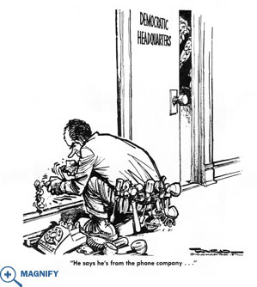
Notes: The Nixon Presidency

Slide 12
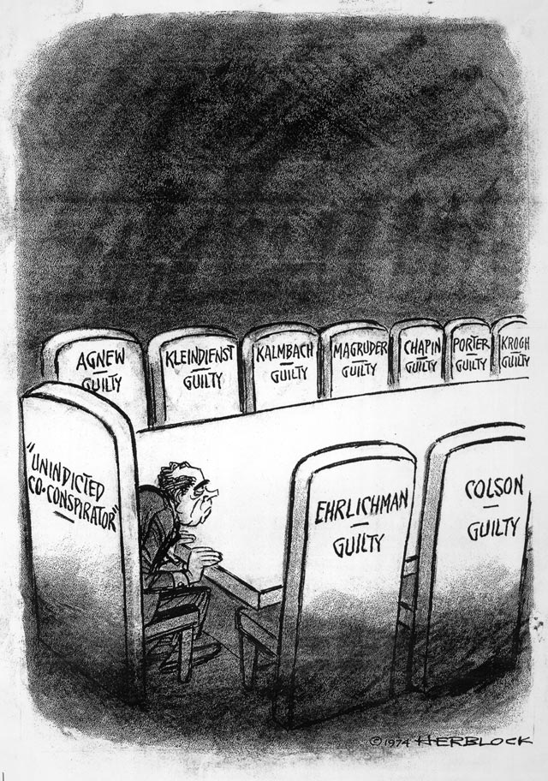
Notes: The Nixon Presidency

Slide 13
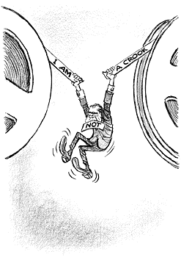
Notes: The Nixon Presidency

Slide 14
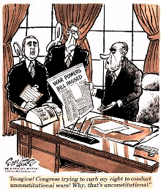
Notes: The Nixon Presidency
Congressional Actions during Nixon’s Term
War Powers Act passed over Nixon’s veto
Required President to inform Congress 48 hours after any unauthorized use of the military
Congress had to approve any action lasting longer than 60 days
US supports Israel in Six-Day War against Syria and Egypt
Organization of Petroleum Exporting Countries places Arab Oil Embargo on United States
Led to economic recession particularly in auto-industry
Congress enacts a 55-mile per hour speed limit
Creates Alaska oil pipeline

Slide 15
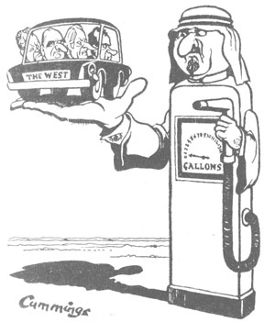
Notes: The Nixon Presidency

Slide 16
Independent Work: Vietnam War
Steps:
Go to mrvandsburger.weebly.com
Download the files:
Nixon Presidency Documents
Nixon Worksheets
Email to Mr. Vandsburger when you are finished.
Homework:
Literal and Analytical Notes p. 1002 – 1004, 1006 - 1015
Save Power Point as “Your Name Lesson 5” and email to Mr. Vandsburger (will count as class work grade)
Finish “Nixon Worksheets” by Thursday at 8 pm
Impact of the Warren Court due Tomorrow

