Slide 1
Unit 11 – The Sixties and Seventies
Lesson 4 – Popular Protest in the Sixties and Seventies
4/8/13

Slide 2
Unit 11 Lesson 3: 4/5/13
Warm-Up:
Download this Power Point from mrvandsburger.weebly.com
Respond to the prompt below in the “Notes” part of your Power Point
Prompt: What government policies were Americans likely to oppose during the 1960’s?

Slide 3
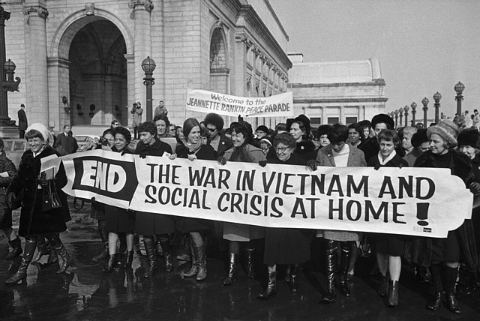
Objective
Unit 11 Lesson 4. SWBAT debate the reasons behind and merits of popular protests in the 1960’s and 70’s in improving the rights of Americans.

Slide 4
Notes: Popular Protest in the 60’s and 70’s
The Student Movement
Concerned about being drafted after graduation
LBJ withdrawal from Election of 1968
Students for a Democratic Society issue the Port Huron Statement calling for democracy in university decisions
Followers known as members of the New Left
Free Speech Movement demand an end to restrictions on student political activities
Opposed drinking restrictions and limitations on co-ed activities

Slide 5
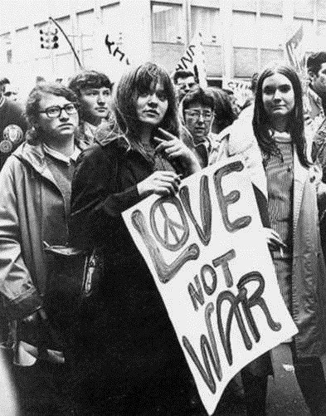
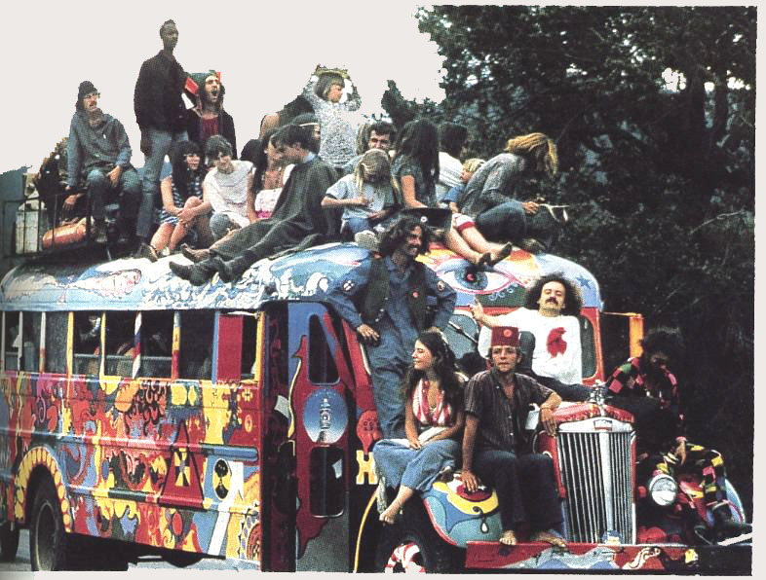
Notes: Popular Protest in the 60’s and 70’s
Counterculture
Youth culture developed in the 60’s to rebel against mainstream culture
Mostly children of the Baby Boom
Exhibited rebellion through dress, music, drug use, and living arrangements
Participants known as “Hippies”
Influential musicians included the Beatles, Bob Dylan, Joan Baez, Rolling Stones, Jim Morrison, and Joan Baez
Wrote songs criticizing materialism, the Cold War, conservatism, and more
“Woodstock” music festival marked the pinnacle of counterculture
Some participated in radical and sometimes violent groups which discredited their message

Slide 6
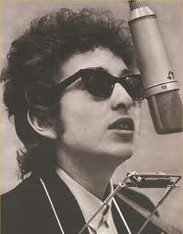
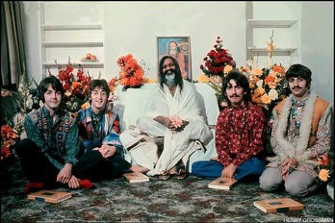
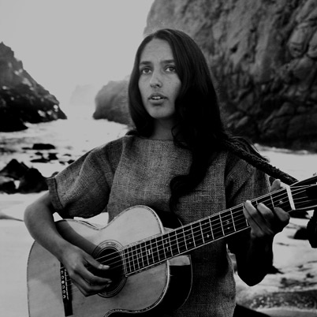
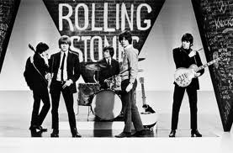
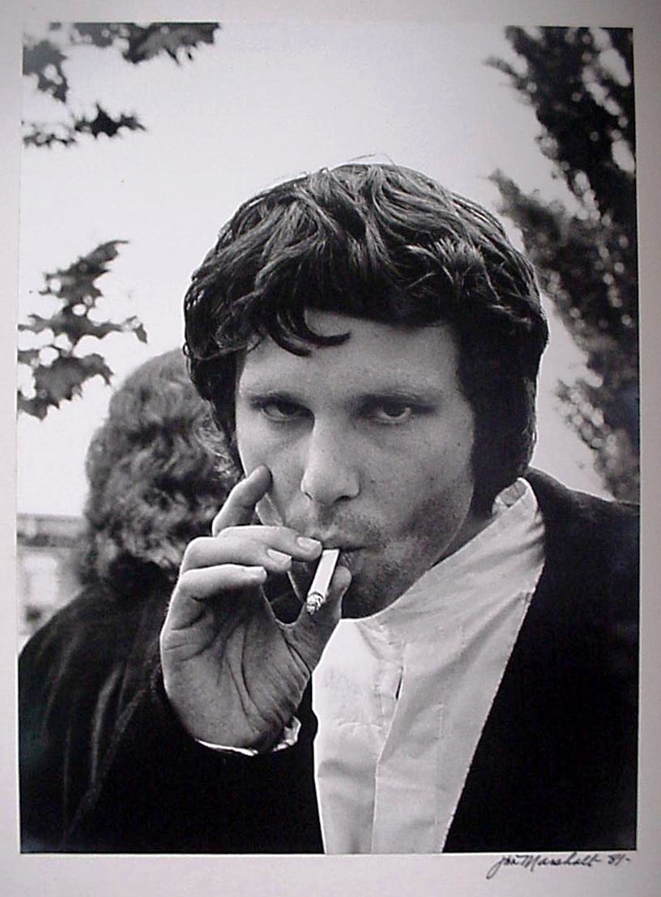
Notes: Popular Protest in the 60’s and 70’s

Slide 7
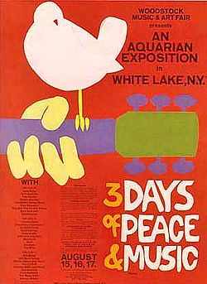
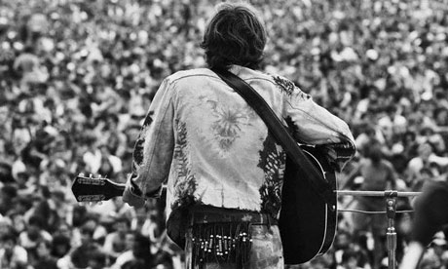
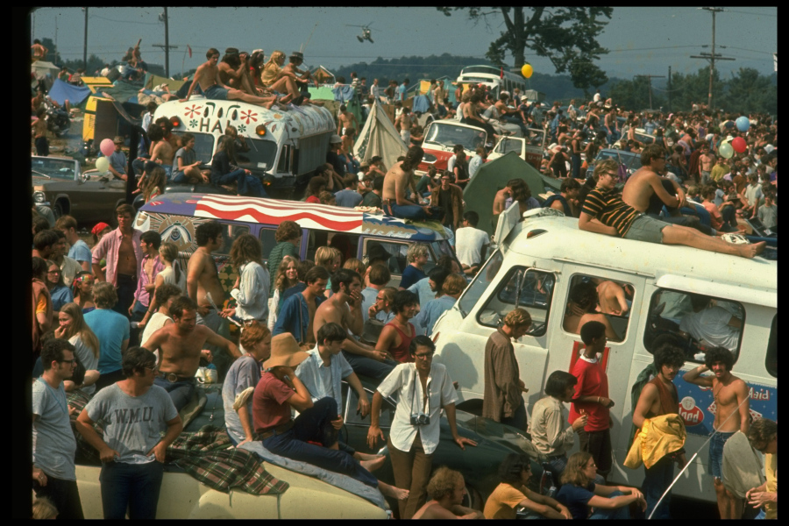
Notes: Popular Protest in the 60’s and 70’s

Slide 8
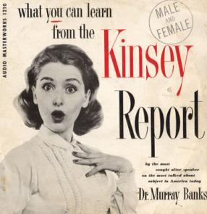
Notes: Popular Protest in the 60’s and 70’s
The Sexual Revolution
Alfred Kinsey challenges ideas about sex in American society
Premarital sex, infidelity, and homosexuality were more common than believed
Medicine and technology promote idea of sex as something casual
Birth control, antibiotics to treat VD
Sexualized advertisements further change social mores
Heavy drug use by Counterculture movement also loosens restrictions

Slide 9
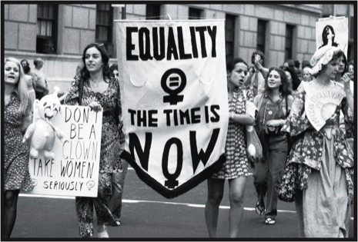
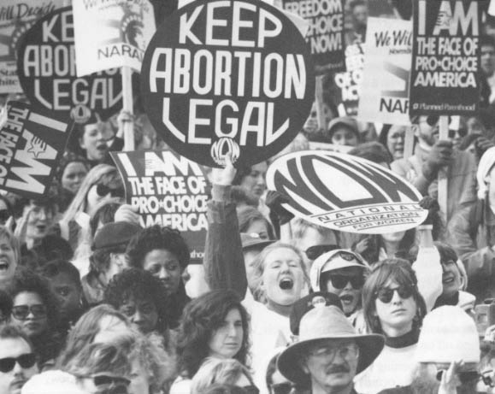
Notes: Popular Protest in the 60’s and 70’s
Women’s Movement
Betty Friedan, author of the Feminine Mystique, helps found the National Organization for Women
Used activism to promote gender equality
Equal Pay Act of 1963 and Civil Rights Act of 1964 benefit women by prohibiting employment discrimination
Equal Rights Amendment passed by Congress would have prevented states from limiting rights based on gender
Phyllis Schalfly organized the Eagle Forum to campaign against the ERA
Failed to meet 38 state requirement (3/4 of the states) for Amendments
Saw improvements in employment and hiring
Roe v. Wade (1973) limited ability of states to place restrictions on abortions

Slide 10
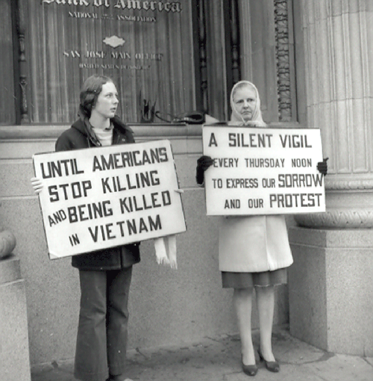
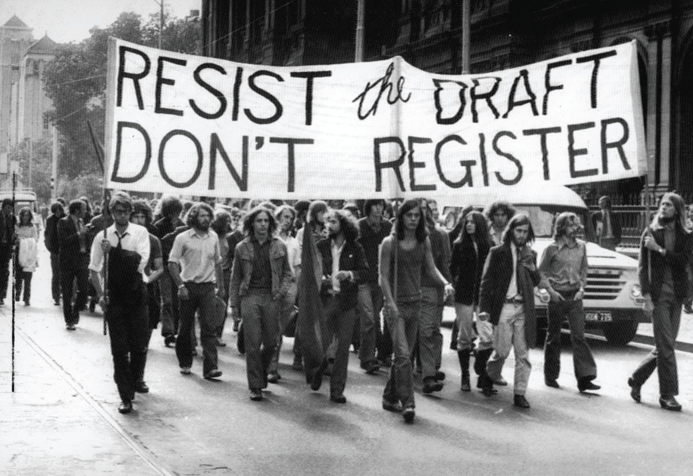
Notes: Popular Protest in the 60’s and 70’s
Protesting the War
Nationwide protests opposed American involvement in the Vietnam War
Nixon ordered National Guard troops to stop protests
Kent State Massacre killed 4 students and turned the public against the war

Slide 11
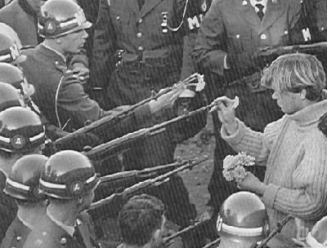
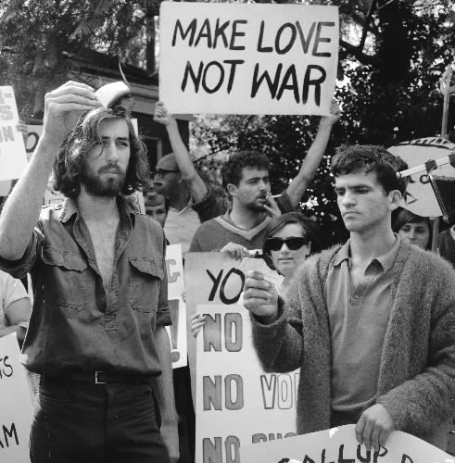
Notes: Popular Protest in the 60’s and 70’s

Slide 12
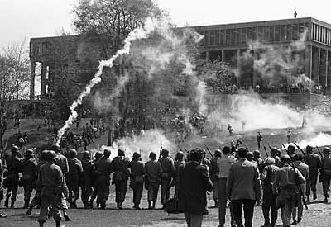
Notes: Popular Protest in the 60’s and 70’s

Slide 13
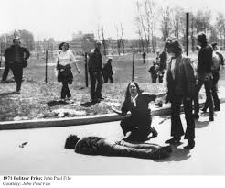
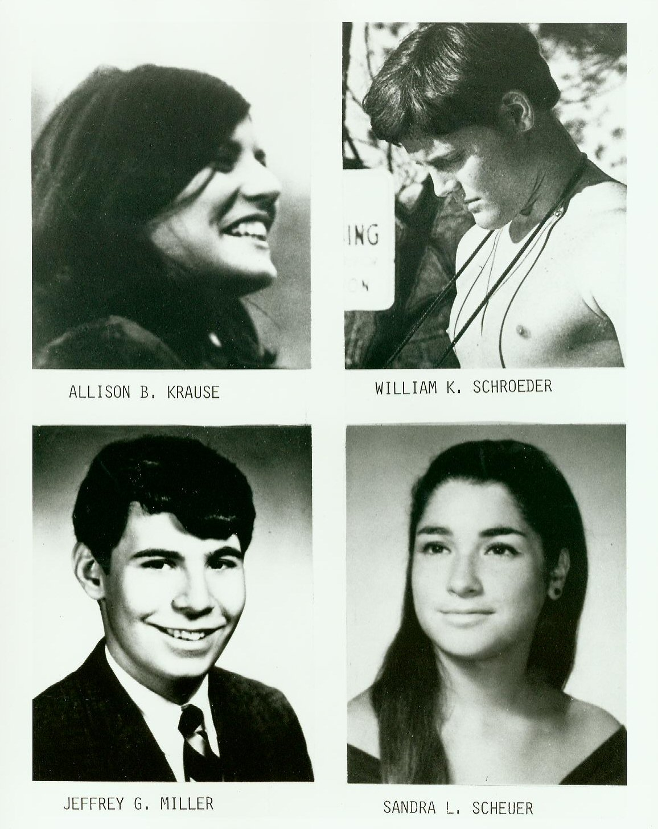
Notes: Popular Protest in the 60’s and 70’s

Slide 14
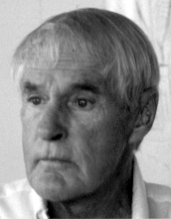
Notes: Popular Protest in the 60’s and 70’s
Literary Developments
Dr. Timothy Leary encourages Americans to “turn on, tune in, drop out”
Promotes use of psychedelic drugs
Ralph Nader writes Unsafe at Any Speed to expose dangers of automobile industry
Rachel Carson exposes the problems of pesticide use on the environment in Silent Spring
Supported by Lady Bird Johnson’s Beautify America campaign

Slide 15
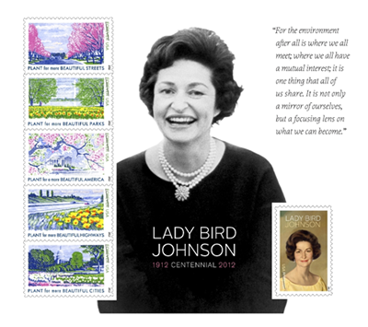
Notes: Popular Protest in the 60’s and 70’s

Slide 16
Independent Work: Vietnam War
Steps:
Go to mrvandsburger.weebly.com
Download the file:
Impact of the Warren Court
Email to Mr. Vandsburger when you are finished.
Homework:
Literal and Analytical Notes p. 994 – 999, 1017 – 1021
Save Power Point as “Your Name Lesson 4” and email to Mr. Vandsburger (will count as class work grade)
Finish “Impacts of Warren Court” by Wednesday at 8 pm
Vietnam War Map Activity due Tomorrow

