Slide 1
Unit 11 – The Sixties and Seventies
Lesson 3 – The Vietnam War
4/5/13

Slide 2
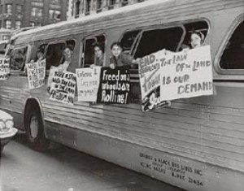
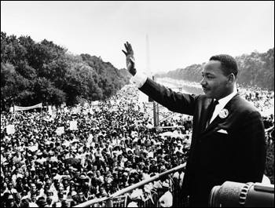
Unit 11 Lesson 3: 4/5/13
Warm-Up:
Download this Power Point from mrvandsburger.weebly.com
Download the Civil Rights Movementand submit responses by 11:12

Slide 3
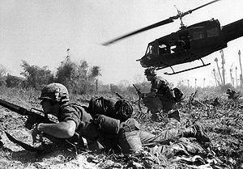
Objective
Unit 11 Lesson 3. SWBAT evaluate the impact of Communist victory in Vietnam on the balance of power around the world.

Slide 4
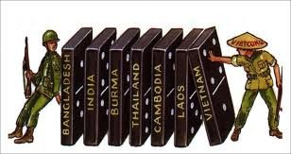
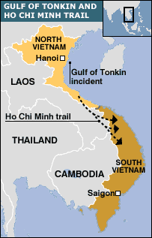
Notes: The Vietnam War
Kennedy’s Approach to Vietnam
Believed in Eisenhower’s Domino Theory
If one nation fell to communism, others would fall: Cambodia, Laos, Thailand, Malaysia, Indonesia
Sent 16,000 troops to support South Vietnam
Do not intervene when Ngo Dinh Diem is assassinated
The Gulf of Tonkin Incident
Johnson criticized for not sufficiently supporting South Vietnam
Gulf of Tonkin Incident (August, 1964) gives Johnson cause to ask Congress to increase support
American warships attacked by North Vietnamese in Gulf of Tonkin
Gulf of Tonkin Resolution gave Johnson power to take “All Necessary Measures” to protect American interests in Vietnam
Was not a declaration of war

Slide 5
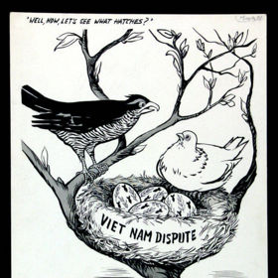
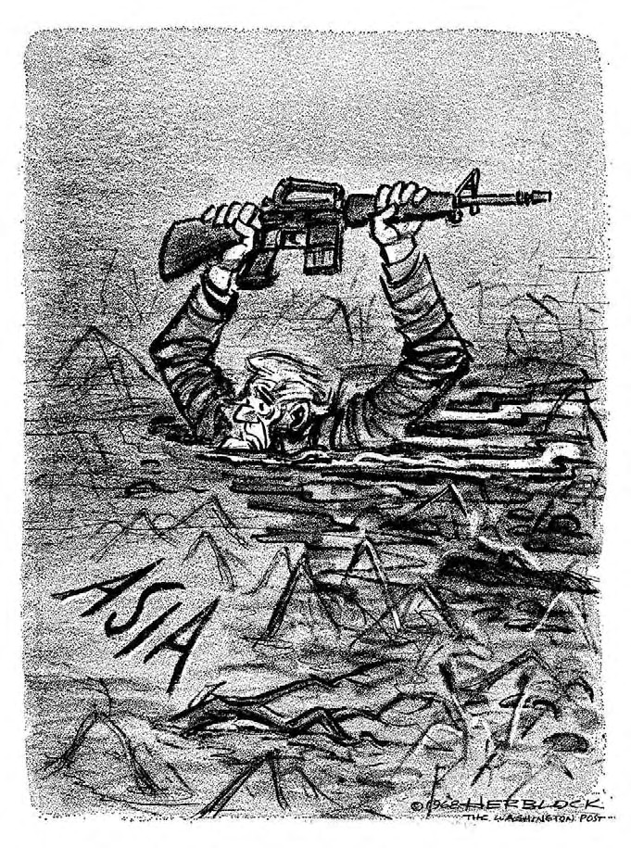
Notes: The Vietnam War
American Involvement in the War
Steady escalation throughout the 1960’s
Began with aerial bombing
Troop deployment increased to 184,000 by 1965 and 485,000 by 1967
General William Westmoreland convinced there is a “light at the end of the tunnel”
“Hawks” believed the US must prevent a Soviet-backed takeover
“Doves” thought the war was a civil war to overthrow a corrupt government so they opposed American involvement
Disliked loss of American life
Thought money would be better spent on Great Society Programs
Greatest opposition comes from college students
Senator Eugene McCarthy challenges Johnson for the 1968 nomination
Vietcong launch Tet Offensive (January, 1968) on cities in South Vietnam
US counterattacks and heavily damage the Vietcong
American public turns on Johnson after viewing footage of counterattack
Johnson announces attempt to negotiate for peace
Withdraws from 1968 election
1968 peace talks fall apart

Slide 6
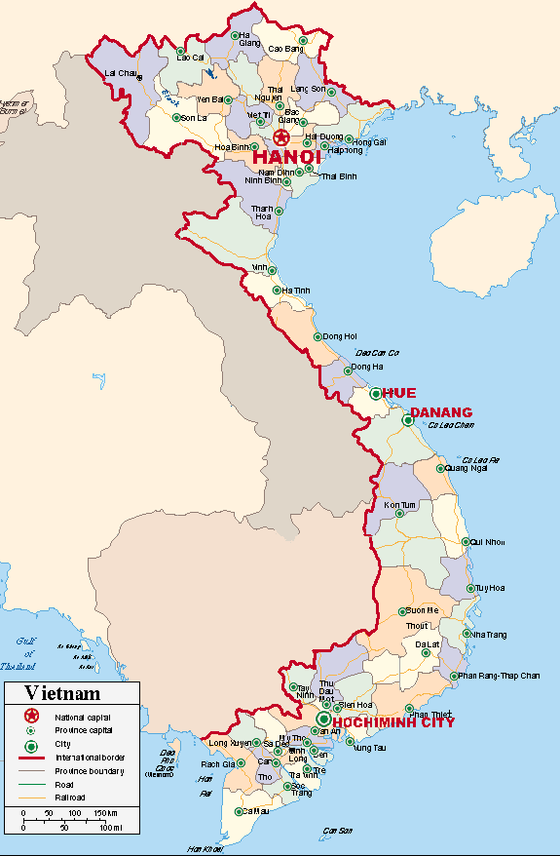
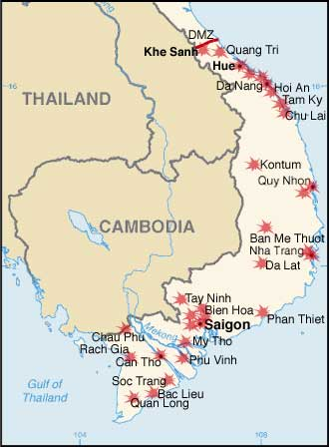
Notes: The Vietnam War

Slide 7
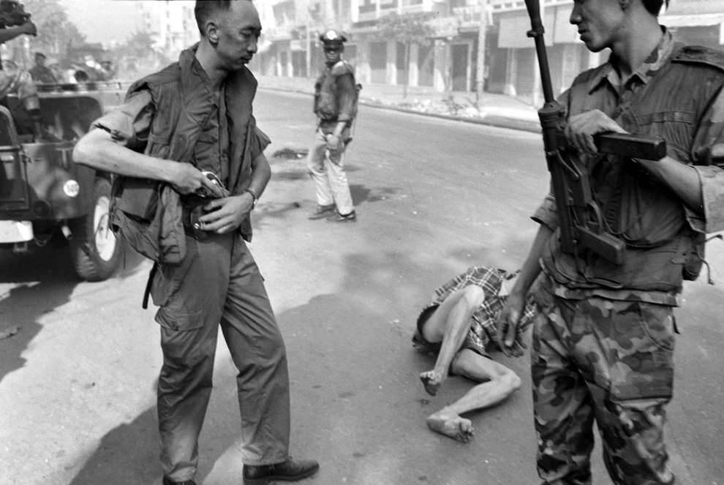
Notes: The Vietnam War

Slide 8
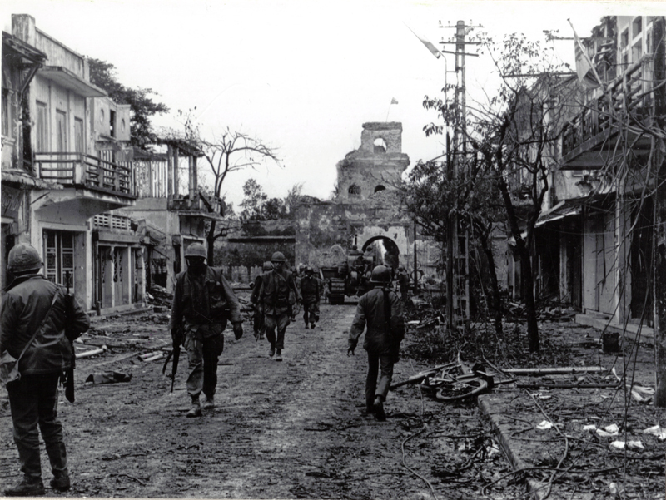
Notes: The Vietnam War

Slide 9
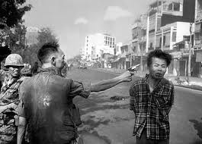
Notes: The Vietnam War

Slide 10
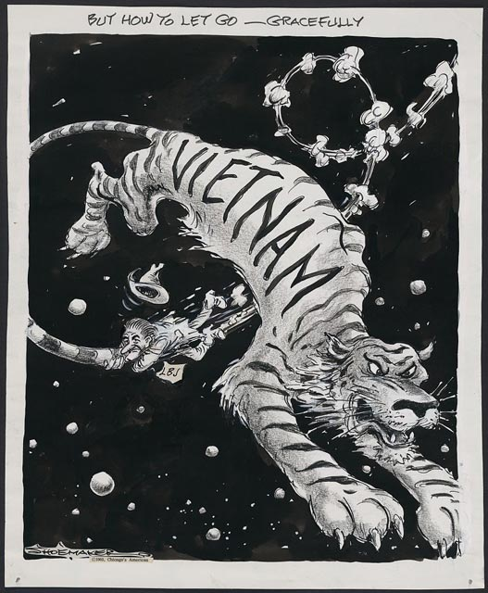
Notes: The Vietnam War

Slide 11
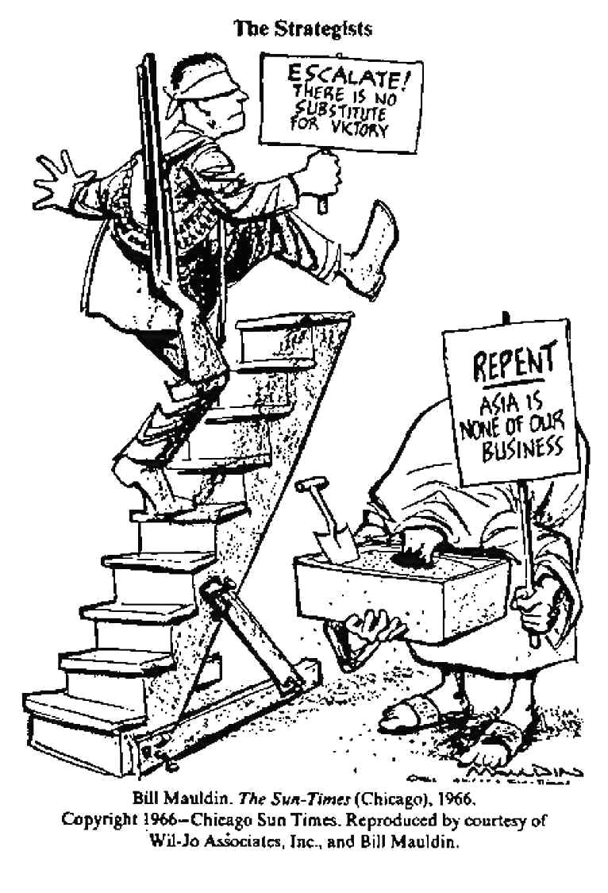
Notes: The Vietnam War
Nixon and the Vietnam War
Sought “Peace with Honor”
Began Vietnamization where US would give South Vietnam the money, weapons, and training to take over the war
Steadily withdrew American troops
Nixon Doctrine – US would provide aid to SE Asia but no troops
Re-escalated by invading Vietcong bases in Cambodia
Congress repeals Gulf of Tonkin Resolution
My Lai Massacre further turns public support against war
Pentagon Papers released secret documents casting doubt over America’s role in Vietnam
Secretary of State Henry Kissenger negotiates Paris Peace Accords of 1973
US would withdraw troops, North Vietnam would allow free and fair elections
War continues and communists take over South Vietnam
58,000 killed, $118 billion spent, and Domino Theory put to the test

Slide 12
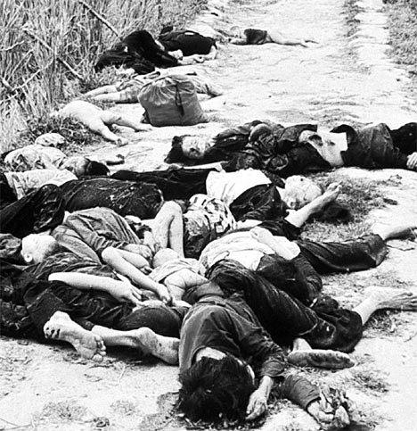
Notes: The Vietnam War

Slide 13
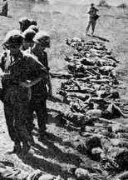
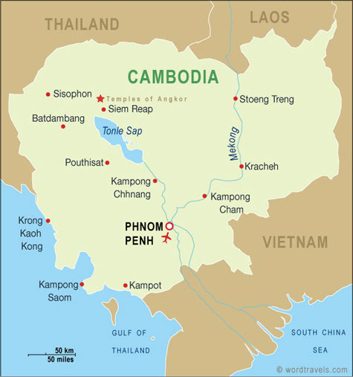
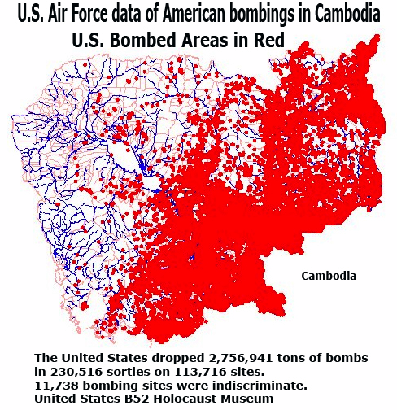
Notes: The Vietnam War

Slide 14
Independent Work: Vietnam War
Steps:
Go to mrvandsburger.weebly.com
Download the file:
Vietnam War Map Activity
Hand in to Mr. Vandsburger when you are finished.
Homework:
Literal and Analytical Notes p. 991 – 994, 1004 – 1006, 1016 - 1017
Save Power Point as “Your Name Lesson 3” and email to Mr. Vandsburger (will count as class work grade)
Finish Lesson 2 Assignments by Sunday at 8 pm
Finish Map Activity if not Completed in Class

