Slide 1
Unit 11 – The Sixties and Seventies
Lesson 2 – Civil Rights in the Kennedy / Johnson Eras
4/4/13

Slide 2
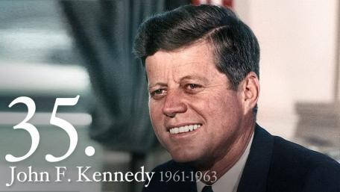
Unit 11 Lesson 2: 4/4/13
Warm-Up:
Download this Power Point from mrvandsburger.weebly.com
Download the Kennedy’s Policies Quiz and submit responses by 11:12

Slide 3
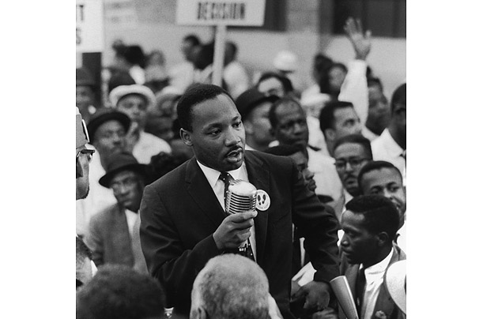
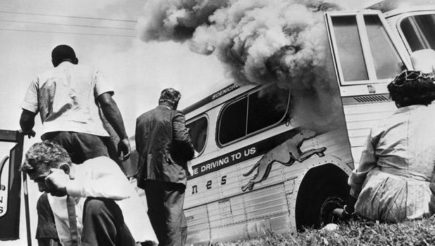
Objective
Unit 11 Lesson 2. SWBAT analyze how changes in political perceptions of the Civil Rights Movement impacted the success of the movement.

Slide 4
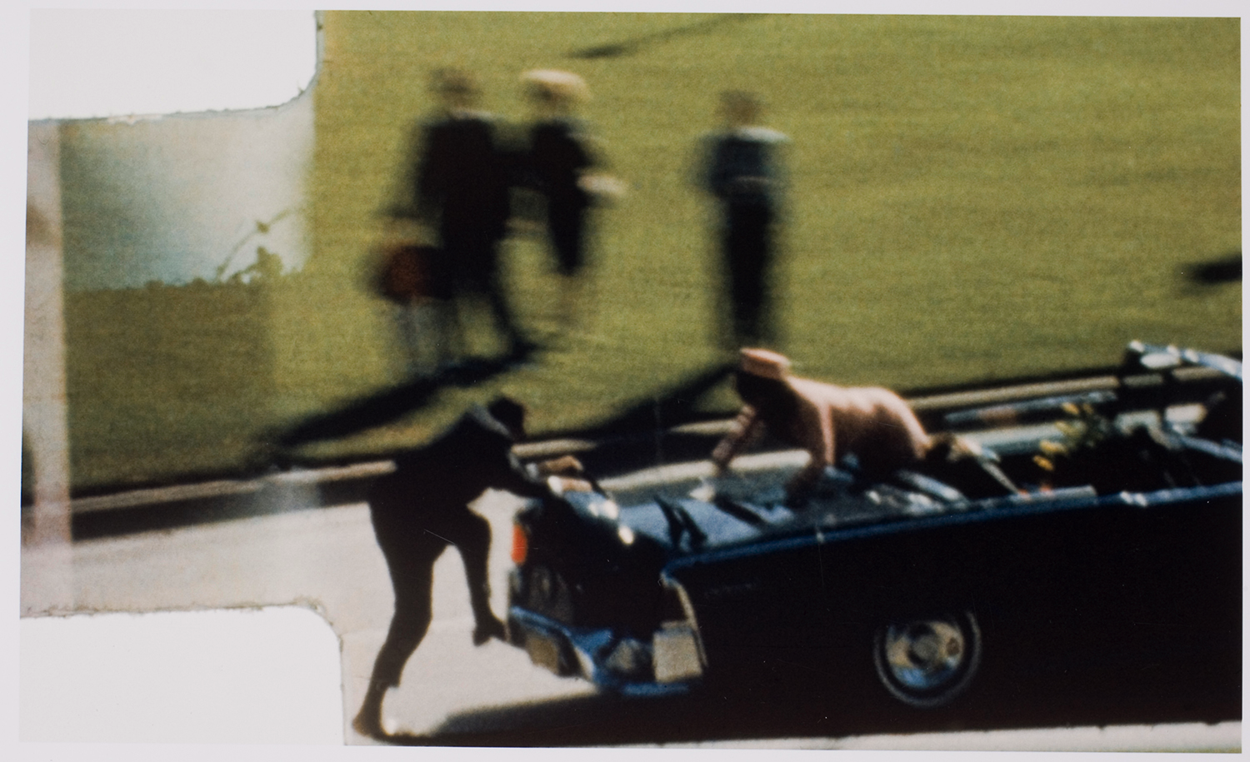
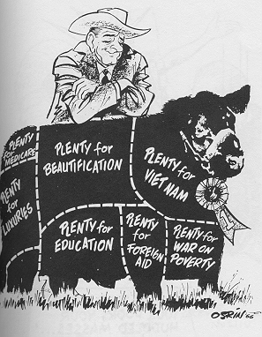
Notes: Civil Rights in the Kennedy / Johnson Eras
Johnson’s Great Society
Kennedy assassinated on November 22, 1963
Lee Harvey Oswald arrested as assassin
Killed two days later by Jack Ruby
Warren Commission led by Supreme Court Chief Justice Earl Warren investigates
Dozens of conspiracies lead to loss of credibility in government
Johnson takes office with desire to bring back legacy of the New Deal
Calls his plan the Great Society
Pushes social reforms and civil rights
Cuts income taxes to increase consumer spending

Slide 5
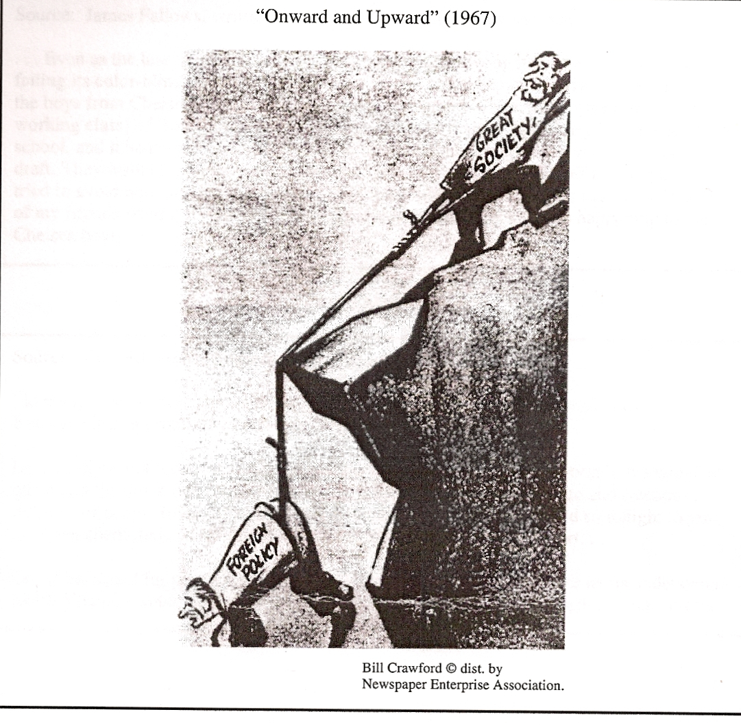
Notes: Civil Rights in the Kennedy / Johnson Eras
Great Society: Fighting Poverty
Michael Harrington’s book The Other America (1964) focuses national attention on poverty
Johnson declares “unconditional war on poverty”
Congress approves the Office of Economic Opportunity
Sponsors Head Start, Job Corps, and the Community Action Program
Created Medicare and Medicaid to support the elderly and the poor
Successful until most Great Society funds are cut in order to pay for the Vietnam War

Slide 6
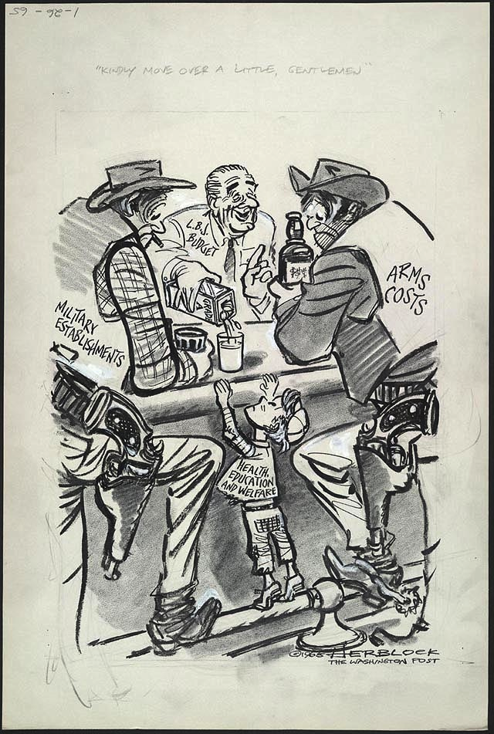
Notes: Civil Rights in the Kennedy / Johnson Eras

Slide 7
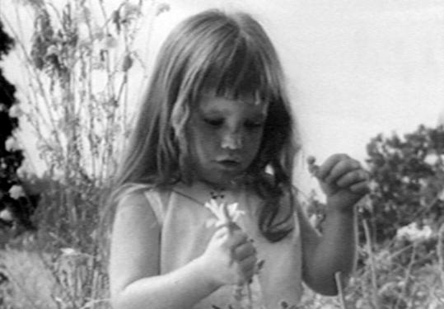
Notes: Civil Rights in the Kennedy / Johnson Eras
The Election of 1964
Johnson (Democrat) contrasted greatly with his opponent Barry Goldwater (Republican, AZ)
Goldwater wanted return to conservativism
Johnson used negative campaign ads to portray Goldwater as a dangerous extremist
“Daisy Ad” sets standard
Johnson wins in a landslide with 61% of popular vote
Democrats control both houses of Congress
Great Society reforms pushed through
Critics debated value of reforms

Slide 8
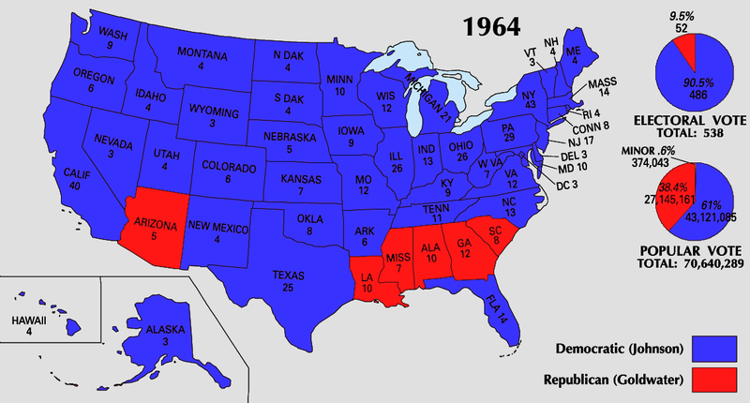
Notes: Civil Rights in the Kennedy / Johnson Eras

Slide 9
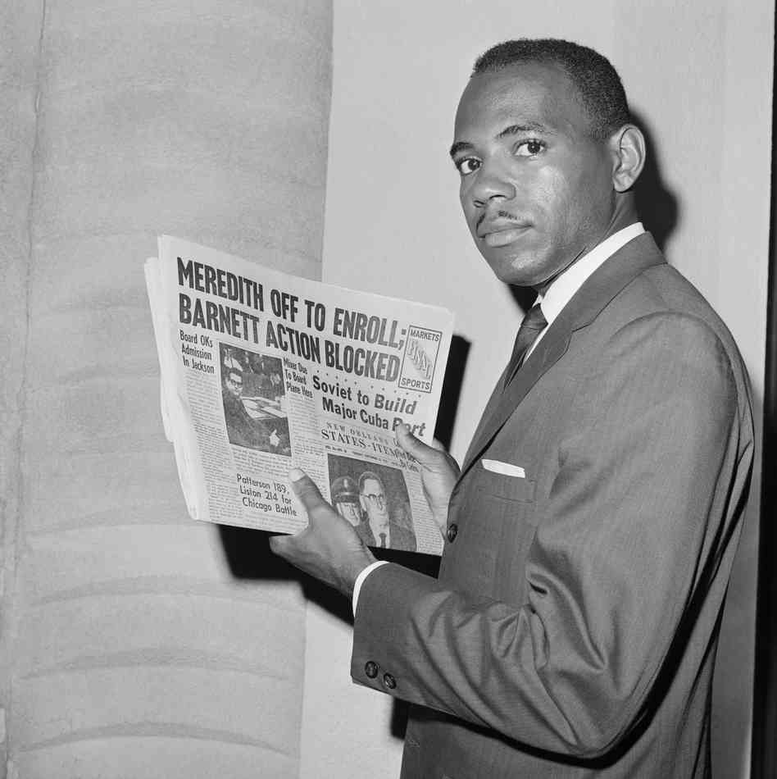
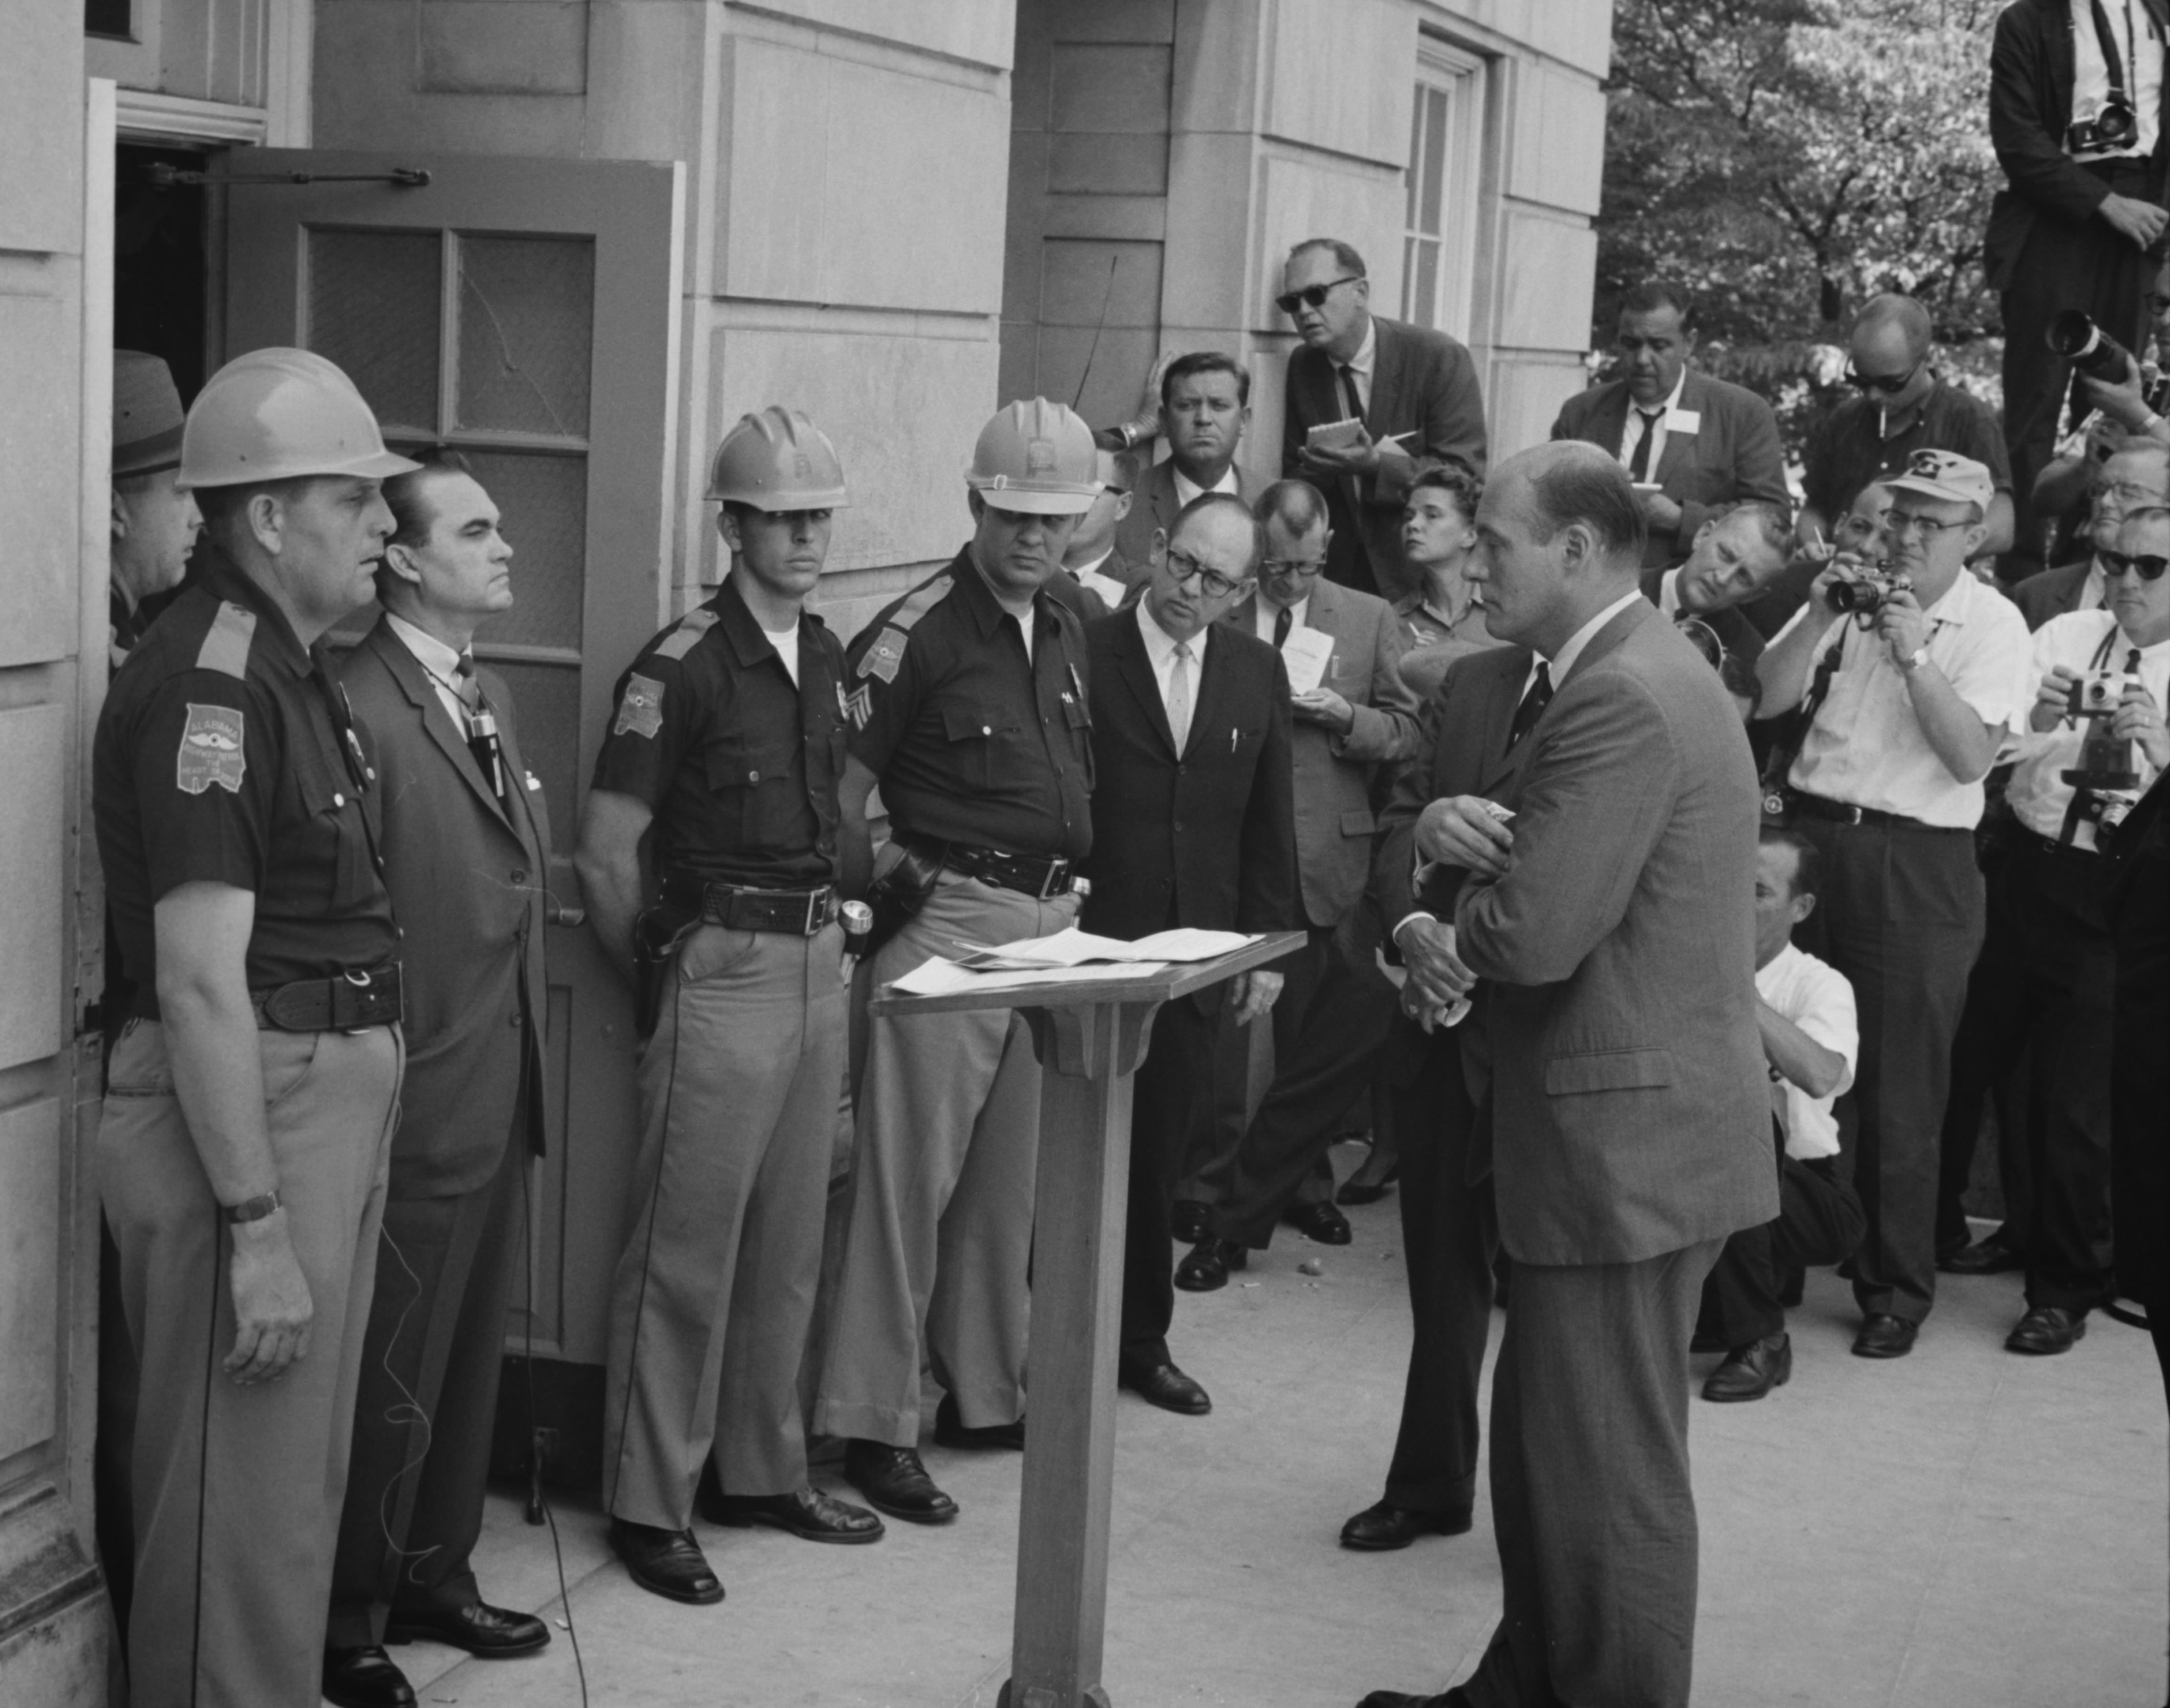
Notes: Civil Rights in the Kennedy / Johnson Eras
Civil Rights Under Kennedy and Johnson
Close election of 1960 forced Kennedy to reach out to minority voters
Used federal troops to protect James Meredith’s right to attend the University of Mississippi
Prevented Alabama governor George Wallace from blocking desegregation at the University of Alabama
Voter Education Project supported registration drives
Executive Order 10925 creates Affirmative Action to protect employment rights
Civil Rights Act of 1964 bans segregation in public facilities
Gives government power to enforce school desegregation
Created the Equal Employment Opportunity Commission to prevent hiring discrimination
24th Amendment bans the poll tax
Congress passes the Voting Rights Act of 1965 to end literacy tests and protect voting rights in the South

Slide 10
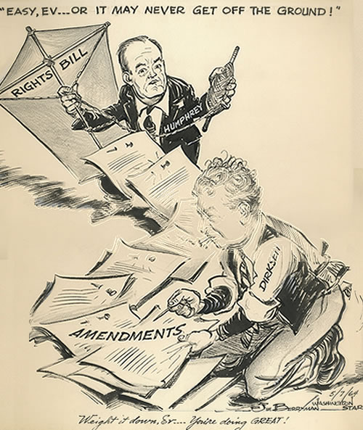
Notes: Civil Rights in the Kennedy / Johnson Eras

Slide 11
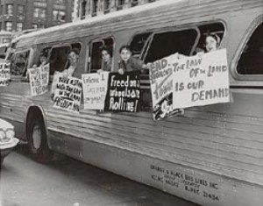
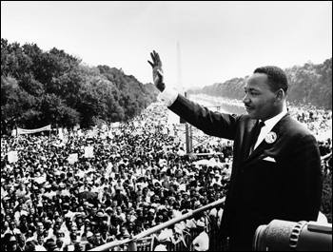
Notes: Civil Rights in the Kennedy / Johnson Eras
The Civil Rights Movement
Freedom Summer attempts to register as many black voters as possible (June, 1964)
Activists and Freedom Riders are met with violence
Mississippi Freedom Democratic Party challenged white-only status of Democratic Party
Martin Luther King Jr. remains committed to Non-Violent Direct Action
“Letter from a Birmingham Jail” argues his arrest was unjust
Convinced Kennedy to support a tougher Civil Rights bill
MLK leads March on Washington in August, 1963 in support bill
Delivers “I Have a Dream” speech
March to Montgomery is met with violence in Selma (1965)
Many African Americans question MLK’s non-violent methods

Slide 12
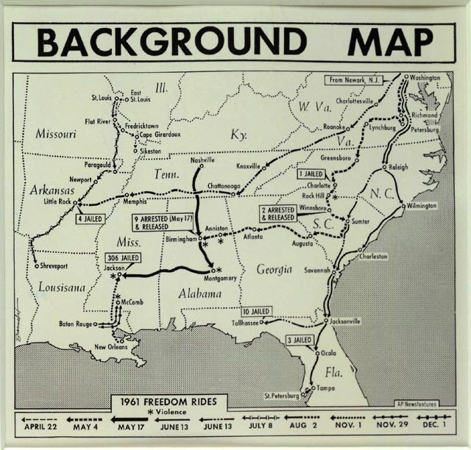
Notes: Civil Rights in the Kennedy / Johnson Eras

Slide 13
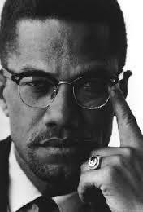
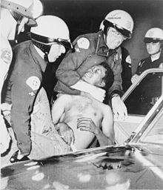
Notes: Civil Rights in the Kennedy / Johnson Eras
Malcolm X Transforms the Civil Rights Movement
Joins the Black Muslims and advocated self-defense
Killed by black opponents after he created the conciliatory Organization of Afro-American Unity
Stokely Carmichael, leader of SNCC, influenced by Malcolm X
Rejects non-violence
Advocates “black power” and nationalism
Black Panther Party formed to advocate self rule for African Americans (1966)
Blamed for L.A. Riots (1965) but Kerner Commission finds segregation was the cause
MLK’s assassination in 1968 sparks riots in 168 cities

Slide 14
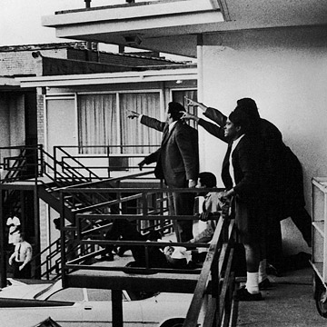
Notes: Civil Rights in the Kennedy / Johnson Eras

Slide 15
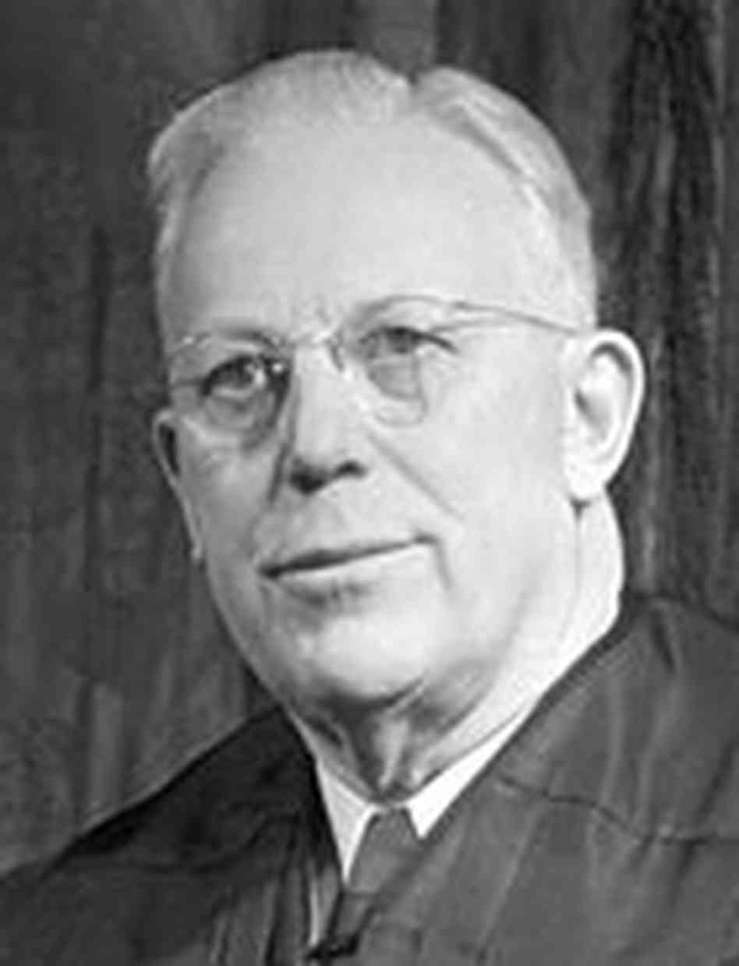
Notes: Civil Rights in the Kennedy / Johnson Eras
The Warren Court and Civil Rights
Supreme Court Chief Justice Earl Warren shifted focus from property rights to individual rights
Pushed through sweeping Civil Rights reforms
Impact compared to John Marshall
Focused on issues of criminal justice, reapportionment, civil rights, and freedom of expression and privacy

Slide 16
Independent Work: Civil Rights
Steps:
Go to mrvandsburger.weebly.com
Download the files:
Kennedy and Johnson Domestic Actions Assignment
Martin Luther King “I Have a Dream Speech”
Interview with Malcolm X
MLK and Malcolm X Questions
Email to Mr. Vandsburger when you are finished.
Homework:
Literal and Analytical Notes p. 979 – 990
Save Power Point as “Your Name Lesson 2” and email to Mr. Vandsburger (will count as class work grade)
Finish Lesson 2 Assignments by Sunday at 8 pm

