Slide 1
Unit 11 – The Sixties and Seventies
Lesson 1 – Kennedy’s Policies
4/3/13

Slide 2
Unit 11 Lesson 1: 4/3/13
Warm-Up:
(1) Download this Power Point from mrvandsburger.weebly.com
(2) Use the map below to answer the questions in the “Click to Add Notes” section
Notes:
Based on the map how did the Electoral College impact the results of the Presidential Election of 1960?
What major issues would likely have been the focus of the election of 1960?
Was the third party candidate influential in the results of this election? Why or why not?

Slide 3
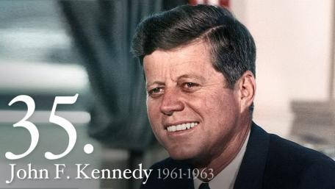
Objective
Unit 11 Lesson 1. SWBAT judge the extent to which Kennedy’s foreign policies were successful in promoting peaceful coexistence between the United States and the Soviet Union.

Slide 4
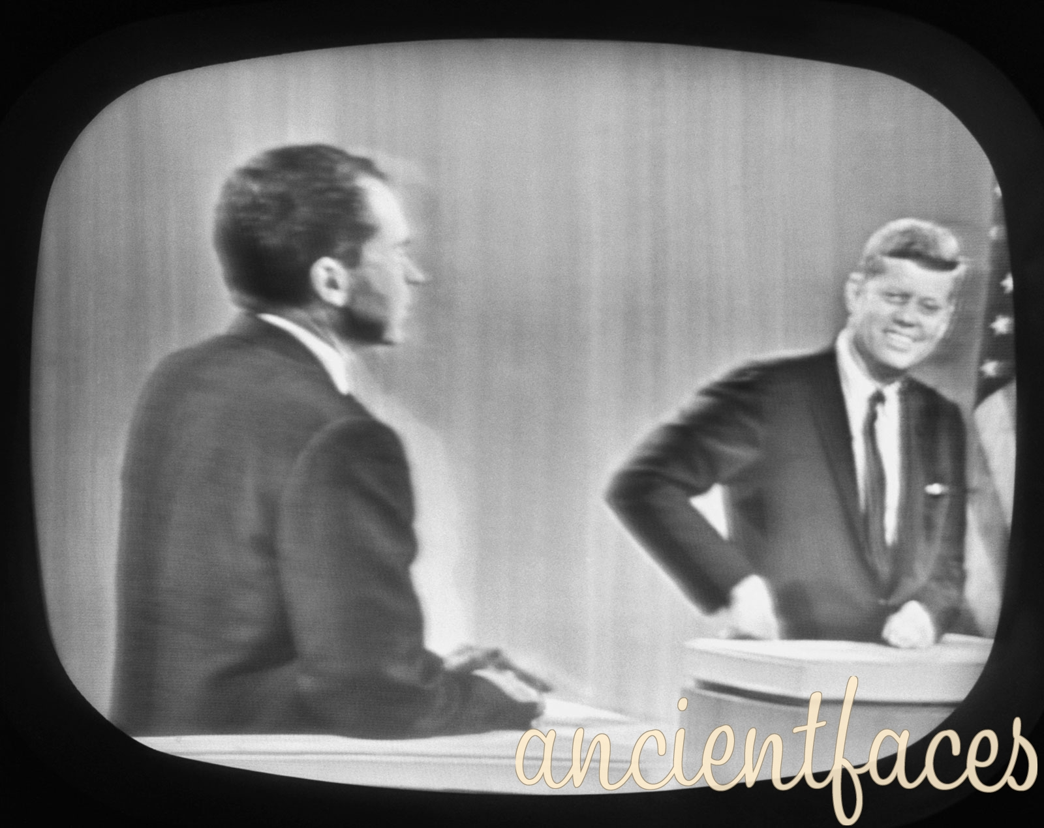
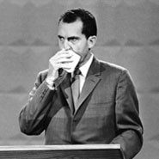
Notes: Kennedy’s Policies
Election of 1960
Republicans nominate Richard Nixon
Served 8 years as Eisenhower’s VP
Stood up to Khrushchev in the Kitchen Debate
Kennedy nominated as Democratic candidate
Lyndon B. Johnson chosen as VP candidate to help carry Southern states
Struggled in South due to Catholic beliefs
Called “balancing the ticket”
Campaign involved first televised debates
Kennedy appeared comfortable, Nixon looked ill
Kennedy uses Sputnik as proof that Eisenhower let the Soviets take lead in the Cold War
Kennedy wins in one of the closest races in US history
Decided by less than 100,000 votes

Slide 5
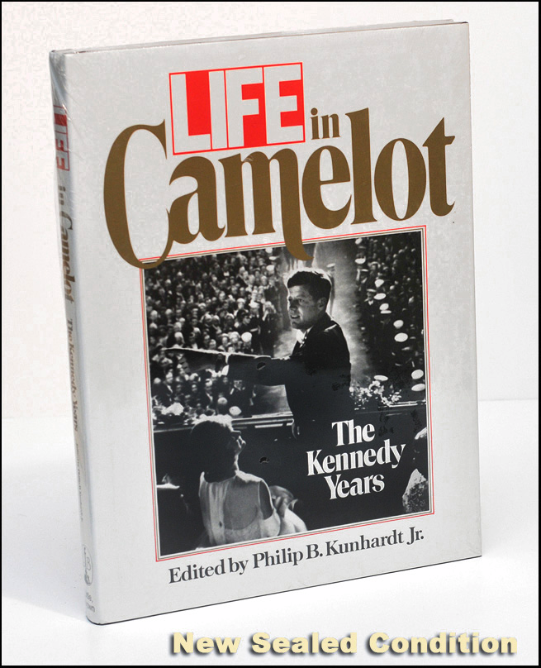
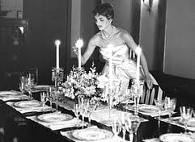
Notes: Kennedy’s Policies
Kennedy’s Domestic Policies
Promises to lead young generation of Americans into a New Frontier
Kennedy is youngest President at 43
Media likens Kennedy’s administration to the court of Camelot
Wife Jacqueline “Jackie” Kennedy opens White House to Americans
Brother Robert Kennedy nominated as Attorney General
New Frontier Programs supported education, health care, urban renewal, and civil rights
Delayed in Congress, most passed under Johnson
Opposed price increases in steel industry
Stimulated the economy through defense spending and space program
Promised to land on the moon by the end of the decade
Apollo Program succeeds in 1969

Slide 6
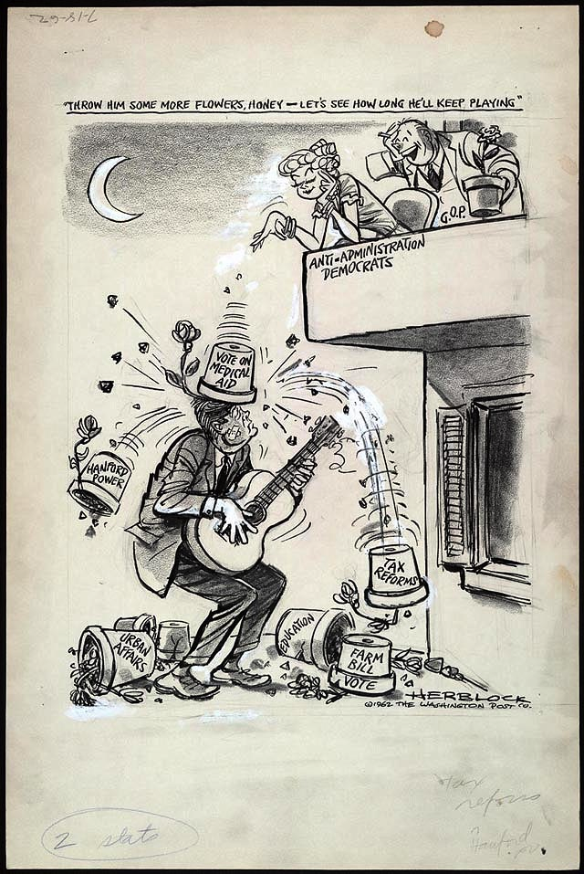
Notes: Kennedy’s Policies

Slide 7
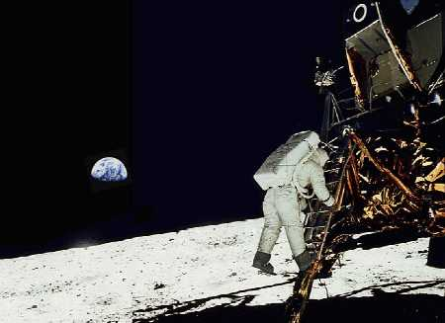
Notes: Kennedy’s Policies

Slide 8
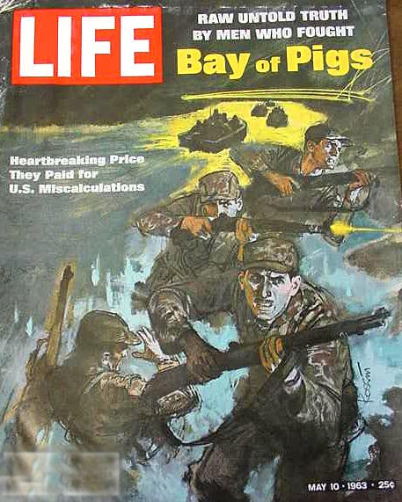
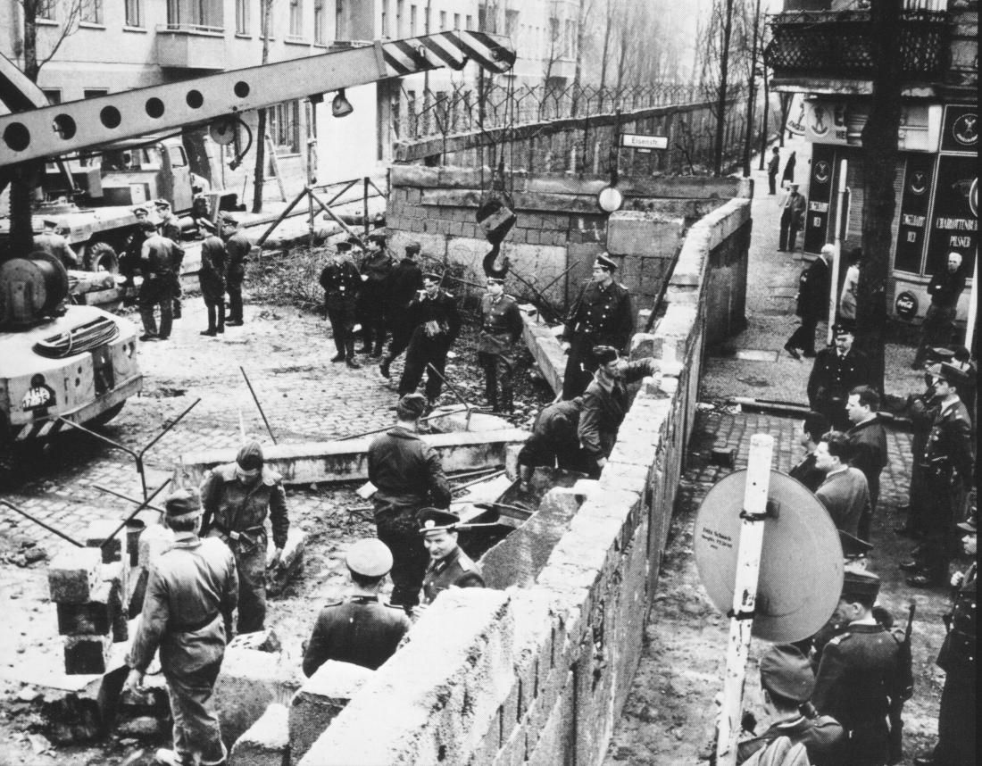
Notes: Kennedy’s Policies
Kennedy’s Foreign Policies
Founds the Peace Corps to allow young Americans to help develop the Third World
Alliance For Progress formed to promote development in Latin America
Trade Expansion Act (1962) reduced tariffs placed on members of the European Economic Community (EEC)
Commits major blunder with Bay of Pigs Invasion (1961)
Planned to use Cuban exiles to overthrow Castro
Failed miserably and used by Castro to strengthen support
Kennedy meets with Khrushchev who demands American withdrawal from Berlin
USSR builds Berlin Wall to keep East Germans from fleeing to West Germany
Kennedy delivers “Ich Bin Ein Berliner” Speech in response
Soviet backed conflicts in Southeast Asia and Africa known as “Brushfire Wars”
Secretary of Defense Robert McNamara develops Flexible Response to focus on conventional forces

Slide 9
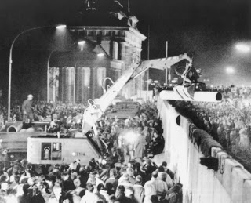
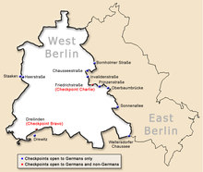
Notes: Kennedy’s Policies

Slide 10
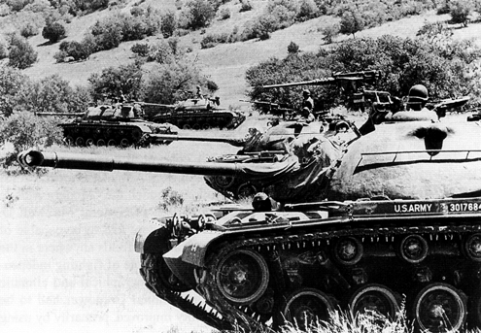
Notes: Kennedy’s Policies

Slide 11
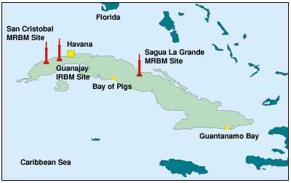
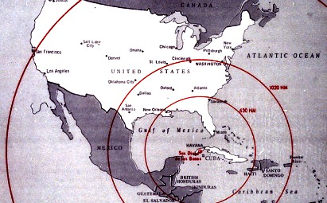
Notes: Kennedy’s Policies
Cuban Missile Crisis (October, 1962)
US spy planes discover Soviet missiles in Cuba
Kennedy orders a blockade until missiles are removed
Soviet challenge to blockade would cause nuclear war
Khrushchev agrees to remove missiles
Results
Direct link established between Washington and Moscow
Both nations sign Nuclear Test Ban Treaty (1963)
Offset by new round of Arms Race testing

Slide 12
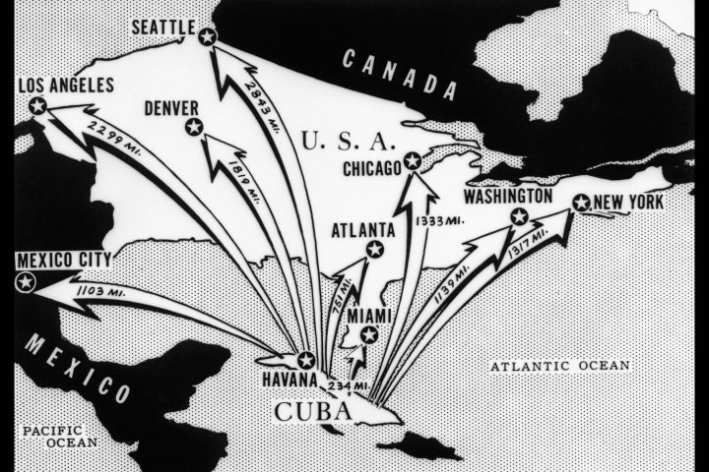
Notes: Kennedy’s Policies

Slide 13
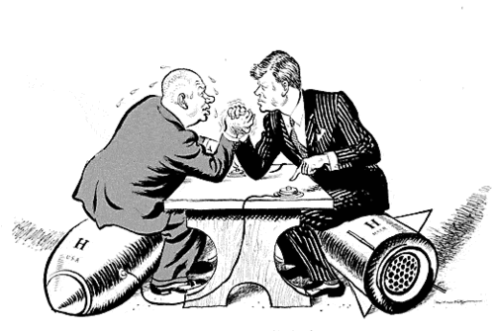
Notes: Kennedy’s Policies

Slide 14
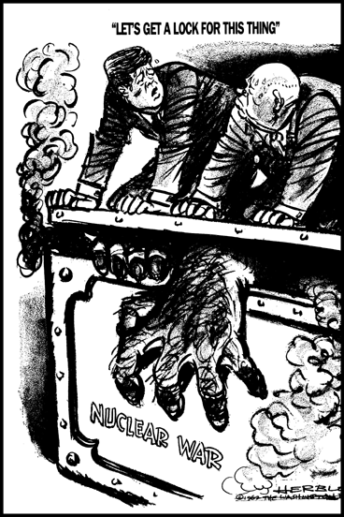
Notes: Kennedy’s Policies

Slide 15
Independent Work: Cuban Missile Crisis Assignment
Steps:
Go to mrvandsburger.weebly.com
Download both the “Cuban Missile Crisis Assignment” and “Cuban Missile Crisis Documents” files
Use the documents from the PDF to complete the Assignment
Email to Mr. Vandsburger when you are finished.
Homework:
Literal and Analytical Notes p. 972 – 979
Save Power Point as “Your Name Lesson 1” and email to Mr. Vandsburger (will count as class work grade)
Finish Cuban Missile Crisis Assignment by Friday

