Slide 1
Unit 10 – Truman and Eisenhower: 1945 - 1960
Lesson 6 – Fighting for the Third World
3/20/13

Slide 2
Unit 10 Lesson 6: 3/20/13
Warm-Up:
(1) Download this Power Point from mrvandsburger.weebly.com
(2) Send answers to MC Quiz by email by 11:12

Slide 3
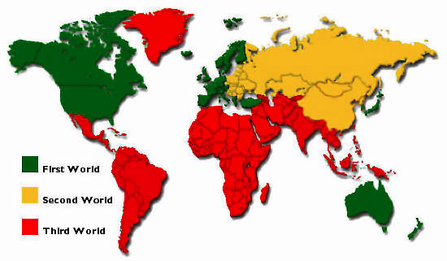
Objective
6. SWBAT analyze the results of American Cold War policies on nations in the Third World.

Slide 4
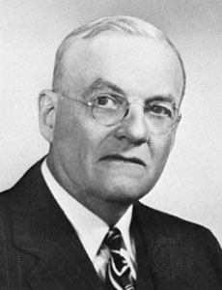
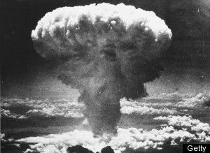
Notes: Fighting for the Third World
I. Superpower Rivalry
Eisenhower’s Secretary of State John Foster Dulles continues containment policy
Calls it Liberation to sound more intimidating
Promises “Massive Retaliation” to describe nuclear attack America would launch if Soviet aggression increased
Promoted Deterrence – Soviet fear of destruction prevents their challenging the US
Both nations seek to avoid Mutually Assured Destruction
Allows conflict to escalate toward war using Brinkmanship strategy
Calls it a “policy of boldness”
Reflects Eisenhower’s “New Look” Policy in emphasizing effective weapons

Slide 5
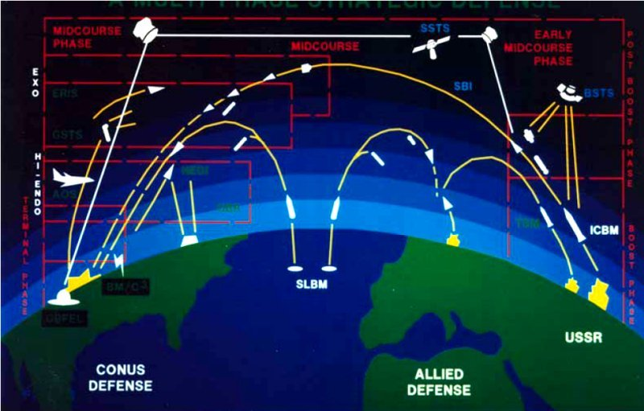
Notes: Fighting for the Third World

Slide 6
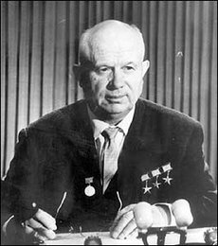
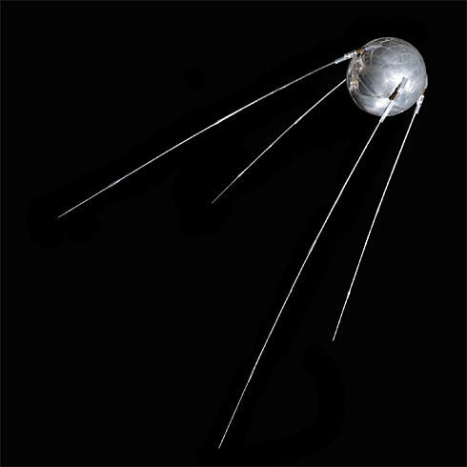
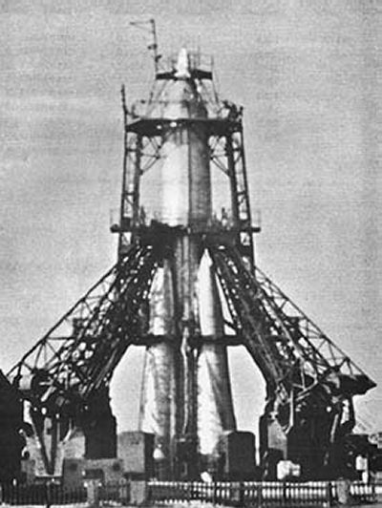
Notes: Fighting for the Third World
Stalin replaced by Nikita Khrushchev
Initially calls for “peaceful coexistence” then resumes icy relations
USSR successfully develops hydrogen bomb
Soviet satellite Sputnik launched into space (1957)
US funds National Aeronautics and Space Administration (NASA) in response

Slide 7
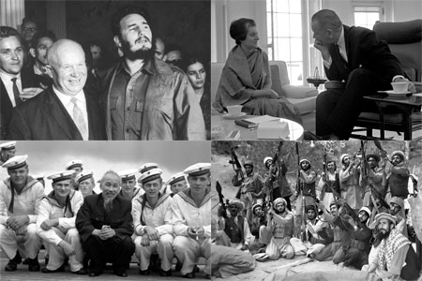
Notes: Fighting for the Third World
II. Fighting for the Third World
Eisenhower fears the Domino Theory
If communism spread to South Vietnam surrounding nations would fall
Former European colonies side with neither US or USSR
Called the Third World
US and USSR hope to gain access to markets and resources in third world
Initially prevented by sweeping nationalism
Third World becomes focus of Cold War “Proxy Wars”
US uses CIA Covert Operations to influence newspapers, politicians, and businesses around the world.

Slide 8
Independent Work: Third World “Proxy Wars” Power Point
Steps:
Go to mrvandsburger.weebly.com
Download the “Proxy War Power Point” assignment
Research your assigned conflict and create your 6-slide power point
Homework:
Literal and Analytical Notes p. 958 – 969
Save Power Point as “Your Name Lesson 6” and email to Mr. Vandsburger (will count as class work grade)

