Slide 1
Unit 10 – Truman and Eisenhower: 1945 - 1960
Lesson 5 – Eisenhower’s Domestic Policies
3/18/13

Slide 2
Unit 10 Lesson 5: 3/18/13
Warm-Up:
(1) Download this Power Point from mrvandsburger.weebly.com
(2) Respond to the prompt in the section “Click to Add Notes”
Prompt: What were 3 methods used to enforce segregation in the South (can be legal or non-legal methods)? How did segregation impact the political, social, and economic lives of African Americans living in the South?

Slide 3
Objective
5. SWBAT compare Eisenhower’s domestic policies with those of Truman.

Slide 4
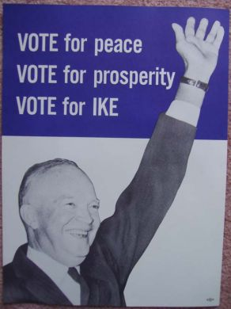
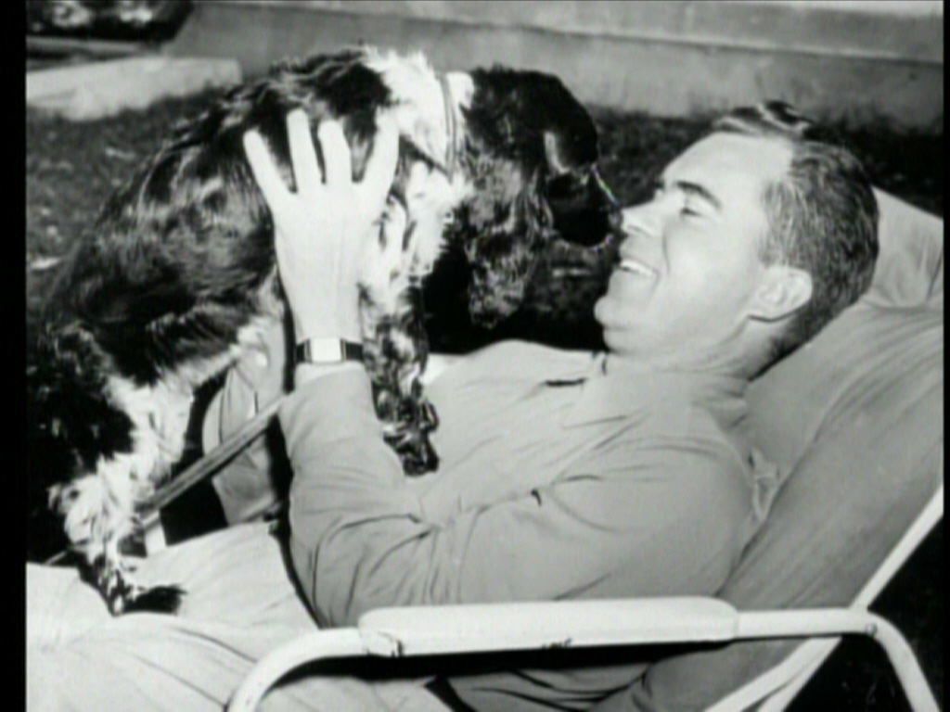
Notes: Eisenhower’s Domestic Policies
I. Eisenhower’s Domestic Politics
Republican’s nominate Dwight D. Eisenhower in Election of 1956
Popularity as war hero and rising “conservatism” support “Ike”
Selects Richard Nixon as VP running mate
Avoids being removed from the ticket after televised “Checkers Speech”
Sets precedent for emotional appeals by the President
Truman divided Democratic party
Easily defeats Adlai Stevenson
US economy continues to thrive
G.I. Bill resulted in stable consumerism

Slide 5
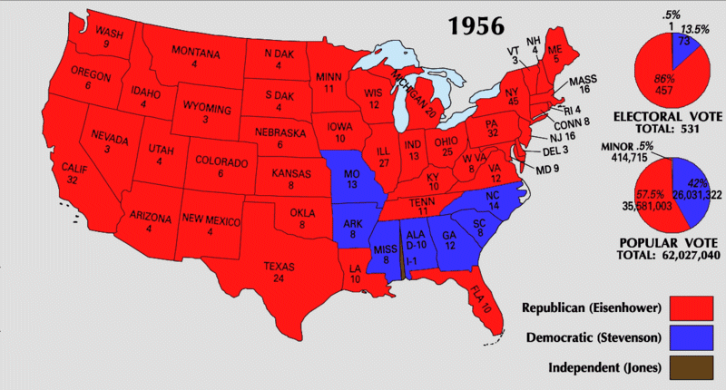
Notes: Eisenhower’s Domestic Policies

Slide 6
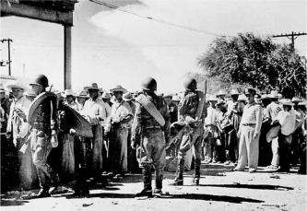
Notes: Eisenhower’s Domestic Policies
Develops the “New Look Army” by reducing troops but increasing powerful weapons
Fails to reduce deficit spending
Federal Highway Act of 1956 begins creation of the Interstate Highway System
Intended for military use in case of Soviet attack
Served tourists, businesses, and suburbs
Policy of Termination – Eliminating reservations and support of Natives subjecting them to state laws, is largely a failure
Immigration and Naturalization Service conducts Operation Wetback to try and remove illegal immigrants from Southwestern United States

Slide 7
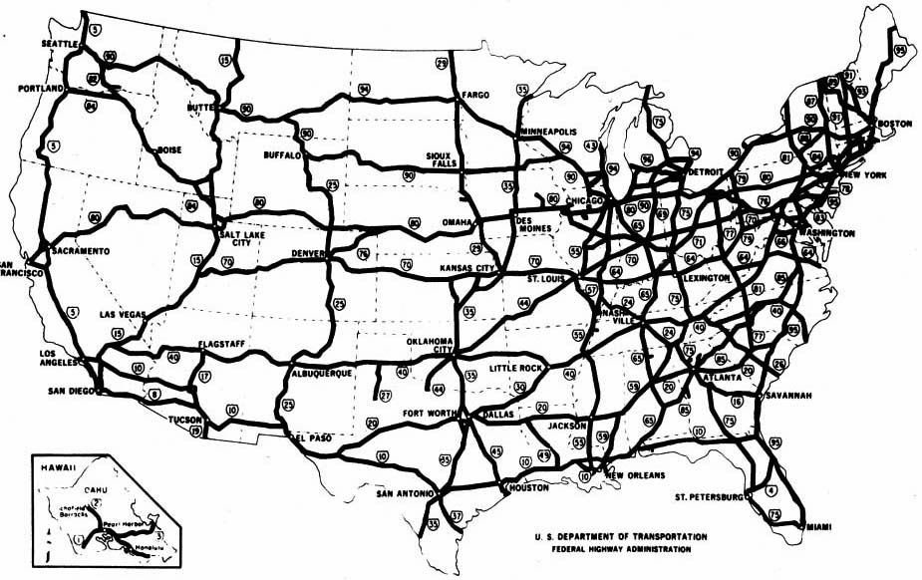
Notes: Eisenhower’s Domestic Policies

Slide 8
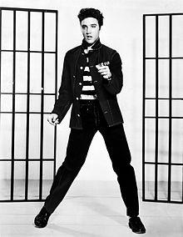
Notes: Eisenhower’s Domestic Policies
II. Social Trends of the Eisenhower Era
1950’s thought of as era of social conformity and a consensus of values
Challenges to “consensus”
Betty Friedan writes the Feminine Mystique to display the growing discontent of housewives in America
Sparks second wave of America’s feminist movement
Rock ‘n’ Roll transforms music
Elvis Presley, Little Richard, Chuck Berry
The Beat Generation of writers use literature as a form of social criticism
Jack Kerouac writes On the Road
Allen Ginsberg is best known poet, writing “Howl”

Slide 9
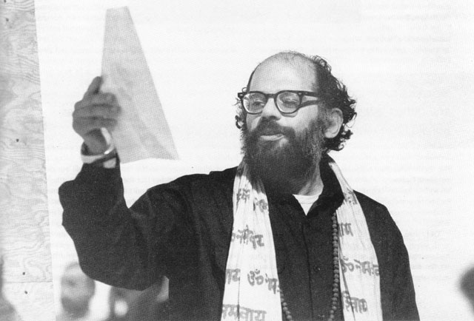
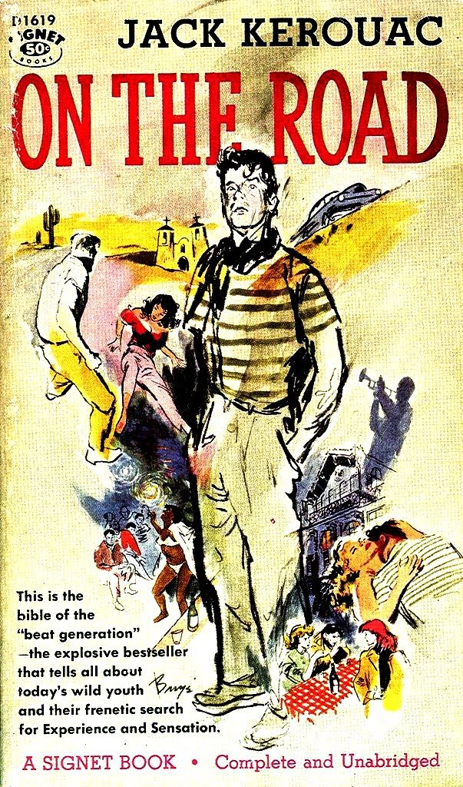
Notes: Eisenhower’s Domestic Policies

Slide 10
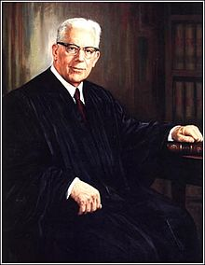
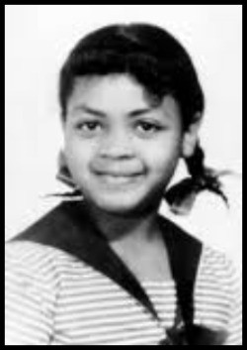
Notes: Eisenhower’s Domestic Policies
III. Developments of the Civil Rights Movement
Sipuel v. Board of Regents of Oklahoma protects right of African Americans to attend universities under “equal protection” clause of 14th amendment
Earl Warren appointed as Chief Justice of the Supreme Court (1953)
Warren Court pushes through sweeping Civil Rights reforms
Supreme Court hears case of Brown v. Board of Education of Topeka (1954)
NAACP challenges segregation in schools
Overturns “separate but equal” standard set by Plessy v. Ferguson
Arkansas Governor Orval Faubus prevents Little Rock Nine from entering schools
Courts order Eisenhower to enforce laws
Sends in national guard troops to force integration

Slide 11
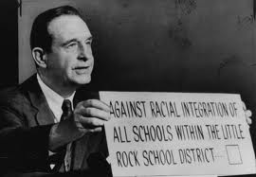
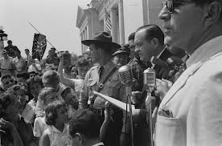
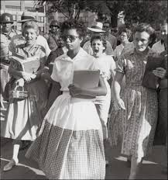
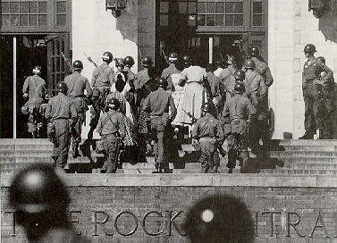
Notes: Eisenhower’s Domestic Policies

Slide 12
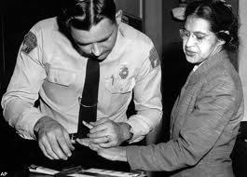
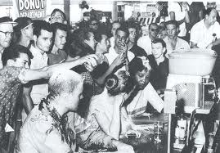
Notes: Eisenhower’s Domestic Policies
Montgomery Bus Boycott (1955) begins when Rosa Parks is arrested for violating “Jim Crow Laws”
Martin Luther King Jr. gains national prominence by organizing boycott
Supreme Court rules in favor of transportation integration
King encourages the organization of the Student Non-Violent Coordinating Committee
Coordinate sit-ins in Greensboro, North Carolina

Slide 13
Independent Work: Brown v. Board Analysis
Steps:
Go to mrvandsburger.weebly.com
Download the “Brown v. Board Analysis”
Email to Mr. Vandsburger when you are finished. Due on Wednesday
Homework:
Literal and Analytical Notes p. 943 – 950
Save Power Point as “Your Name Lesson 5” and email to Mr. Vandsburger (will count as class work grade)

