Slide 1
Unit 10 – Truman and Eisenhower: 1945 - 1960
Lesson 4 – Truman’s Domestic Policies
3/15/13

Slide 2
Unit 10 Lesson 4: 3/15/13
Warm-Up:
(1) Download this Power Point from mrvandsburger.weebly.com
(2) Download the “Korean War and McCarthyism Quiz”
(3) Send an email to tvandsburger@uascriminaljustice.org with your answers
Must be sent by 11:18

Slide 3
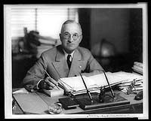
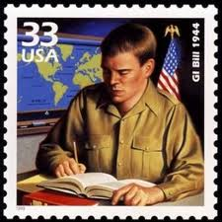
Objective
4. SWBAT evaluate the extent to which the post-World War II period was truly an era of economic success for Americans.

Slide 4
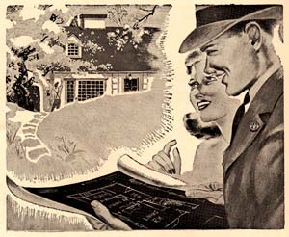
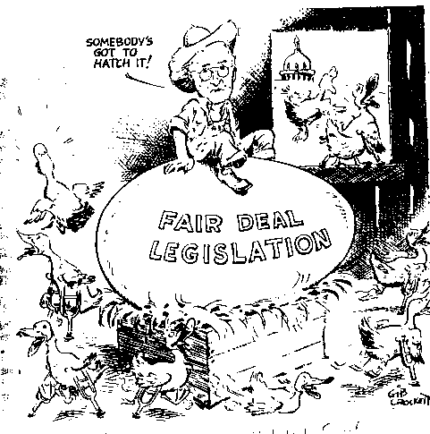
Notes: Truman’s Domestic Policies
Economic Developments of the Truman Era
Servicemen’s Readjustment Act of 1944, known as the GI Bill supports returning WWII veterans
Provides loans for housing, to start businesses, and education
The Fair Deal – Seeks to continue legacy of the New Deal
Looked to counteract rising unemployment after WWII
Mostly rejected by growing conservatism in Congress
Operation Dixie attempts to unionize the South, fails due to Jim Crow Laws
United Mine Workers strike cuts off energy supply to several industries
Truman orders a government Seizure of the Mines
Alienates organized labor

Slide 5
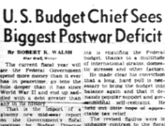
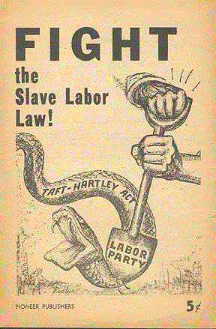
Notes: Truman’s Domestic Policies
Employment Act of 1946 created to prevent return of the Great Depression
Established the Council of Economic Advisors
Sets goals of full employment, full production, and stable prices to combat inflation
1946 Midterm Election results in Republican control of the Eightieth Congress
Congress passes the Taft-Hartley Act prohibited “union only” industries called Closed Shops

Slide 6
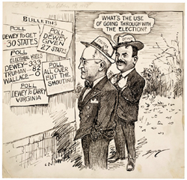
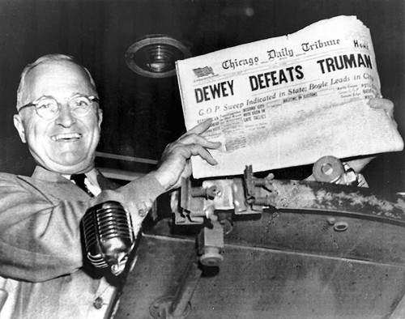
Notes: Truman’s Domestic Policies
Political Developments of the Truman Era
Presidents Committee on Civil Rights called for end to segregation, poll taxes, and enforcement of anti-lynching laws
Truman orders end to racial discrimination in hiring federal employees and desegregation of the military
“Segregationist” democrats known as Dixiecrats abandon Truman
Congress rejects Truman’s Fair Deal promises to increase aid to schools, farmers, the elderly, the disabled, and civil rights
Truman recalls Congress and challenges them to pass their platform
Eightieth Congress fails to pass any of their conservative legislation
Truman soundly defeats John Dewey in Election of 1948
Democrats regain control of Congress

Slide 7
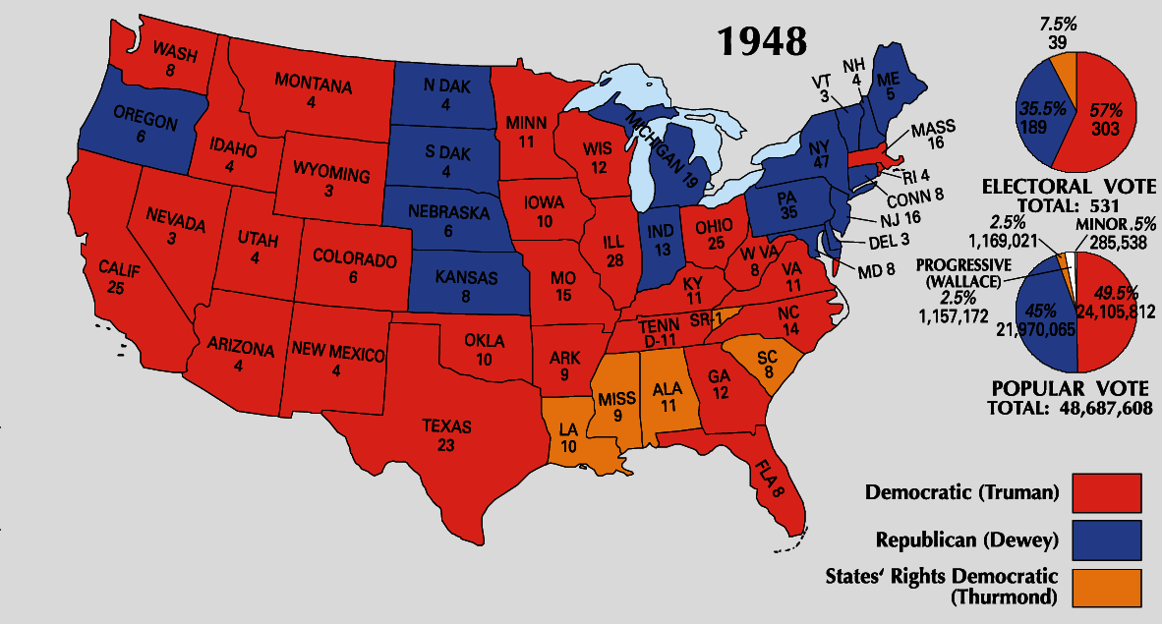
Notes: Truman’s Domestic Policies

Slide 8
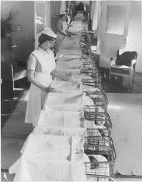
Notes: Truman’s Domestic Policies
Social Developments of the Truman Era
Marriage Rates increase among returning veterans causing the Baby Boom
Raising a family made easier by the GI Bill
Benjamin Spock becomes famous pediatrician publishing parenting guides
Results in Housing Boom, rise in Consumer Demand, and consequently a boom in the Labor Force
Suburban areas such as Levittown develop outside of major cities

Slide 10
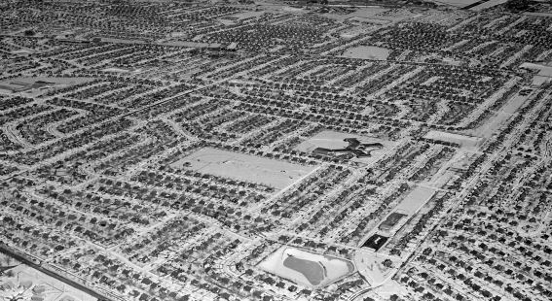
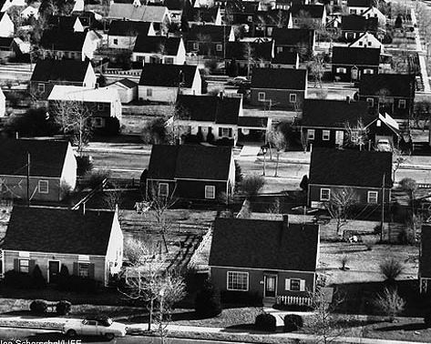
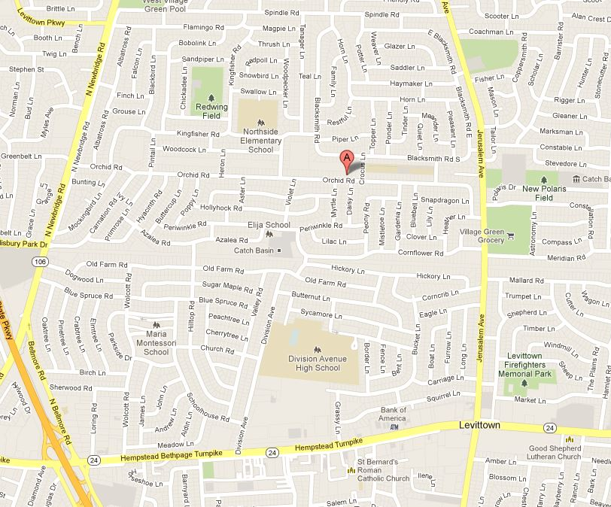
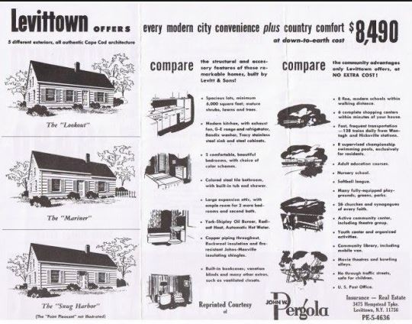

Slide 11
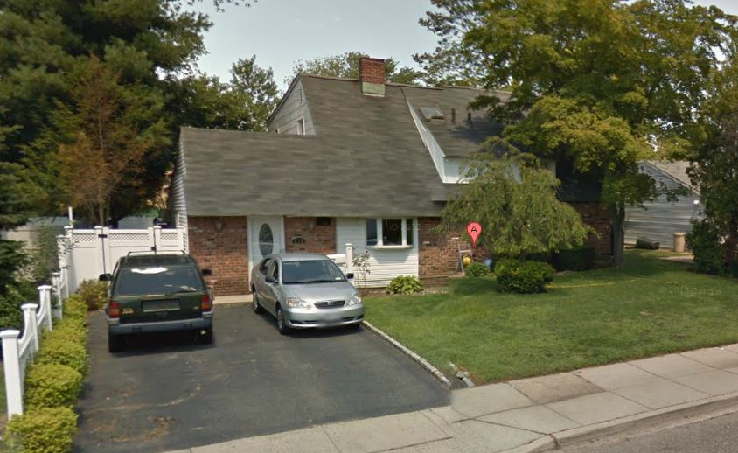
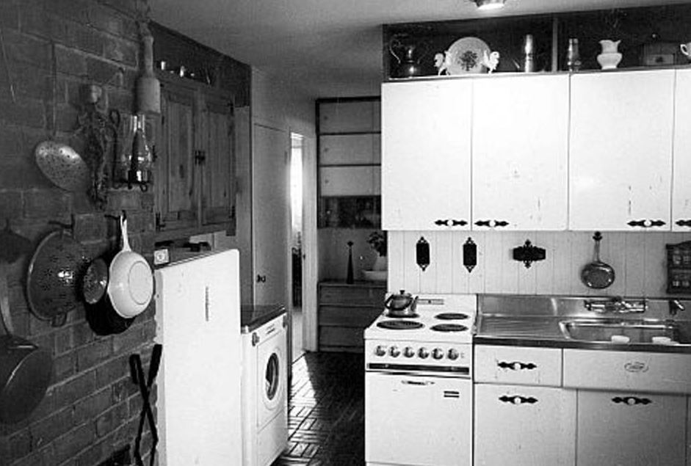
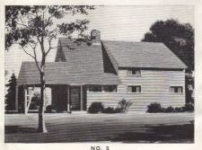
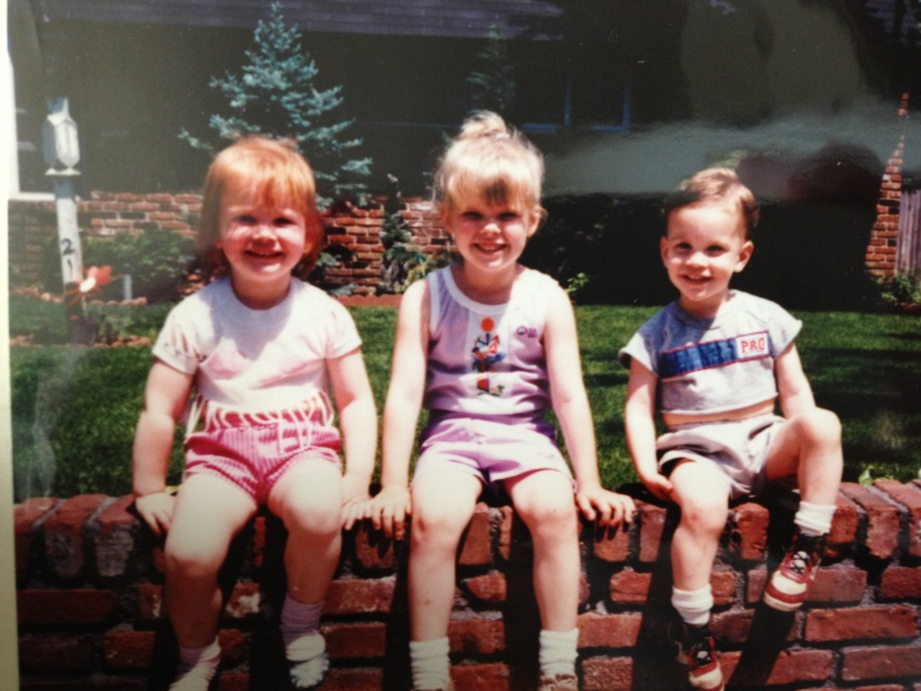

Slide 12
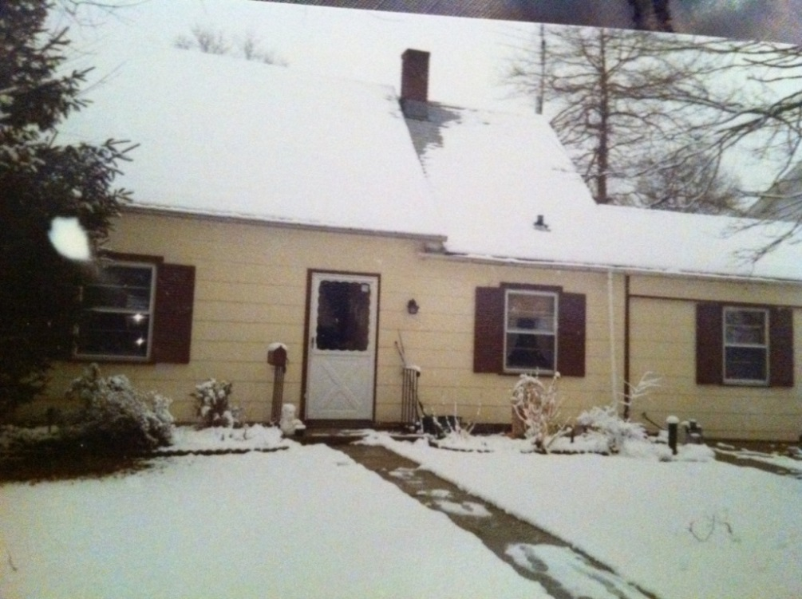
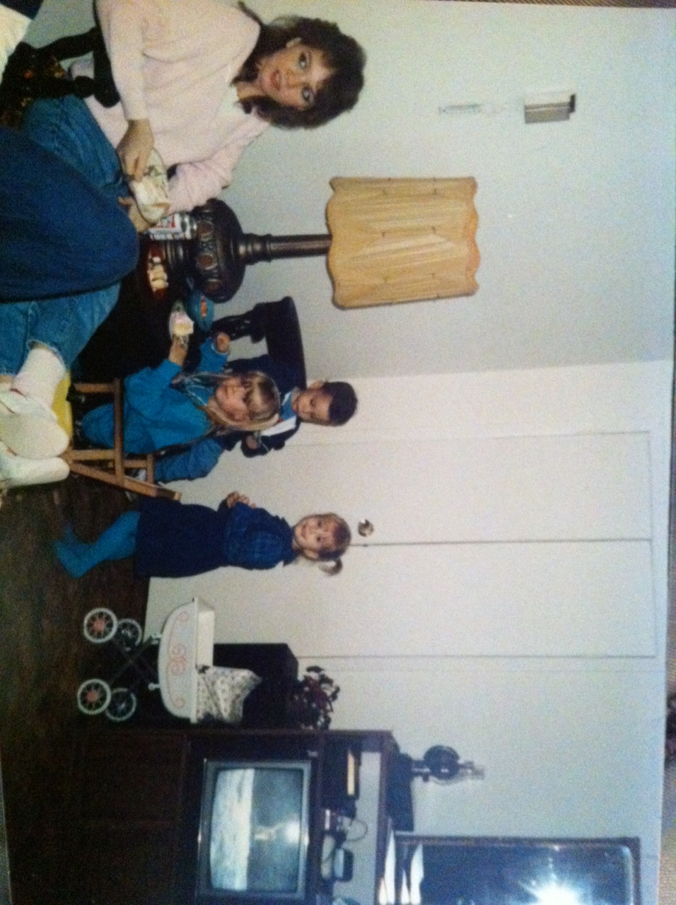
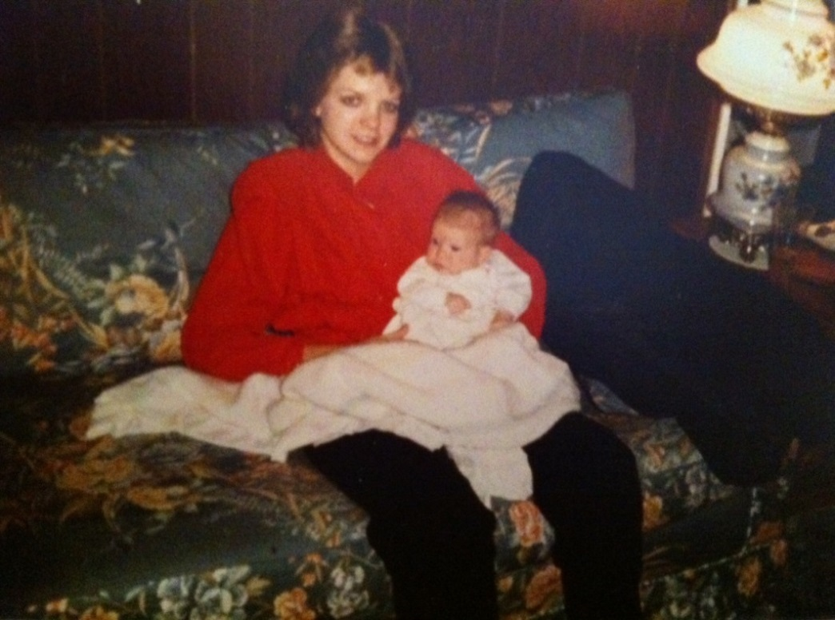

Slide 13
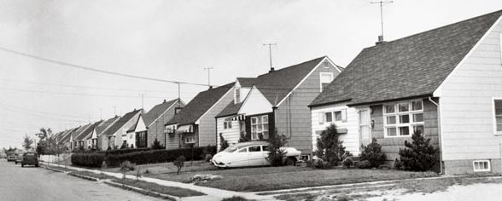
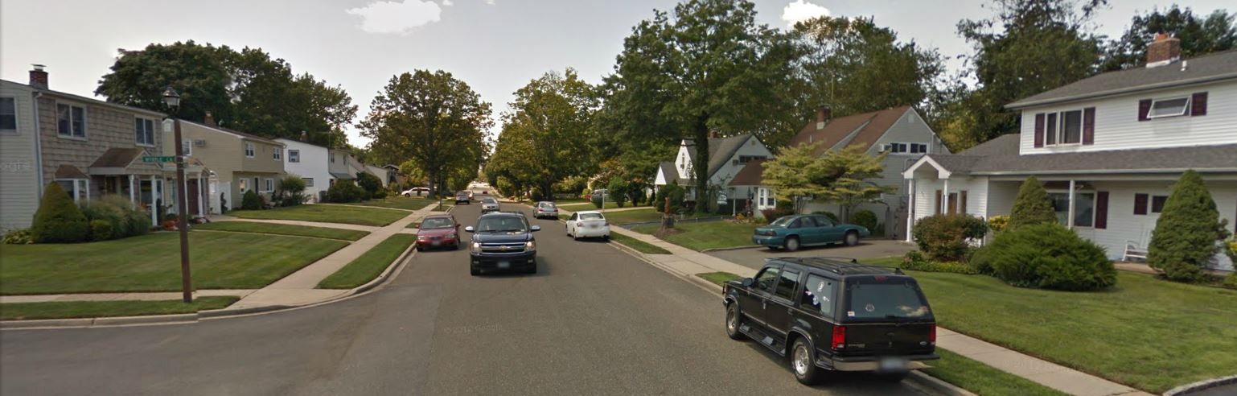

Slide 15
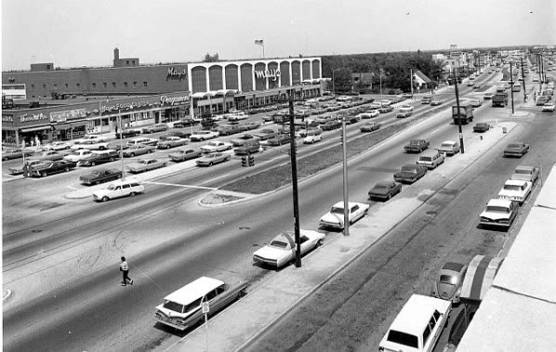
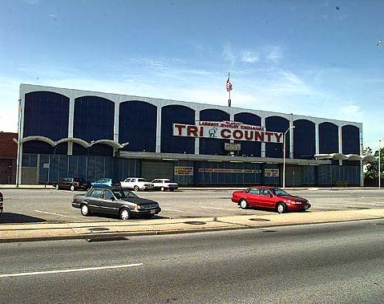
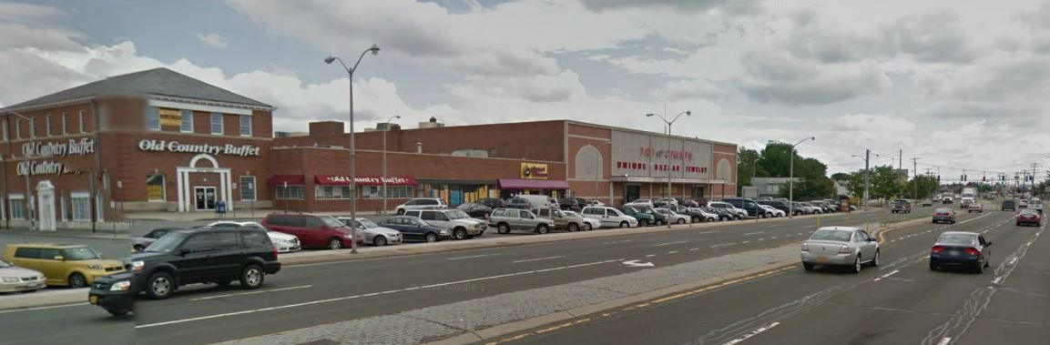
Tri County Flea Market

Slide 16
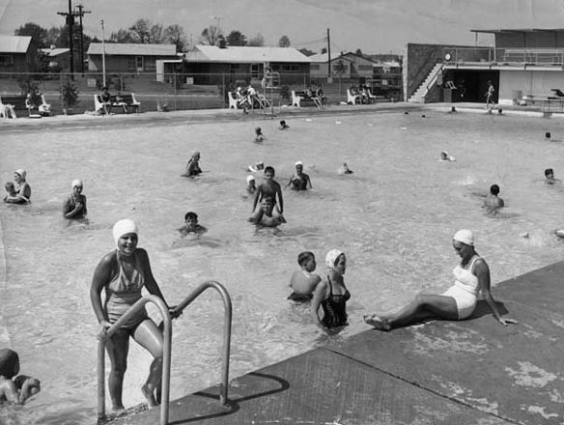
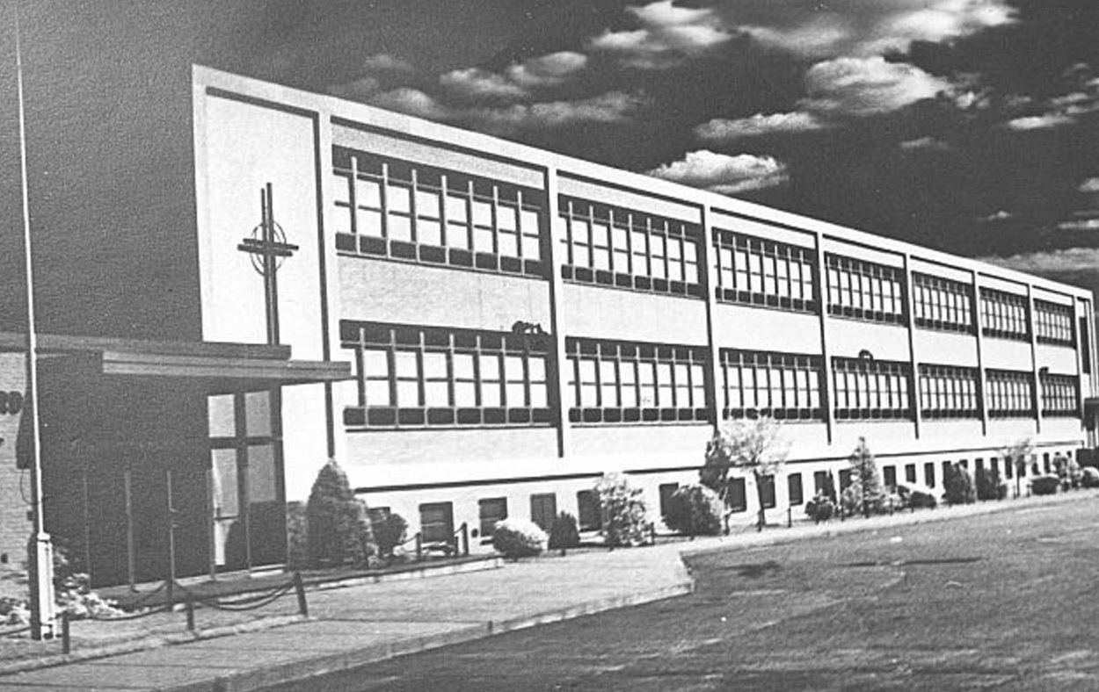
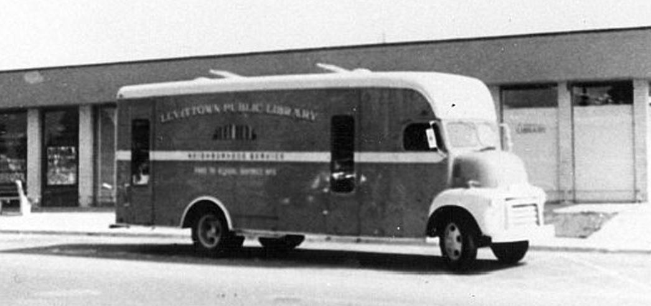

Slide 17
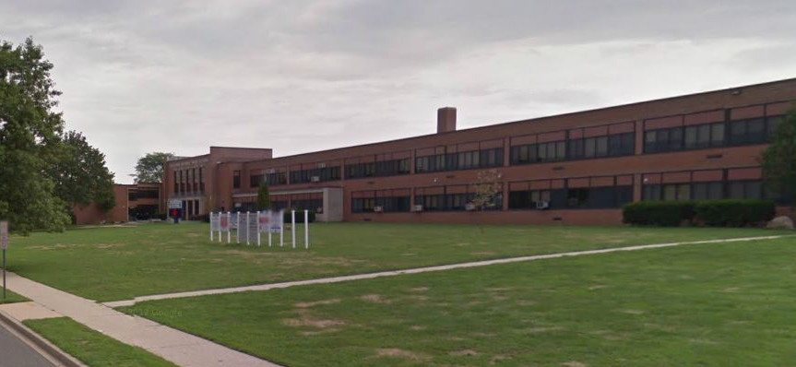
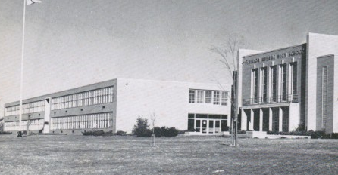
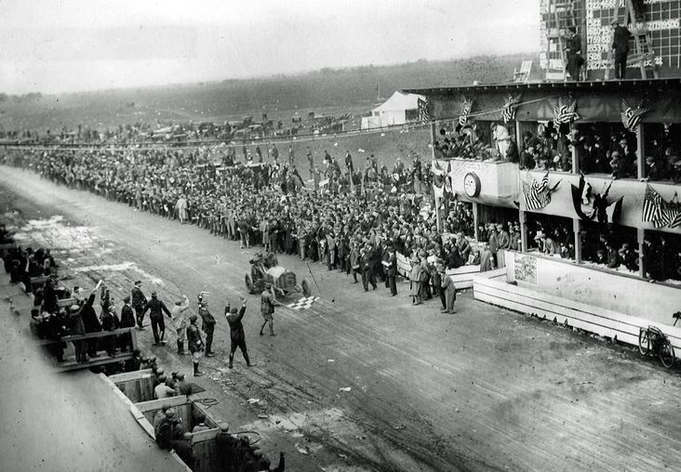
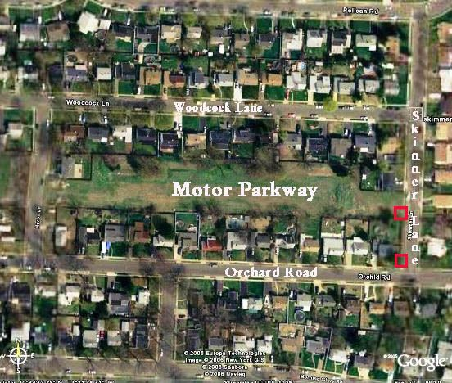
Division Avenue High School
Vanderbilt Raceway

Slide 18
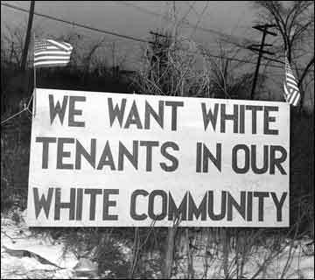
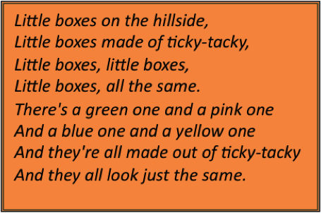
Notes: Truman’s Domestic Policies
Critics described movement of veterans to suburbs as “White Flight”
Escape poor, racially mixed urban areas
Malvina Reynolds describes suburban houses as “Little Boxes”
Commentary similar to critiques of the Lost Generation
Millions move to Sunbelt region for job opportunities, warmer climates, and improved race relations

Slide 19
Notes: Truman’s Domestic Policies

Slide 20
Independent Work: McCarthyism Questions
Steps:
Go to mrvandsburger.weebly.com
Download the “Economic Analysis” Questions and “Literature of the 1950’s”
Use the documents to complete the Economic Analysis and what you recall of each piece of literature (you have read all 3 texts) to complete the Literature of the 1950’s
Email to Mr. Vandsburger when you are finished. Due on Monday
Homework:
Literal and Analytical Notes p. 910 – 920
Save Power Point as “Your Name Lesson 4” and email to Mr. Vandsburger (will count as class work grade)
Economic Analysis and Literature of the 1950’s due on Monday

