Slide 1
Unit 10 – Truman and Eisenhower: 1945 - 1960
Lesson 3 – McCarthyism
3/14/13

Slide 2
Unit 10 Lesson 3: 3/14/13
Warm-Up:
(1) Download this Power Point from mrvandsburger.weebly.com
(2) Go to the site:http://news.bbc.co.uk/onthisday/low/witness/august/7/newsid_2946000/2946420.stm
(3) Respond to the prompt below in your Power Point:
How were writers like Arthur Miller impacted by the actions of the House Un-American Activities Committee? Why do you believe this Committee might have targeted writers?

Slide 3
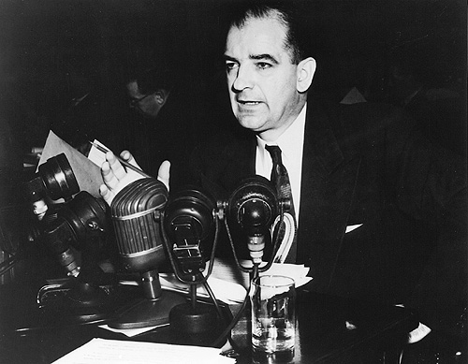
Objective
3. SWBAT analyze the impact of the McCarthy era on political, social, and economic lives of Americans.

Slide 4
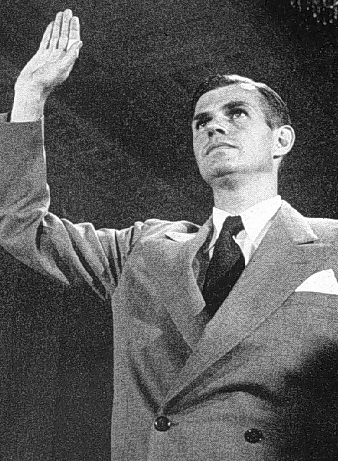
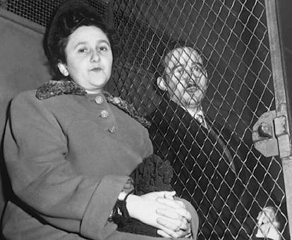
Notes: McCarthyism
McCarthyism and a Climate of Fear
Cold War conflict brings back anti-communist paranoia
Similar to Red Scare after WWI
Truman orders search of “security risks”
Former State Department official Alger Hiss found guilt of working with a communist spy
Julius and Ethel Rosenberg are executed for passing Atomic secrets to Soviets

Slide 5
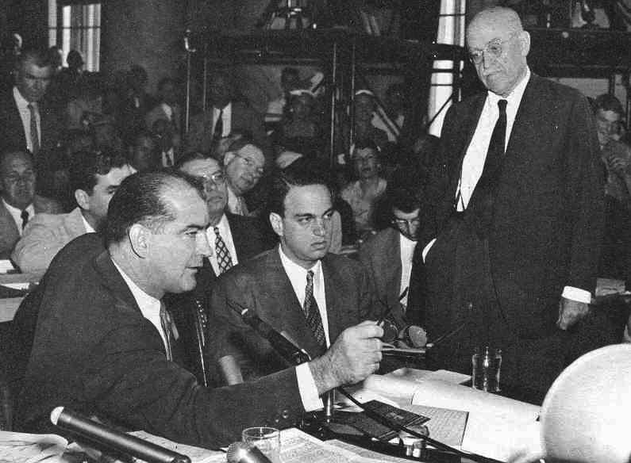
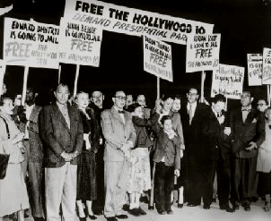
Notes: McCarthyism
McCarthyism and a Climate of Fear
Senator Joseph McCarthy leads campaign to uncover “200 known communists” in the State Department
Organizes the House Un-American Activities Committee
Holds McCarthy Hearings placing officials, teachers, entertainers, writers, and actors on trial
Does not uncover a single communist
Those on trial are placed on blacklists
Hollywood Ten banned from making films
McCarthy accuses the Army of harboring communists
Army McCarthy Hearings make McCarthy look foolish
Edward R. Murrow helps expose lies behind charges

Slide 6
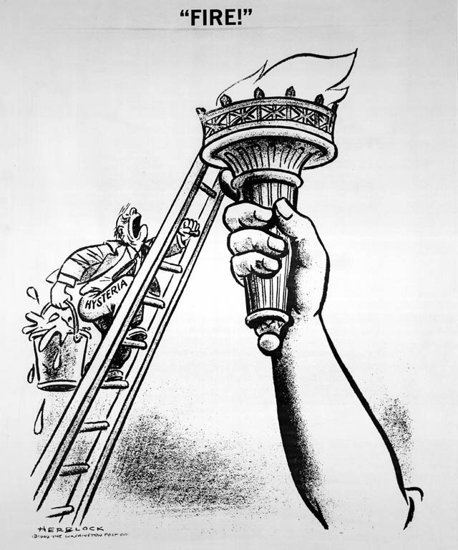
Notes: McCarthyism

Slide 7
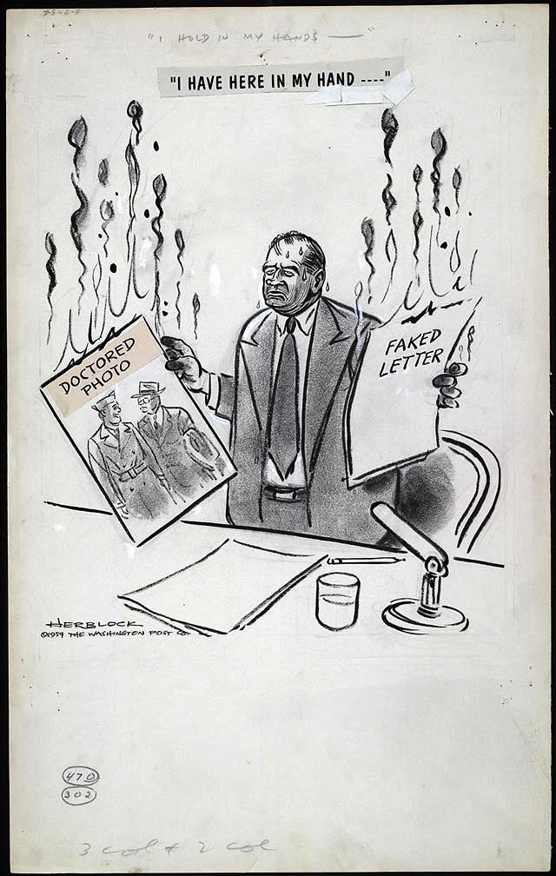
Notes: McCarthyism

Slide 8
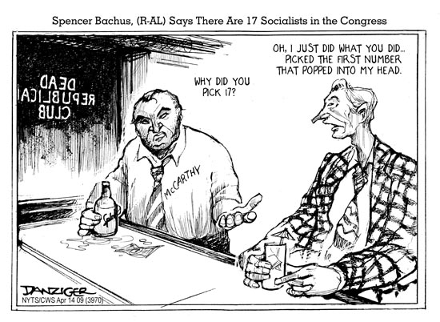
Notes: McCarthyism

Slide 9
Independent Work: McCarthyism Questions
Steps:
Go to mrvandsburger.weebly.com
Download the “McCarthyism” Questions
Use your American Nation text and internet research to answer the Literal Questions, and your own analysis to respond to the Critical Thinking Questions
Email to Mr. Vandsburger when you are finished.
Homework:
Literal and Analytical Notes p. 934 – 937, 950 – 951
Save Power Point as “Your Name Lesson 3” and email to Mr. Vandsburger (will count as class work grade)
Finish McCarthyism Questions due Tomorrow
Finish Cold War Web Quest by Friday

