Slide 1
Unit 10 – Truman and Eisenhower: 1945 - 1960
Lesson 2 – International Developments in the Cold War
3/13/13

Slide 2
Unit 10 Lesson 2: 3/13/13
Warm-Up:
(1) Download this Power Point from mrvandsburger.weebly.com
(2) Download the “Truman’s Foreign Policy Practice Questions”
(3) Send an email to tvandsburger@uascriminaljustice.org with your answers
Must be sent by 11:08

Slide 3
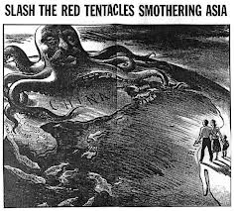
Objective
2. SWBAT judge whether America’s involvement in early Cold War conflicts were justified.

Slide 4
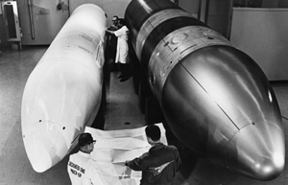
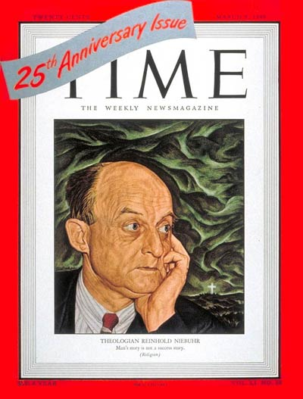
Notes: International Developments in the Cold War
American Involvement in International Conflicts
USA and USSR never directly fight each other
Participate in Proxy Wars instead
USSR supports pro-Communist revolutions
US defends pro-democracy governments
Reinhold Niebuhr cultivates popular religious and philosophical support for anti-communist efforts

Slide 5
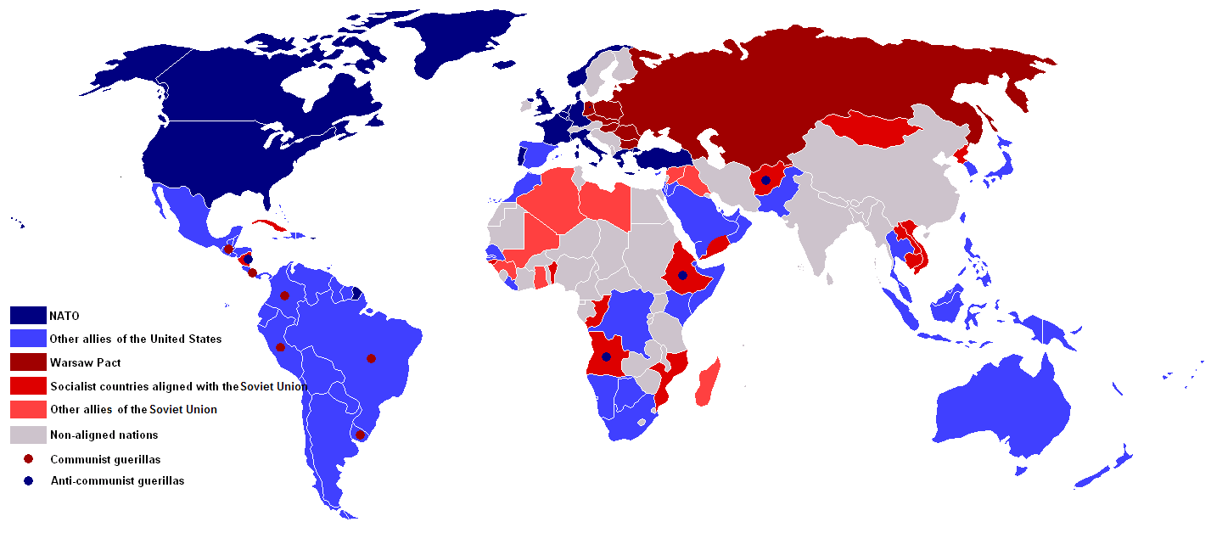
Notes: International Developments in the Cold War

Slide 6
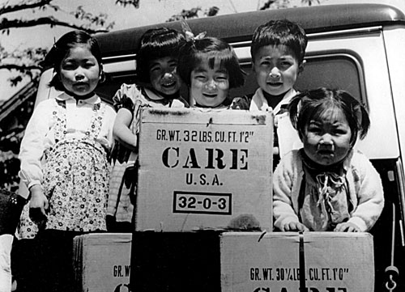
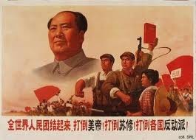
Notes: International Developments in the Cold War
II. Involvement in Asia
US assumes control of the reconstruction of Japan
General Douglas MacArthur leads the creation of a democratic constitution, demilitarization, and economic recovery
Chinese Revolution results in victory for Mao Zedong and rise of communist system
US supported Chiang Kai-Shek (sometimes called Jiang Jieshi)
Shek and Nationalist government is exiled to Taiwan
Truman supports French against Vietnamese in first war for independence

Slide 7
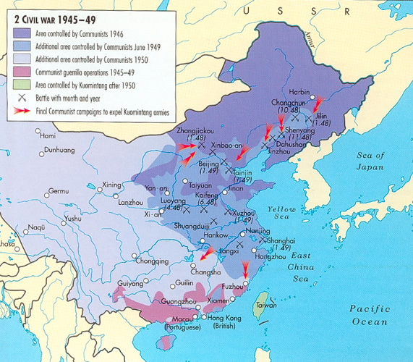
Notes: International Developments in the Cold War

Slide 8
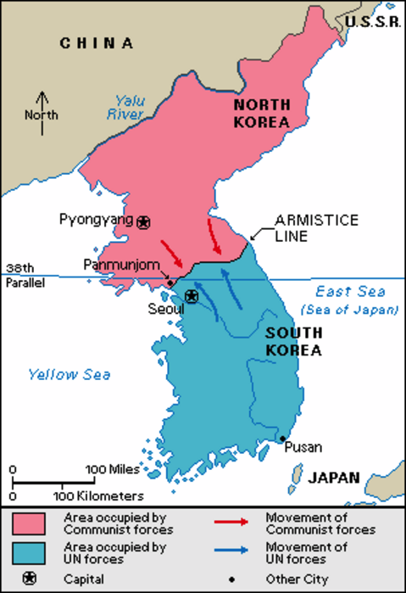
Notes: International Developments in the Cold War
III. The Korean War
Post-WWII division of Korea
USSR assumes control of North, USA controls South
Divided at 38th Parallel
Communist North invades South Korea
American troops repel invasion with support from United Nations
China is provoked into supporting North Korea
Pushes American and South Korean troops back to 38th Parallel

Slide 9
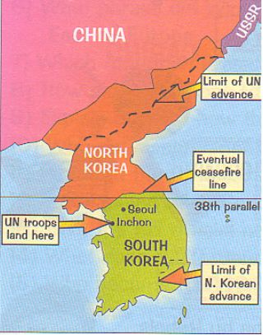
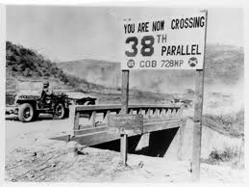
Notes: International Developments in the Cold War

Slide 10
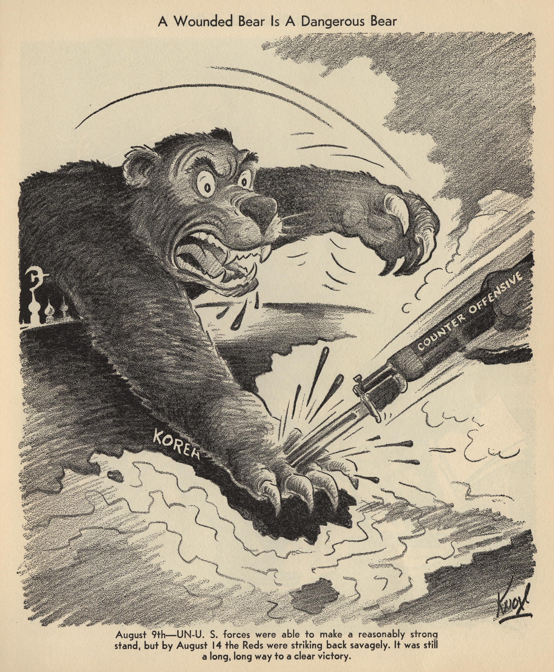
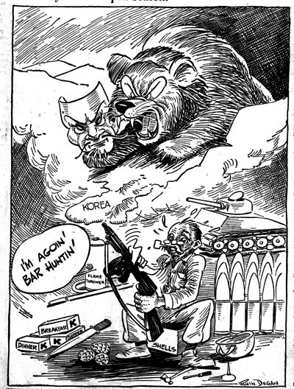
Notes: International Developments in the Cold War

Slide 11
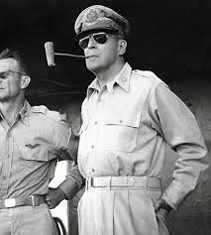
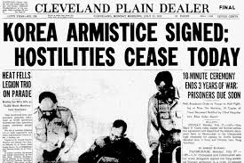
Notes: International Developments in the Cold War
III. The Korean War
General MacArthur recommends war with China
Seeks to overthrow Communist government and reinstate Chiang Kai-Shek
Truman rejects idea of war with world’s largest nation
MacArthur publicly criticizes Truman leading to his firing
Conflict ends with Armistice signed in 1953
No official treaty to end war
North Korea remains communist
North Korea invalidated armistice on Monday March 11, 2013!

Slide 12
Independent Work: Korean War Document Analysis
Steps:
Go to mrvandsburger.weebly.com
Download both the “Korean War Documents” and “Korean War Document Analysis Chart” files
Use the CIA method to analyze the documents and complete your chart
Email to Mr. Vandsburger when you are finished.
Homework:
Literal and Analytical Notes p. 931 – 934, 937 – 939
Save Power Point as “Your Name Lesson 2” and email to Mr. Vandsburger (will count as class work grade)
Finish Cold War Web Quest by Friday

