Slide 1
Unit 10 – Truman and Eisenhower: 1945 - 1960
Lesson 1 – Truman’s Foreign Policy
3/12/13

Slide 2
Unit 10 Lesson 1: 3/12/13
Warm-Up:
(1) Download this Power Point from mrvandsburger.weebly.com
(2) What were 3 disagreements or conflicts between the United States and Soviet Union that arose out of the post-World War II conferences at Yalta and Potsdam?
List the 3 disagreements that took place at the conferences in the section that says “Click to add notes”:

Slide 3
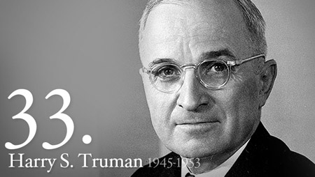
Objective
1. SWBAT evaluate whether Truman’s foreign policies during the early years of the Cold War should be considered a success or a failure.

Slide 4
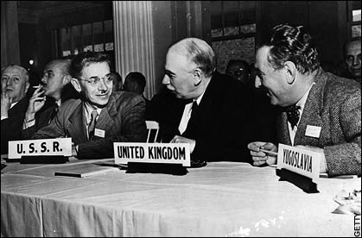
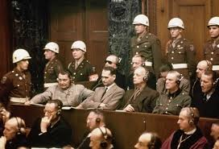
Notes: Truman’s Foreign Policy
Major Questions Following WWII
How to address destruction of war in Europe
Bretton Woods Conference established fixed currency exchange rates and International Monetary Fund to support rebuilding nations
Nuremberg War Crimes Trials punish remaining Nazi leaders
Established the International Criminal Court
Which political and economic ideologies were superior
Capitalism vs Communism
Evolves into Cold War – High tensions but no direct conflict between USA and USSR

Slide 5
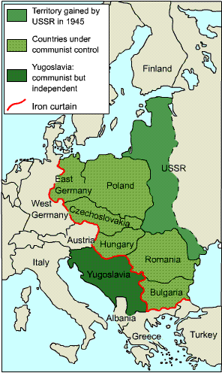
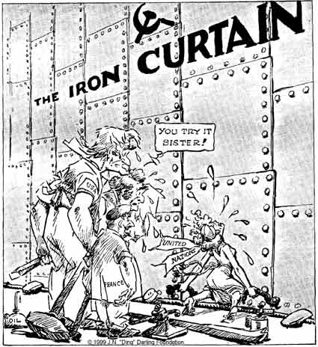
Notes: Truman’s Foreign Policy
Soviet Aggression in 1940’s
Establish Poland, Hungary, and Czechoslovakia as Soviet “satellites”
Communist revolutions in Greece and Turkey (1947)

Slide 6
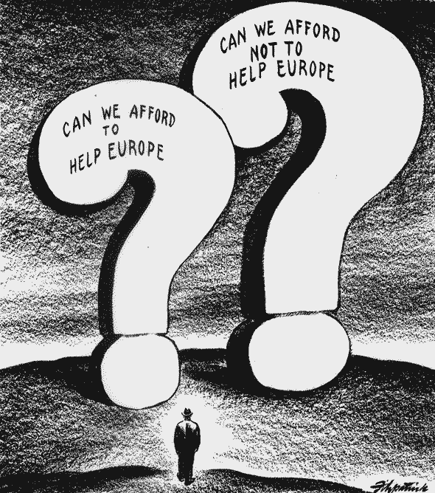
Notes: Truman’s Foreign Policy
Truman’s Foreign Policies
Truman Doctrine – US will support “free peoples”
“Containment” Policy defends countries facing Soviet takeover
Developed by George Kennan in Long Telegram
Marshall Plan sends $12 billion to help rebuild European cities and economy
Nations accepting money became American allies
National Security Council and Central Intelligence Agency created in response to successful Soviet test of atomic bomb and fear of Soviet invasion

Slide 7
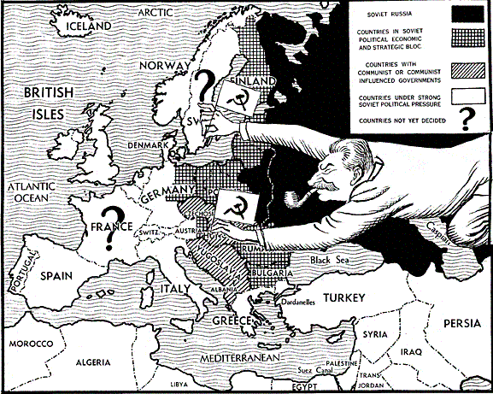
Notes: Truman’s Foreign Policy

Slide 8
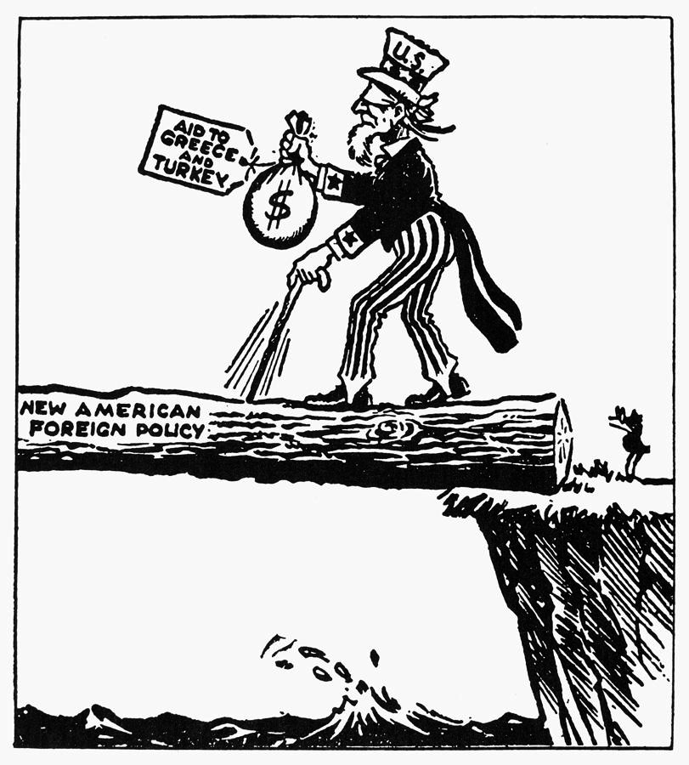
Notes: Truman’s Foreign Policy

Slide 9
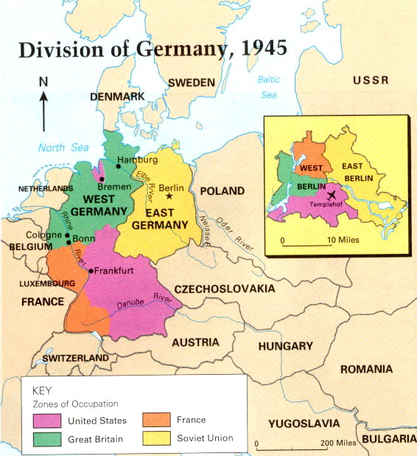
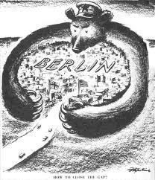
Notes: Truman’s Foreign Policy
Crisis in Berlin
US, Britain, and France plan to unite Western Germany
Soviets respond with Berlin Blockade of goods sent to West Berlin
Berlin located in Soviet sector
Truman orders Berlin Airlift
Convinces Congress to join North Atlantic Treaty Organization – defense alliance of Western European nations
Soviets respond by creating Warsaw Pact

Slide 10
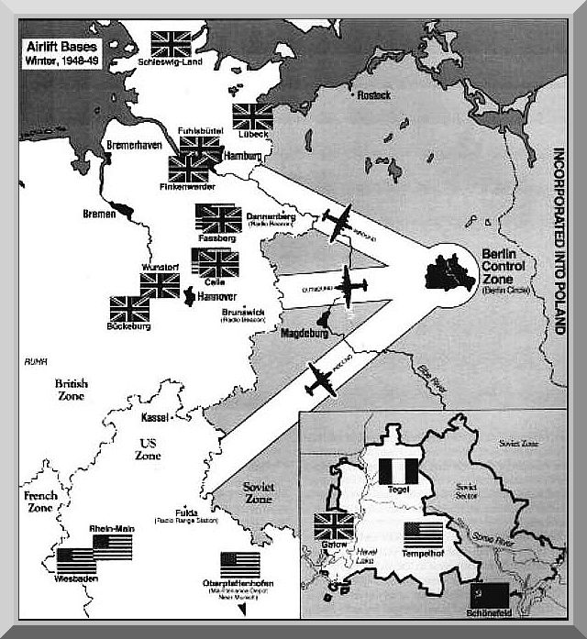
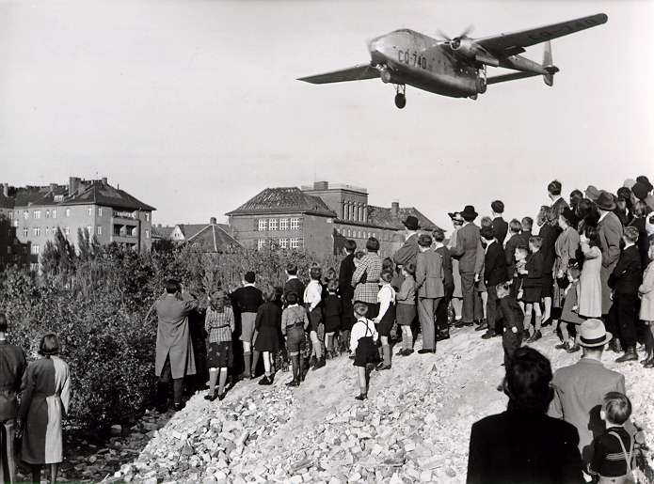
Notes: Truman’s Foreign Policy

Slide 11
Independent Work: Cold War Web Quest
Steps:
Go to mrvandsburger.weebly.com
Download both the “Cold War Web Quest” and “Cold War Web Quest Sites” files
Respond to each of the questions in complete sentences using the readings referenced in each question
Email to Mr. Vandsburger when you are finished.
Homework:
Literal and Analytical Notes p. 920 – 931
Save Power Point as “Your Name Lesson 1” and email to Mr. Vandsburger (will count as class work grade)
Finish Cold War Web Quest by Friday

