Slide 1
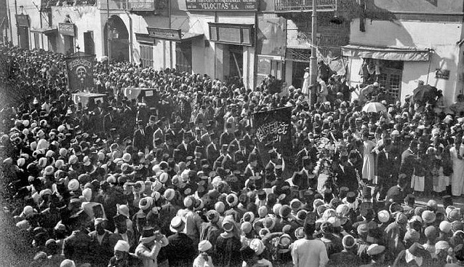
The Egyptian Revolution of 1952 and the Suez Crisis
By: Sara Iqbal 20 March 2013

Slide 2
We all have our part to play
Countries Involved: Egypt: The people believed that their leader worked under British influence, so t America: They claimed that the Egyptian government was corrupt, and used their CIA agents in Egypt to incite a revolution. The USSR: Like America, they believed that Egypt’s gov’t was corrupt, and used their own people, the KGB, to spark a revolution among the Egyptians.
Major Leaders Involved: Egypt: Muhammad Naguib: One of the leaders of the Revolution, he took up Presidency in Egypt after the former King had abdicated his position and been sent into exile. Gamal Abdel Nasser Hussein: Another leader of the Revolution, he served as the Minister of the Interior.

Slide 3
What happened here?
The government of Egypt was seen as corrupt, so an army called the Free Officers Movement was formed to bring it down.
Muhammad Naguib joined the movement in order to show how determined the people were to overthrow the government.
During the Revolution, British support was cut off, leaving the King to turn to America, who didn’t help them.
With the King overthrown, the Free Officers debated whether the he should be tried and executed or simply abdicate and go into exile.
The King went into exile to Italy, leaving Naguib as the first President of Egypt.

Slide 4
Where?
1952: Revolution begins. Naguib and Nasser overthrow King Faroud; Naguib becomes first President of Egypt.
1954: Nasser becomes Prime Minister; Naguib’s position as President reduced to a figurehead.
June 1956: Nasser becomes President of Egypt.
July 1956: United States turns its back on Egypt, refusing to help them build the Aswan Dam. As a result, Nasser tries to get the Soviet Union to help them; Alliance between Egypt and SU begins.

Slide 5
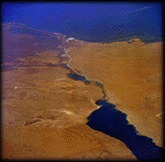
Blame the suez canal!
The Suez Canal was a means of direct travel from the Mediterranean Sea to the Indian Ocean.
With this canal, trade between Asia, the Middle East, Europe, and America would keep going.
Originally, anyone could use the canal, but in 1956, both Britain and France wanted control over the canal.
However, Nasser felt that control of the canal should belong to Egypt.
When America and Britain went back on their promise to help build the Aswan Dam, Egypt decided to use the money from the canal to pay for building the dam.
In retaliation, Britain and France joined with Israel to attack Egypt; within the course of a few days, they had control of the Suez region.
The United Nations forced the two countries to back off from Egypt, and in 1957, Egypt had control of the Canal again, as long all ships from all nations were allowed passage.

Slide 6
Why and how?
Even after this whole conflict ended, neither America or the Soviet Union didn’t care much about Egypt after the Revolution.
Now that Egypt had a new government, the age of colonization was over
During the course of the Revolution and the Canal Crisis, the SU and America didn’t step in that much to help Egypt
Now that Egypt was an ally of the Soviets, it could potentially be a problem for America, as they might lose access to the Canal
It’s possible that France almost went bankrupt due to the Suez Canal
It’s led him to try and undergo a merger (marry) Britain

Slide 7
