Slide 1
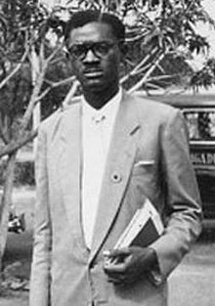
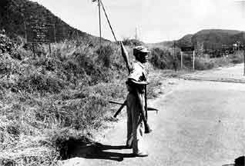
Crisis in Congo and Angolan Civil War
Deeba Mazhar
3/20/13
APUSH

Slide 2
Congo Crisis
Who was involved?
Congo
The Congolese men in the army mutinied against the remaining white officers that lead the Congolese army and attacked the Belgian officers.
Katanga
Katanga which was a country in Southern Congo broke away from the rest of Congo. The leader of Katanga, was Tshombe who led them to being independent.
United Nations
UN became involved because the Prime Minister, Lumumba appealed to the UN. The UN responded to his appeal and helped them restore order by sending an army.
The Soviet Union
USSR became involved in Congo because the USSR wanted to show itself to be a friend of Congo and it strongly supported Lumumba.
United States:
US government gave secret support to Mobutu (army officer who overthrew Lumumba) in his bid for power because they thought that he would be more pro-Western than Lumumba.

Slide 3
Angolan Civil War
Who was involved?
Angola
They were fighting against Portugal in order to control Angola, and gain independence.
MPLA
(Popular Movement for the Liberation of Angola's) was a Marxist organization led Agostinho Neto.
FNLA
The National Front for the Liberation of Angola was led by Holden Roberto
UNITA
The National Union for the Total Independence of Angola was led by Jonas Savimbi
The United States
supplied aid and training for both the FNLA and UNITA
Soviet Union
The Soviet Union provided military training and equipment for the MPLA.

Slide 4
What happened?
Congo Crisis:
Before 1960 Congo was a Belgian colony, but on June 30, 1960 Congo became an independent country.
This threw the country into complete chaos since the government of Belgian didn’t prepare the people of Congo for independence. Therefore, the Prime Minister, Patrice Lumumba had a very difficult situation to handle and control the people of Congo. As a result of the Crisis, Belgian sent paratroops in order to protect Belgian citizens in Congo. This was an illegal act because Congo was free of Belgian rule.
What worsened the conflict was Katanga breaking off from Southern Congo. Thus, Lumumba appealed to the UN and the UN sent about 10,000 troops in order restore power which started the huge Congo Crisis.

Slide 5
Angolan Civil War
What happened?
The Angolan Civil War began when the people of Angola ended the war for independence from Portugal in 1975. It began when the three groups MPLA, UNITA, and FNLA met and signed an Alvor agreement that granted Angolan independence and provided for a three-way power sharing government. But the three groups started to fight again and thus the country descended into a Civil War.

Slide 6
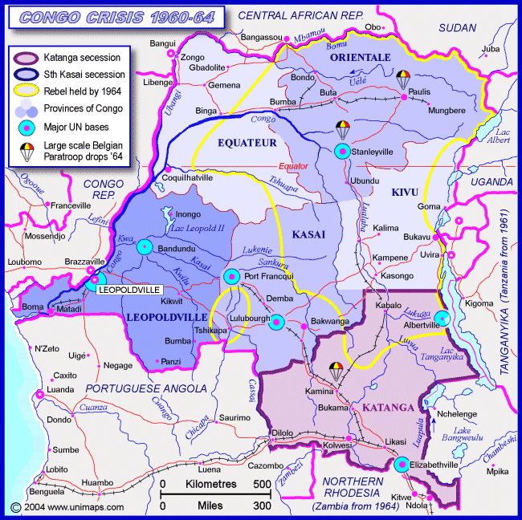
Congo Crisis
The Congo Crisis ocurred from 1960- 1964

Slide 7
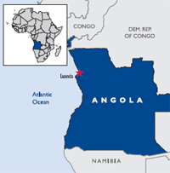
Angolan Civil War
Date: 11 November 1975 – 4 April 2002

Slide 8
Global Balance of power
Both the Soviet Union and the United States considered the conflicts critical to the global balance of power because both wanted Angola and Congo to be on their side for Communism or Capitalism. But in the end in the Congo Crisis, the United States nor Soviet Union had tipped the balance because it wasn’t their defeat. But in the Angolan Civil war UNITA surrendered so the U.S. lost, and the Soviet Union won. The global balance of power was tipped to the Soviet Union’s side in the end.

Slide 9
Turning Point
Congo Crisis
In the Congo Crisis the Turning point was when Lumumba appealed to the UN to help restore power. The UN helped to re-unite Katanga by landing an attack on them. Tshombe fled Congo and therefore, Congo became united again. The UN helped Congo to not go into a Civil war, and they kept Congo as a whole by the end of 1963 and there was political stability.
Angolan Civil War
In the Angolan Civil War the Cuban intervention was a turning point because Cuba became Angola’s biggest ally and provided military weaponry and troops for them. Cuba helped Congo from South African forces that were supporting UNITA. They helped them defeat South African forces and led them to defeat UNITA. In the end UNITA lost and there was a new president who took control of Angola.

Slide 10
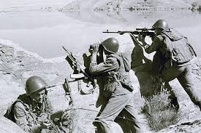
Soviet War in Afghanistan (1979- 1989)
Shanel Montreuil
March 20, 2013
Advanced Placement United States History

Slide 11
Who was Involved?
The Soviet Union enforced military and social reforms that many disagreed with. They started land reforms that disturbed tribal leaders, applied economic procedures that degraded conditions for the poor, and tried to limit ethnic uprisings by mass arrests, torture, and executions of rebels and in-flight attackers.
Afghanistan was having a Civil War. Their people were resisting the government of anarchy.
Hafizullah Amin the leader of Afghanistan. Most people believed that he was betraying the Soviet Union and that his loyalty was with America.
Mujahadeen, who could put up a resistance against the Soviet army.
The United States boycotted the Olympics in Moscow in 1980. The United States' donation of anti-aircraft missiles to the Mujahadeen fighters caused major losses to Soviet aircraft and troops.

Slide 12
Description
The Peoples Democratic party in Afghanistan initially unified to over throw the monarchy government that happened at the time. They then spit to Parcham (Socialism) and Khalq (Marxist Ideals) because they believed in different political views. They overthrew the government in April 27, 1978. The leader of the Khalq faction, Muhammad Taraki became president and renamed Afghanistan the Democratic Republic of Afghanistan. Late 1978, a rebellion against the Taraki government's policies began an Islamic extremist movement in eastern Afghanistan and spread throughout the country, leading to Civil War. Violence increased and Taraki was killed right afterwards then Hafizullah Amin- Taraki's deputy prime minister- took over.

Slide 13
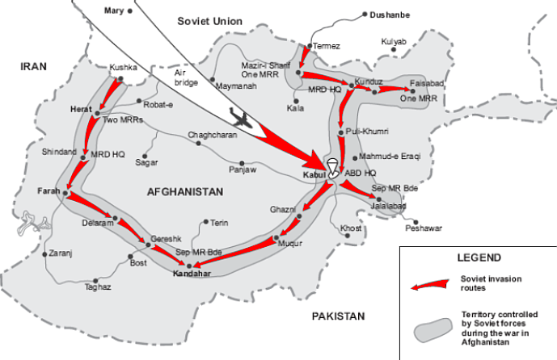
Location and Time Period
The Event began on 1979 and ended 1989. The occurrence existed for 10 years and happened in Afghanistan and only on Afghanistan. You could see that throughout the course of the war, the Soviet Union conquered Afghanistan in order to end the War.

Slide 14
Why did the War Occur?
A major turning point is the Soviet-Afghan Friendship Treaty signed in December 1978 by Amin permitted military assistance and advice to Afghanistan if requested. This gave the Soviet Union full power over Afghanistan and everyone in it. Another point is when the Soviet Union withdrew their forces from Afghanistan’s conflict and their Civil War was still going on.

Slide 15
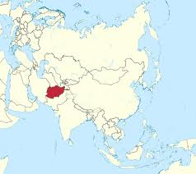
Impact!
The war impacted the Cold War between America and the Soviet Union because the main reason why they fought for Afghanistan in the first place was that they wanted control of the land and oil that existed there. They would be a major trading partner and the Soviet Union thought that if they took control of Afghanistan, they would have the upper hand in spreading communism all throughout Asia since they are in the center of Asia. Mujaheddin won the war with assistance from the United States.

Slide 16
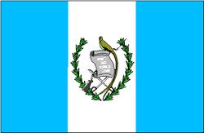
Guatemalan Revolution
By: Tayyaba Rehman

Slide 17
Who was involved?
Guatemala
Jorge Ubico- The President of Guatemala (a dictator) who was forced to resign. His goal was to make Guatemala a strict military country.
Juan Jose Arevalo- The President after Ubico was removed from office. He was voted in
Jacobo Arbenz- The military general who was fired by Ubico and led the revolt to remove all of Ubico’s influence in the government.
U.S.A
United Fruits Company- A fruit produce company in Central America that didn’t hesitate to use America’s political, and military prowess to gain large profits.
CIA- Helped to overthrow President Arbenz when he began to carry out land reforms against the interests of the United Fruit Company.

Slide 18
US and USSR involvement
The U.S was involved in the Guatemalan Revolution because they had the United Fruits Company there and were hoping to influence Central America with it, but with the new land reforms being made by the new President Arbenz they were losing control. The changes made in Guatemala were influencing other countries around them and America was not going to lose it peacefully so a coup d'état was planned to take out the President and they succeeded.

Slide 19
Jorge Ubico
Dictator of Guatemala and was removed in 1944.

Slide 20
What happened?
In 1931 a dictator, Jorge Ubico, took over and made Guatemala communist. Ubico was overthrown in 1944 by Jacobo Arbenz who led the revolt against Ubico. Afterwards, Juan Arevalo was elected as the President. As tensions grew between Arevalo and Arbenz, Arevalo was killed by someone that no one figure out.
After that Arbenz became President and created several land reforms that America didn’t approve of so this President was thrown out as well.

Slide 21
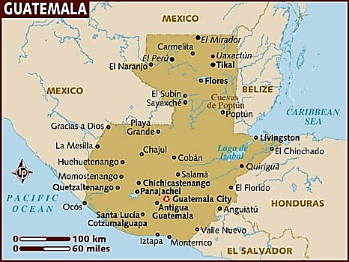
Where? When?
The revolution started in Guatemala in 1944.

Slide 22
Why?
The turning point of the Guatemalan Revolution could be when there was a coup d'état to overthrow President Arbenz because it shows that the fighting will continue unless both the U.S and Guatemala get what they both desire. Guatemala’s citizens and people overthrew President Jorge because they disliked him and his policies. The U.S also overthrew President Arbenz because he was doing something that the U.S disliked as well.

Slide 23
How? (Impact on the balance between the US and ASSR)
This impacted the balance between the U.S and the U.S.S.R was shifted because Guatemala used to be a communist country but after the coups, it had become agrarian based economy. Another country was put in favor of capitalism and therefore that became an addition to America’s influence.

Slide 24
Iranian Revolution (1953)
Lina Alhanshali
03.20.13
APUSH

Slide 25
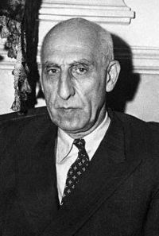
Britain was unhappy that Iran nationalized its oil industry so they pressed the United States to join them in an operation to remove Iran’s democratically elected Prime Minister Mohammed Mossadegh. Even though for a long time the US denied its involvement it played a significant role in the overthrow of this popular prime minister because it organized and lead this coup d’état.

Slide 26
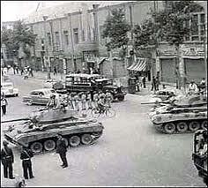
The CIA joined by military and police forces equipped with tanks sacked offices and newspapers aligned with Prime Minister Mohammed and his advisers. They also had a propaganda campaign against him. There were many clashes with Mohamed’s supporters but the most violent was the one that happened in front of the Prime Minister’s home in which 200 people were killed.

Slide 27
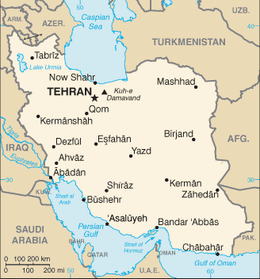
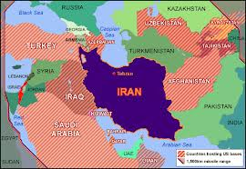
The United States sponsored coup d’etat in Iran on August, 19, 1953

Slide 28
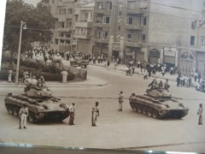
The major turning pint in the conflict is the clash that happened with supporters of Mohammed and the CIA. The CIA noticed that it might need to be more violent in order to quickly overthrow the government and win this revolution.

Slide 29
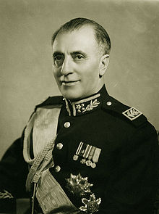
This battle impacted the balance of power between the United States and the soviet Union in that the United States gained more power. After they removed Mohammed from power they replaced him with a U.S. supported Iranian general. From that, they established an Iranian government that they could control. Iran's oil shares are dominated by the United States and Great Britain. After the Shah was placed the oil industry was denationalized and that ended the British oil Embargo against Iran. Oil revenue significantly increased. So by overthrowing the government, the U.S. gained a lot of power from Iran's oil resources which they controlled. This revolution also ended the fear of a communist take over in Iran and prevented the Soviet Union from becoming allies with Iran.

Slide 30
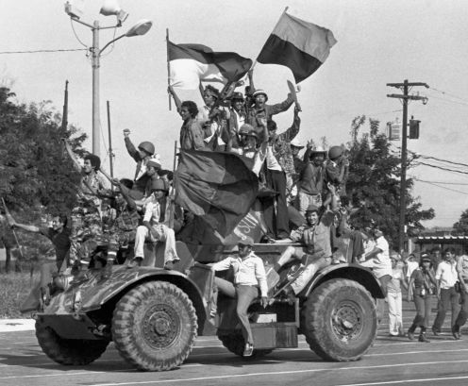
Nicaraguan Revolution 1978–1979
By Hira Ghaffar
AP USH

Slide 31
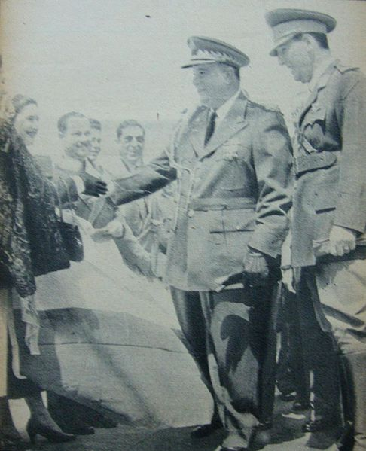
Who Was Involved?
The Somoza family was involved because they were the dictator’s who ruled Nicaragua.
The U.S.
The National Guard.
Sandinista National Liberation Front (FSLN)
Augusto Sandino -War hero!

Slide 32
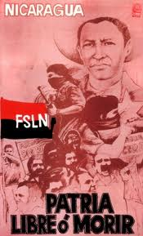
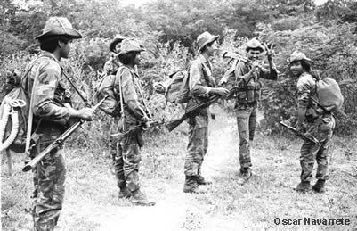
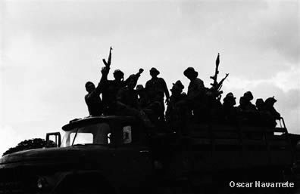
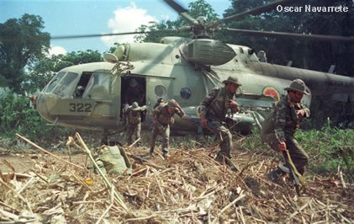
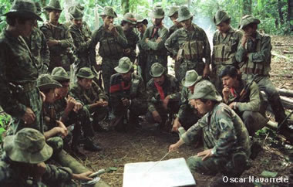
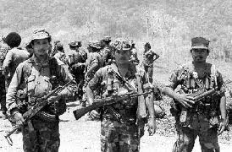
What Happened?
The Nicaraguans were tired of their government and him abusing his power.
So they formed a military movement.
“anti-somocista” was wrapping around the revolutionary views.
Propaganda increased.
Students also got involved
When the FSLN first attacked it ended up as a massacre because they were blocked by the National Guard and the Honduras Army at the national boarder.
Small battles between the FSLN and the National Guard began to happen frequently.
1970: FSLN started period of “accumulation of forces in silence”, they began to fight less and focused on strengthening their organization.
Later they kidnapped some of Somoza’s friends and began to demand brides, the National Guard had no choice but to give them what they asked for.
Somoza started a “reign of terror”. He wanted to defeat the FSLN because he didn’t like the revolts happening that were against him.
started to repress people who were suspects.

Slide 33
Continue…
Later on the FSLN leaders were either assassinated or murdered forcing the group to divide into three groups and continue fighting.
Several battles helped the FSLN. They learned new tactics, like bombing houses that National Guard was fighting near.
Somoza’s control over cities were slowly being overthrown by the FSLN
Somoza couldn’t stop the rebellion so he fled.
Francisco Urcuyo took over for 24 hours and then fled as well
The FSLN WON!!

Slide 34
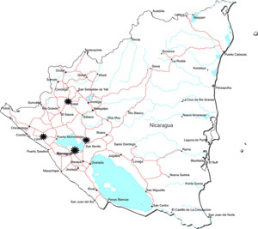
Where / When?
It happened in Nicaragua in 1978 through out 1979
But they originally started these oppositions against their government earlier.

Slide 35
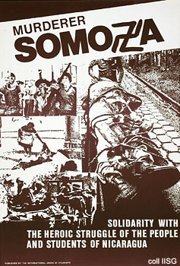
Why?
The Somoza dynasty ruled for 44 years!
They did not treat their people well and they only cared about the power that came along with being a president.
They also didn’t care about their people because they had the U.S. on their side
They also had the National Guard- which the U.S. supported

Slide 36
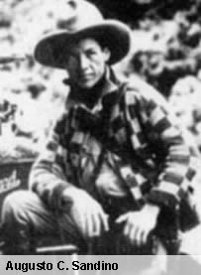
How?
This conflict involved the U.S. and the U.S.S.R. When the revolution had started the U.S. supported the dictator and the helped train the National Guard. The revolution ended with the victory of the FSLN. This meant that they got their independence. Which meant that they have to set up a new government. They set up a government that was a ruling junta. They were closer to the U.S.S.R. The U.S.S.R. provided aid to the country. This conflict helped the U.S.S.R. They received another ally. The U.S. just lost a country and made a new enemy.

Slide 37
The Malayan Emergency
Urwah Ahmad APUSH
03/20/2013

Slide 38
Who Was Involved?
The nations involved in conflict were:
UK- they were involved because Malaya had been under their control since 1874. They had to protect what was theirs and also show their strength.
Australia- they were helping a fellow member of SEATO(southeast Asia treaty org.) and also their own troops there.
Malaya- they were protecting their own homes. The different sects were however also fighting against each other.
Countries that contributed but played a very small role were Fiji, New Zealand, and Rhodesia
Most of these nations were also anti-communist.
The leaders that were involved in the conflict include:
Chin Peng was the leader of the communist party in Malaya.
British:
Harold Briggs Roy Urquhart Henry Gurney(was assassinated) Gerald Templar
Henry Wells was in charge of the Australian division.
The US supported the commonwealth nations and non-communists of Malaya
The Communists were supported by either the Soviet Union or by China and infiltrated Malaya.

Slide 39
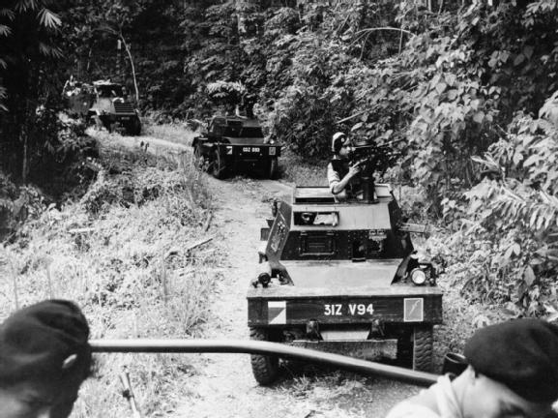
What Happened?
After World War II the Malayan economy was in ruins there was unemployment, low wages, scarce food, and high inflation. These economic problems caused social disorder and considerable labor unrest.
The laws created by British were very disliked and there was more unrest.
Arresting and deportation.
It officially began when European plantation managers were killed at Sungai Siput, Perak, by the Malayan National Liberation Army
The British colonial government declared a national state of emergency due to the rivalry between colonial regime and the Chinese communist party.
The guerrilla army started the war against the colonial government was part of the Malayan Communist Party’s (MCP) military arm, which was called Malayan National Liberation Army (MNLA).
There were three phases to the operation referred to as the Briggs Plan .
The first was the counter attack in 1948 through 1948
Moved the civilians . This made them trust army and to go under the communist influence.
The second was the clear and hold from 1950 to 1952.
They improved their strategy and cooperation was better between the civil, police and military.
Then the rebuilding tool place and making sure Malaya was a functional country happened between1952 to 1960. Telok Anson marsh area

Slide 40
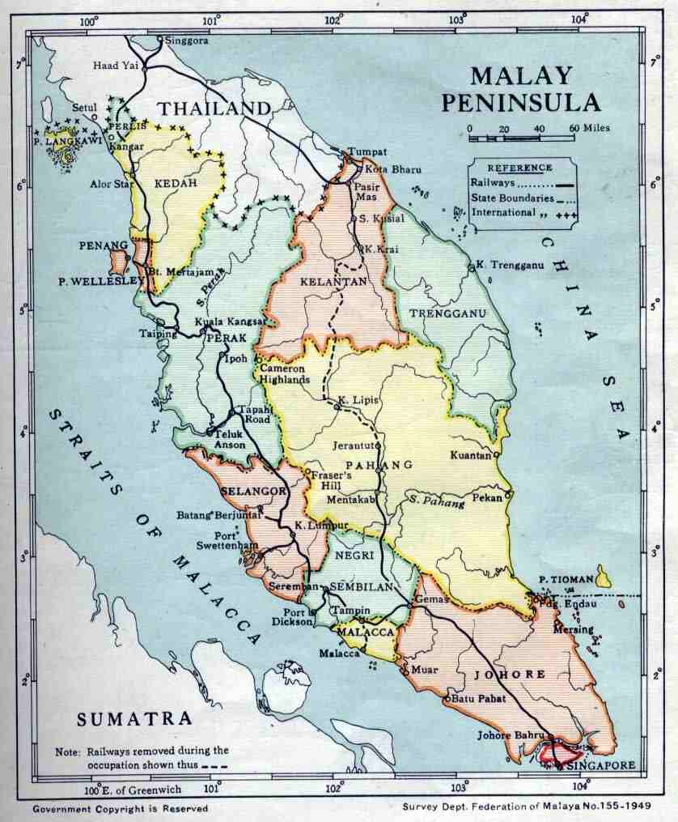

Slide 41
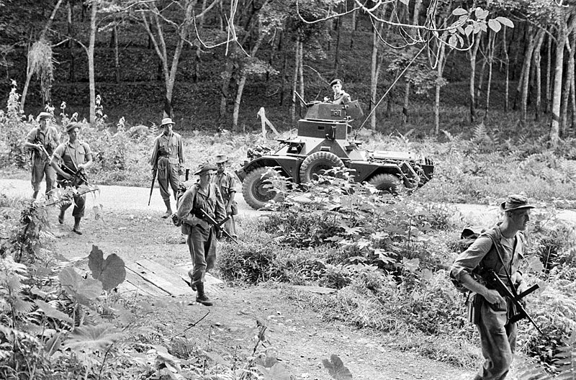
What happened cont…
“New Villages” were created which were guarded camps.
People came to like them because they had better living standards there.
This was a counter-insurgency technique where they removed a population which might be sympathetic to guerrillas.
They had various battalions and regiments but the force was still too small in order for them to fight the communists. Thus more soldiers and supplies were brought to Malaya.
Most of the fighting that was done was done in the forest. Mostly involved guerilla warfare.
At the end of the war the National Liberation Army was been defeated and Chin Peng the commander and many others left the country and went to Beijing, China where they were given asylum.
The last of the resistance from MRLA guerrillas ended with a surrender in the Telok Anson marsh area (1958). The remaining MRLA forces fled to the Thai border and further east.

Slide 42
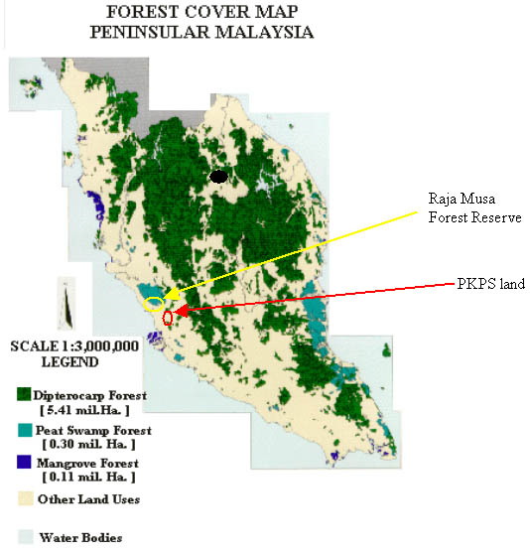

Slide 43
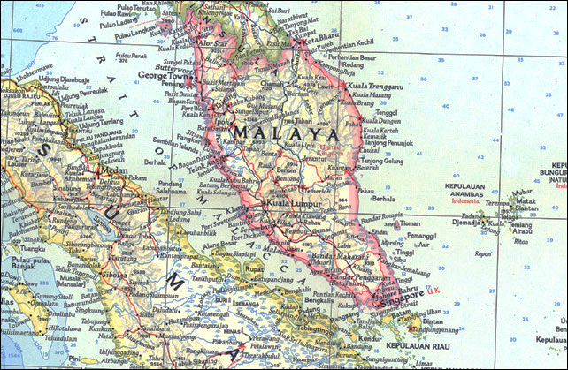
Where and When?
From June1948 to July 1960
The fighting took place for 12 years and was brutal.
Malaya is a peninsula in Southeast Asia.
British Malaya is often used to refer to the Malay States under indirect British rule . Due to it being a combination of several former British territories, including Sabah and Sarawak
Therefore it is also very diverse country there were the Muslim Malays, the Aborigines, Chinese, Indian, and the British.

Slide 44
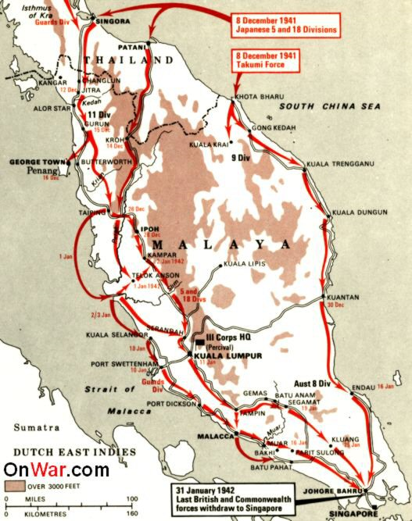

Slide 45
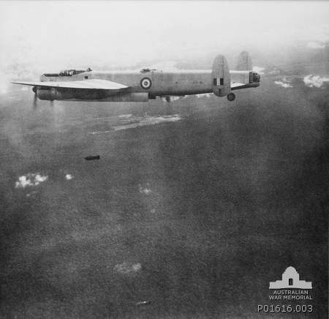
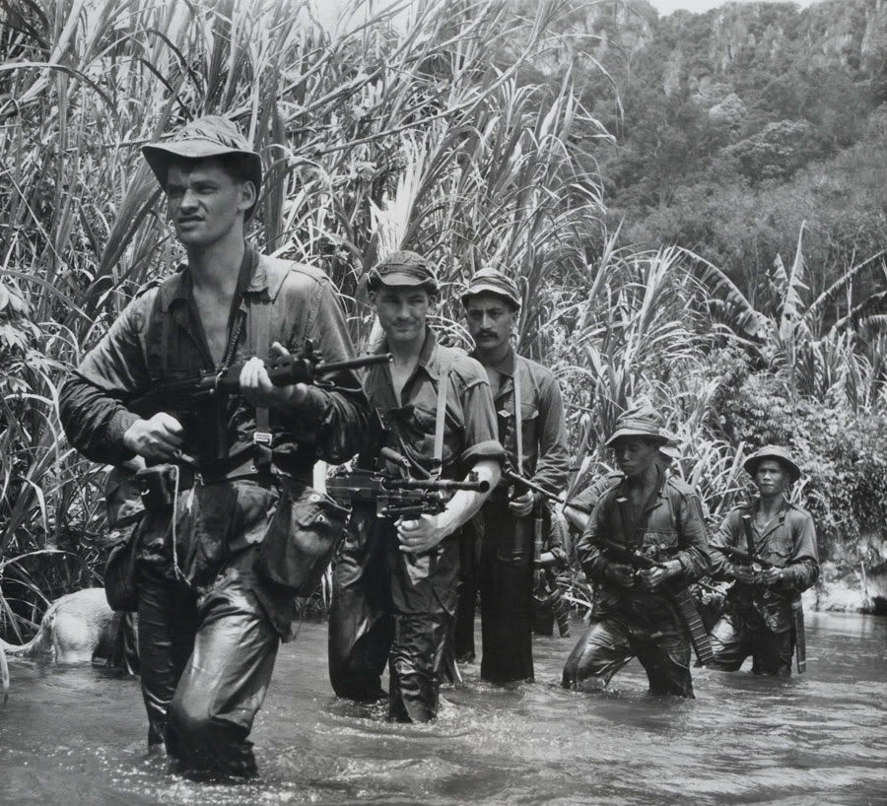
WHY??
The major turning point came in the population control of Phase 2. Briggs Plan was developed, with executive committees (combining police, military, Special Branch, and administrative officers) at local, state and national levels. Executive powers enabled these committees to override administrative fissures. The plan emphasized resettlement of people to New Villages, concentration clustering people in laborers houses, and sustained area patrolling. This allowed for them to protect, gain support, decrease communist influence on the people.
The British and its supporting were at first unprepared. However they developed new and successful techniques that helped to defeat the communist.
Led to the formation of the independent democratic nation of Malaya(now Malaysia)

Slide 46
HOW??
The Malayans managed to repel a communist uprising due to people getting involved. The communist had believed they could win through communist means but were wrong. The capitalist actually gained the peoples trust and were supported. Due to the communist defeat the US technically had more supporters and allies now. This war was won against communism. However it is not that well recalled due to other failures.

Slide 47
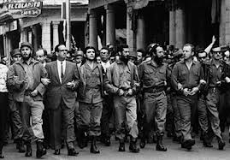
Cuban Revolution
By: Yana Sukhorska APUSH

Slide 48
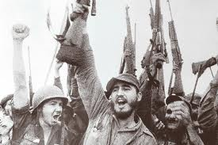
Who was Involved?
The Cuban Revolution was caused by the former president Fulgencio Batista who seized power on March 10, 1952
Even though Cuba received a lot of support from the US the Cuban people themselves were not happy with Batista
One who really opposed Batista was a young lawyer named Fidel Castro who wanted to overthrow Batista because he revealed that Batista’s government was full of corruption and tyranny.
The Cuban population wanted a Communist government because the democratic government was corrupt

Slide 49
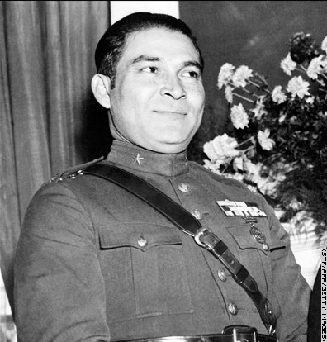
What happened?
On March 10, 1952 when Batista seized power he canceled all election and he became the only candidate in power
Due to this Fidel Castro a lawyer led a brutal one hundred guerillas to attack the Moncada Barracks. This became known as the 26th of July Movement. Although Castro's revolt was crushed and he was sentenced to prison. (Note: Fidel Castro's brother Raul was also part of this attack)
Although in 1954 when Batista became president he released all of the political prisoners and one of them was Fidel Castro
Raul and Fidel fled into Mexico City in June 1955 as in being in exile. This gave them time to come up with a plan to take down Batista

Slide 50
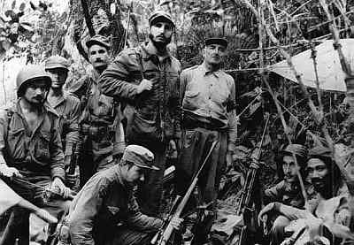
What happened?
When Raul and Fidel formed a group they returned to Cuba on November 1956.
However when they came back Castro’s group was attacked and only a small number of survivors remained, all who did survive regrouped and continued to hike to the Sierra Maestra mountains because they were in exile and could not really enter Cuba.
A couple of months later a Student Revolutionary Directorate stormed the Presidential Palace but most were killed
Since then until 1958 Castro launched many attacks in the Sierra Mountains killing anyone who was loyal to Batista
Batista did try to fight back but Castro won the Battle of La Plata and he escaped capture in the Battle of Las Mercedes
Castro’s group captured many cities in Cuba and in January 1, 1959 Batista was taken from power, and he fled to the Dominican Republic

Slide 51
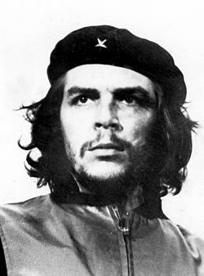
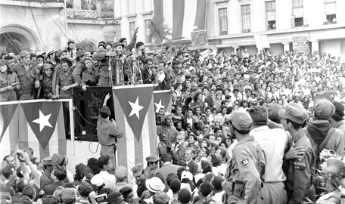
What happened?
After the Cuban Revolution Batista all of Batista's soldiers, policemen, and agents were tried and executed
Castro became the Commander-in Chief, however when the prime minister Jose Miro Cardora resigned Castro became prime minister.
After the revolution Ernesto Che Guevara who helped with the revolution was appointed as president and also was appointed as the minister of industry
The new government was well accepted and valued
Also when the Cuban Revolution came to an end Cuba became the first Communist state in the western hemisphere .

Slide 52
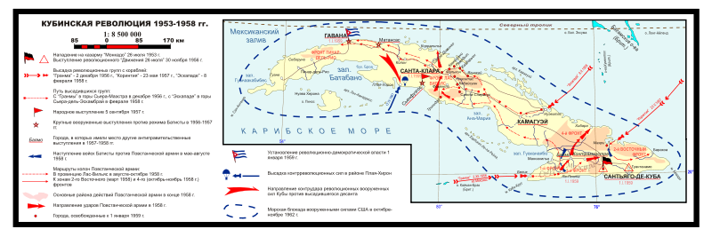
Where/When?

Slide 53
Why?
The major turning point of the Cuban Revolution is that Batista was never going to win because even though he received a lot of support from the United States, the people of Cuba did not want a democratic government because it was corrupt and they wanted change. Also the U.S. foreign policy were not compatible with a radically anti-Americanism when Castro was coming into power in Cuba.

Slide 54
How?
This impacted the Soviet union because as mentioned before Cuba became the first became the first Communist state in the western hemisphere. This gave an advantage to the Soviet Union since people in Cuba favored communism not democracy. Even though there was a lot of influence from the United States, they could not control the pro-communism that was rising in Cuba, since the majority of the population wanted to get rid of democracy due to Batista.

Slide 55
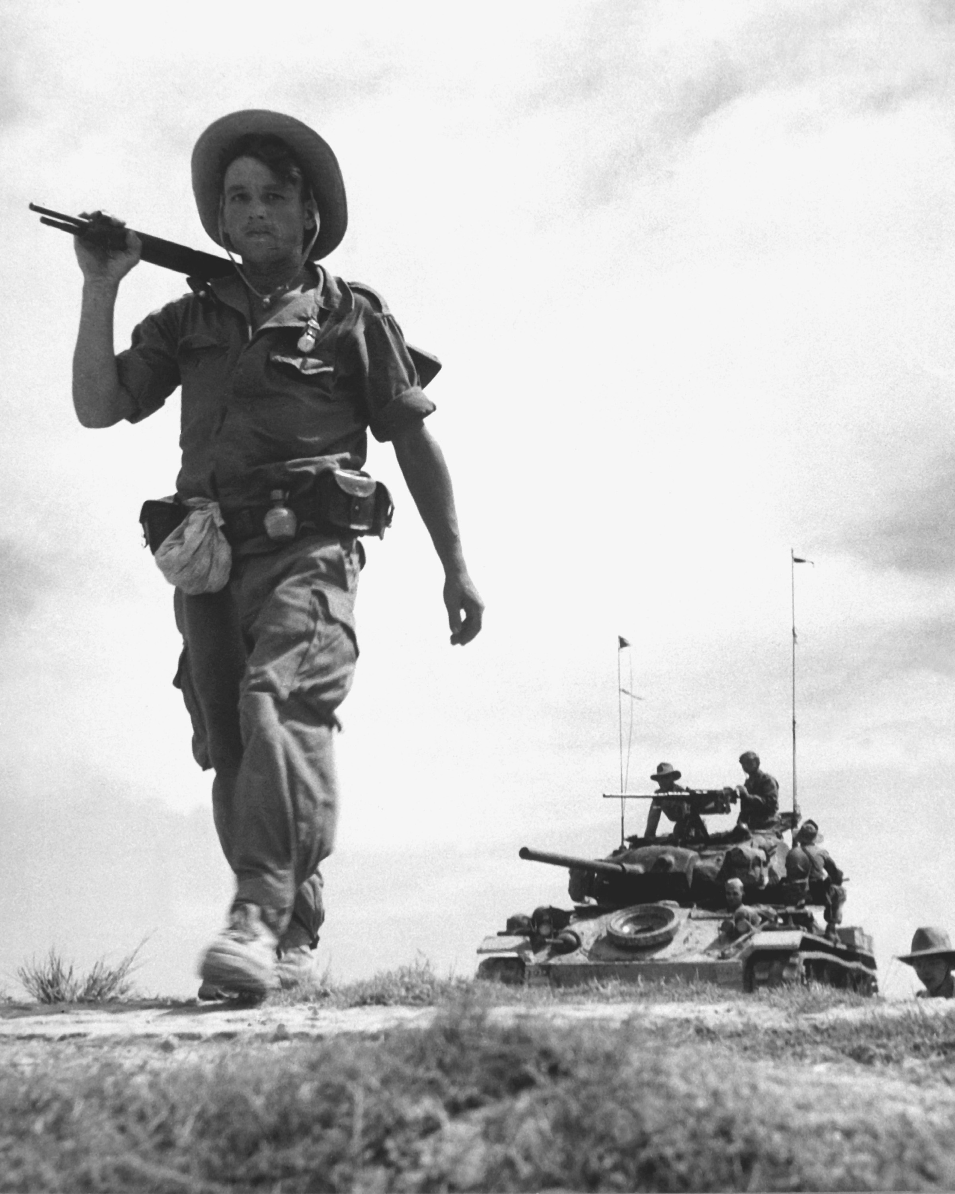
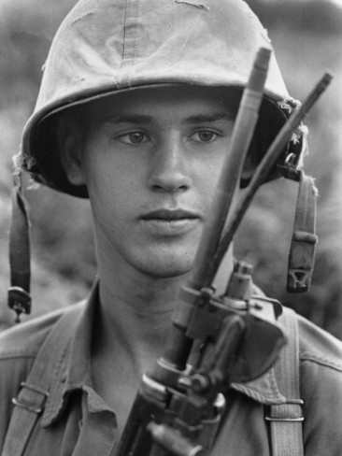
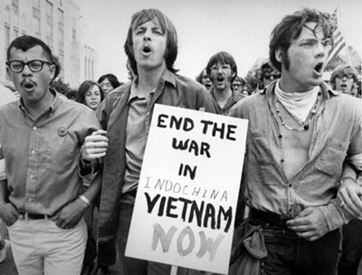
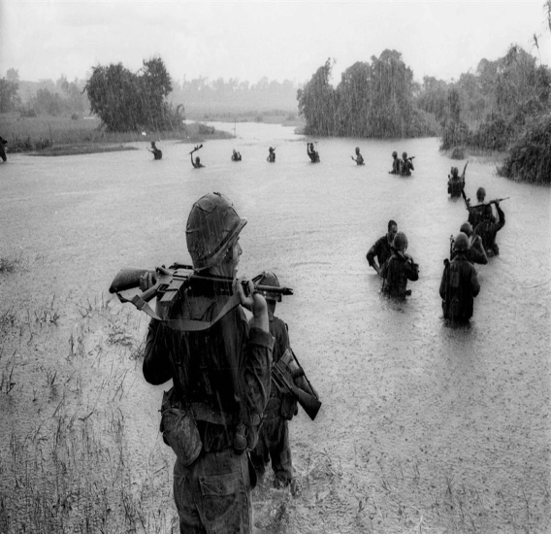
First Indochina War
BY : Aurora Parkinson

Slide 56
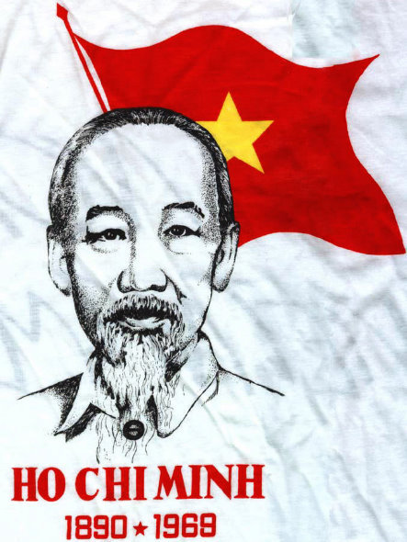
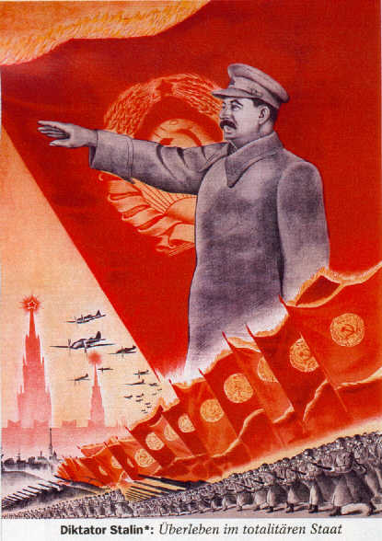
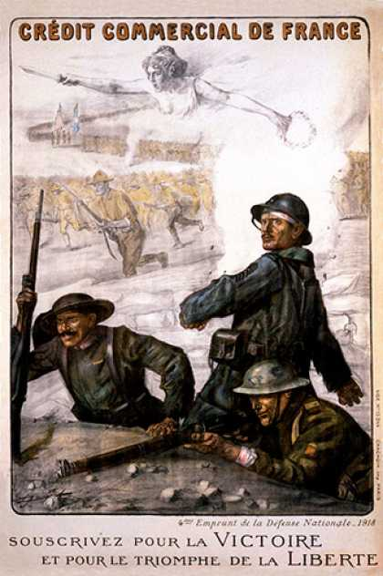
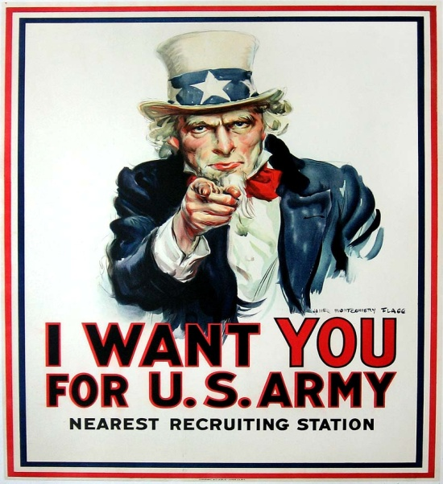
The Nations Involved
Victor’s Side
Viet Minh
Pathet Lao (1950)
Khmer Issarak (1949)
United Issarak Front (1950)
People’s Republic of China
The Soviet Union
Defeated Side
French Indochina
State of Vietnam
Cambodia
Laos
France
The United States
Main Leader
Main Leader

Slide 57
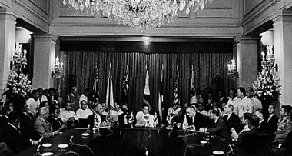
The Nations Involved Continued…
Vietnam, Laos and Cambodia and all been colonized by France in the 19th century.
Vietnam was headed by Communist leader Ho Chi Minh.
The US and the USSR does get involved in the war that originally was between the French and Vietnam.
The US backs up the French through John Foster Dulles’ s “United Action” plan.
Manila Pact was part of the “United Action” and it aimed to find peaceful means to resolve differences in Southeast Asia.
Southeast Asia Treaty Organization (SEATO) defense treaty in order to stop the further Communist takeovers of the areas in the Pacific region.
The Soviet Union backed up the Viet Minh
Supplied the Viet Minh with weapons

Slide 58
What Happened ?
The War was mainly between the French and Vietnam.
Ho Chi Minh’s force, the Viet Minh, attacked the electric plant and other French installations.
The Viet Minh had taken control of the countryside which had resulted in the Viet Minh getting having a lot of spies for them.
The Viet Minh had the advantage of surprise attacks.
The French had tried to turn around the Viet Minh but in August 1, 1954 the French had to withdraw.
The French lost

Slide 59
Timeline Of How It Began
1945 – At the Potsdam Conference the Allies agree to postwar occupation of Vietnam.
1946- The Vietminh resist. The war offically begins
1950- President Truman authorizes military aid to the French.
1952- 400 U.S advisers are working with the French in Vietnam.
1953- Ho Chi Minh has been steadly winning the war and he introduces a land reform program that supports Communism.
1954- French are defeated at Dien Bien Phu after the US denies to send air support. French-US side offically looses the war.

Slide 60
The Turning Point
The Battle of Dien Bien Phu was the turning point of the First Indochina War. Although the French were losing most of the time they always could’ve bounced back however when the U.S denied the French air support that was the main reason that the French lost the war.

Slide 61
This impacted the balance of power between the U.S and the Soviet Union because the U.S had lost this war. This resulted in the Soviet Union gaining more territory making the US more wary of the Soviet Union’s growing power.

Slide 62
Rhodesian Bush War/Zimbabwe’s Independence
Manahil Sami
APUSH
March 21st, 2013

Slide 63
When and Where Did This War Take Place?
1965-1979

Slide 64
What Happened?
Rhodesia (now known as Zimbabwe) used to be a colony of Great Britain.
In 1965, Rhodesia declared its independence from Britain through the Unilateral Declaration of Independence, even though this independence was not yet accepted internationally.
The government that was established was white and it was the minority group.
The Africans were opposed to the white authority which caused the start of the civil war.

Slide 65
Who Was Involved?
Rhodesian Government – the white minority, under Ian Smith and then Abel Muzorewa as the Prime Ministers.
Zimbabwe African National Union (ZANU) – Under the command of Robert Mugabe.
Zimbabwe African People’s Union (ZAPU) – Under the command of Joshua Nkomo.
The ZANU and ZAPU were both black nationalist political organizations who wanted to end the white domination in the government and country. But, they also fought against each other on a local level because they wanted control over those areas.
Soviet Union’s Role: The ZAPU took advice from the Soviet Union on how to take over the country.
The plan was that the ZAPU would build up their army in Zambia and let the ZANU fight the Rhodesian army just until they were about to win. Then, at that point, the ZAPU would come in so they could be the ones to have officially defeated the Rhodesians.
United States Role: They first denied helping the ZAPU and ZANU when asked, so later they ended up joining the side of the Rhodesians.

Slide 66
Actions of the ZANU and ZAPU
The ZANU placed Soviet anti-tanks land mines on the roads which killed many Rhodesians.
The Rhodesians reacted by working with South Africa to create mine protected vehicles.
The ZAPU looked more on keeping their bases in Zambia and were also more focused on negotiating than fighting. But this didn’t meant that they didn’t have a substantial sized army.
They held two attacks on the Rhodesian airplanes and shot them down using SAM-7 surface-to-air missiles.

Slide 67
Results of the War
The country ended up getting its formal and official independence through peaceful negotiation.
Their first election was held in 1980 and Robert Mugabe won, being recognized throughout the world.
Even though the Soviet Union was more involved in the war, Rhodesia, which turned into Zimbabwe, ended up becoming a capitalist nation. This would impact the balance of power between the United States and Soviet Union by showing that the United States can still be more influential regardless of what their actions
are toward a certain group of people in these kinds of situations.

Slide 68
Turning Points
December, 1979: The United States and Britain finally approve of a government for Zimbabwe after several failed attempts. That is when they remove the sanctions against that country. Sanctions were when the United States and United Nations said that they weren’t going to give Zimbabwe humanitarian aid because if they supported a communist government which would lead to humanitarian crises.

Slide 69
Quemoy and Matsu: First and Second Taiwan Straight Crisis (1954 – 1958)
APUSH
By: Marium Dar
March 20, 2013

Slide 70
Okay, so who’s who?
The People’s Republic of China
The United States of America
Harry Truman – President of the United States
He wanted to avoid conflict with communist China, and implemented the military non-intervention policies. However, they still ended up as part of the conflict. They wanted to end communism and “liberate” the Chinese from the Soviet Union’s aggression.
Dwight Eisenhower – 34th President after Truman
He wanted to end the hostilities between the nationalistic Chinese and the mainland China in Taiwan. He hoped to end communist invasions in the islands around China.
Mao Tse-tung - Leader of Communist China
He wanted to spread and have control over a Communist country
Chiang Kai-shek – Leader of Chinese Nationalists (anti-communists)
They wanted to have their own independent government and did not want to side with the Communists nor the Capitalists

Slide 71
Okay, so whose who?
In this particular situation, the U.S. was involved through the Korean War. Because the U.S. was fighting the Korean War, President Truman decided to help the nationalists as well in Taiwan from military attacks by Mao. The USSR was involved indirectly through the Chinese. The Chinese were communists and followed the beliefs of the Soviet Union.

Slide 72
The 1st Taiwan Strait Crisis
Although aware of the conflict, President Truman decided to use military non-intervention with Taiwan to prevent any conflict with the new Communist superpower. However, when the Korean War erupted, President Truman abandoned the idea of military non-intervention, and called Taiwan a neutral waterway.
President Truman found out about Mao planning on launching a military strike on the nationalists, and sent the 7th Fleet to the straits to protect the nationalists.
President Eisenhower took office near the end of the Korean War, lifted the U.S. naval blockade of Taiwan, as an attempt to show good will towards the Chinese. After the removal of the U.S. military, Chiang Kai-shek tried to regain control of China, and allowed troops to move to Quemoy and Matsu
Mao saw the blockade removal as a sign of the U.S. trying to “liberate” or “separate” Taiwan from China, and ordered for the two straits to be bombed to unite Taiwan and the Chinese against threats like the U.S. The U.S. ended up signing a peace pact with China called the Formosa Resolution, which said the American defense of Taiwan in the case of a communist invasion. There was no mention of whether the United States would intervene to protect the islands around China.
This shaped the fighting because it caused both sides of the conflict to realize that they were strong-willed.

Slide 73
The 2nd Taiwan Crisis
The U.S. and Taiwan made a mutual security pact, which made it hard for Mao to achieve his communist plans. From 1956 – 1957 Mao changed his tactics and wanted to make peace with the nationalists and end the conflict, even though Chiang Kai-shek did not want to remove his troops from the Quemoy and Matsu.
Tensions remained the next year in the two straits, and with increased American involvement in Taiwan affairs, Mao decided to try a more hardcore strategy. Another reason why Mao wanted Taiwan to join the Chinese was because of the Great Leap Forward, which would help China mobilize more after a radical cause.
Mao ordered the bombing of Quemoy in 1958, and said it was to teach a lesson to the U.S., when in reality it was an opportunity for the Chinese to be an independent nation from the Soviet Union as well.
President Eisenhower had his troops stand strong, and that’s when the Chinese eased down on the bombing. China wrote a peace settlement in 1958 with the nationalists and ended the second strait crisis.
The Chinese avoided direct contact with the U.S. from then on as they knew how strong the U.S. was.

Slide 74
Where and When?
On the two straits of Taiwan: Quemoy and Matsu
The 1st strait crisis occurred from 1953 – 1954
The 2nd strait crisis occurred in 1955

Slide 75
So, what’s your point?
The U.S.’ decision to send the 7th fleet showed a change in U.S. foreign policies regarding how to deal with problems in the area more aggressively.
Chinas decision to agree with the peace settlement showed the U.S. triumphing over the S.U. (both the first and second one).
The nationalists mutual agreement with the U.S. after the first strait crisis enabled the U.S. to develop military bases in Taiwan and help defeat China if further attacks occurred. The U.S. would be stronger.
The last peace agreement that China made with the nationalists showed the defeat of communist China and the Soviet Union itself.

Slide 76
How…does this affect US or the SU?
In the beginning this conflict showed the transition of U.S. foreign policies in dealing passively with the S.U. They became more aggressive and used military tactics to intimidate the S.U. This increased hostilities between the two superpowers.
Also, the U.S.’ decision to place a blockade on Taiwan, and then lift it off showed how much more the S.U. would feel the need to unite all the communist people to prevent foreign threats like the U.S. from hindering their form of “liberation.” Of course, this would increase tension between the U.S. and the S.U. causing for them to compete on a whole new level.
Also, the U.S. would be getting more trade partners, such as Taiwan, and this would increase their economy, causing for the S.U. to lag behind on socially mobilizing like the U.S. More military, economical, and political power was given to the U.S. in this situation.
Overall though, the U.S. pretty much won this war, and they scored one for the competition. The tension still continues today though, so it is still in discussion.

Slide 77
Devonique McBrown
AP United States History
Proxy wars: Hungarian Rev.
3/20/13

Slide 78
Who was Involved?
Rakosi: Hungarian leader ( put in power by Stalin. Later forced to resign as a gesture to the Hungarian people).
Imre Nagy: Prime Minister of Hungary.
Janos Kadar: Foreign Minister

Slide 79
Who, What, When, Where, Why, How?
Hungarians under control of Moscow since 1945
October 23, 1956, Students and workers protested their personal freedoms in 16 points (more food, the removal of secret police, removal of Russian control, etc).
Red Army pulled out, Nagy started political parties again.

Slide 80
October 31, 1956, Nagy announced that Hungary would be withdrawing from Warsaw Pact
Pushed Russians too far
Kadar left gov’t in disgust
Started rival gov’t in East Hungary ( supported by Soviet tanks).
Soviet tanks went into Budapest to restore order (acted with immense brutality, killing and wounding many people).
About 30,000 killed
200,000 fled Hungary to go west.
Dragged the bodies around the capital by tanks as a warning to those who were still protesting.
November 4 1956, Order restored to Hungary.
Kadar put in charge ( Soviet rule restored).

