Slide 1
Lesson # 3 – Origins of Colonial Rebellion
10/11/2012

Slide 2
Warm-Up
Reading Quiz: Complete and Submit by 11:10
Copy homework below:
American Revolution Diary due Friday (for Discussion)
Agenda
Reading Quiz
Lecture

Slide 3
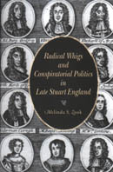
I. Origins of Independent Thought
New World gives opportunity for original and revolutionary ideas
Republicanism – Citizens sacrifice their interests in favor of the common good.
Citizens participation necessary
Naturally opposed to authoritarian institutions
Radical Whigs – Feared any threat to rights and corruption in government
Self Government in Response to Salutary Neglect

Slide 4
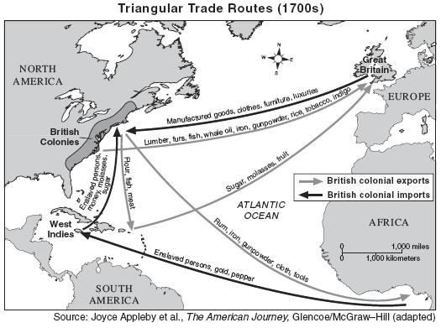
II. Mercantilism Breeds Resentment
Mercantilism
Country’s wealth measured by amount of gold or silver in treasury.
Export more than import
Restrict colonial trade to mother country
American colonies expected to supply raw materials to England and import manufactured goods
Navigation Law of 1750
Results in currency shortages
Parliament used Veto to prevent colonies from printing paper currency

Slide 5
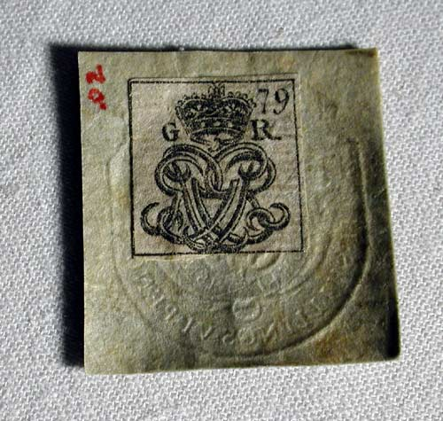
III. The Stamp Act
Britain incurs 140 million pounds in debt during French and Indian War
Prime Minister George Grenville determines that taxation would be used to pay off the debt
Sugar Act of 1764
Stamp Tax of 1765
Quartering Act – Required colonists to house and feed troops
Dissenters would be tried in Admiralty Courts
Source of quote: “No taxation without representation”

Slide 6
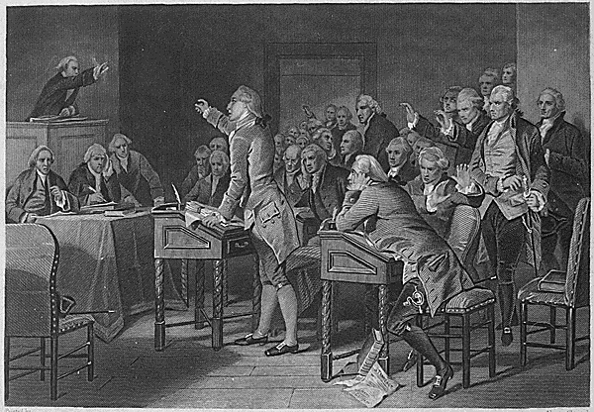
IV. Opposing Taxation
1. Colonists do not want representation
Would legitimize oppressive taxation
2. Stamp Act Congress of 1765
Most important as step toward colonial unity
3. Various forms of boycott harm British merchants
Non-Importation Agreements
Sons / Daughters of Liberty coordinate public protests
4. Successfully force repeal of the Stamp Act

Slide 7
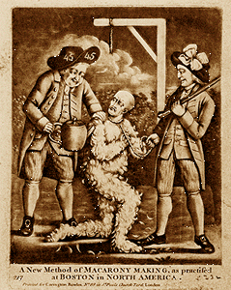
V. British Re-assert Control
Declaratory Act maintains Parliament’s control over the colonies
Townshend Acts
Imposed further duties
Tax on tea was especially frustrating
Duties paid salaries for royal officials
Colonists immediately oppose taxation
Parliament moves to suspend colonial legislatures
NY - 1767

Slide 8
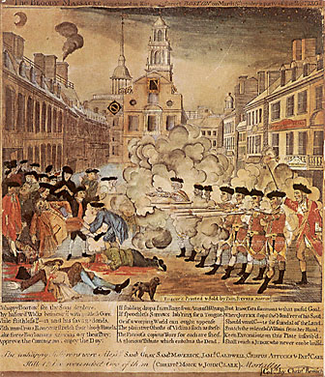
VI. Smuggling and the Boston Massacre
Rather than protest Townshend duties many colonists resort to smuggling
British send troops to prevent further smuggling
Boston Massacre is result of clash between angry colonists and troops
Trial fails to mollify angry colonists
Crispus Attucks glorified for role in leading the mob

Slide 9
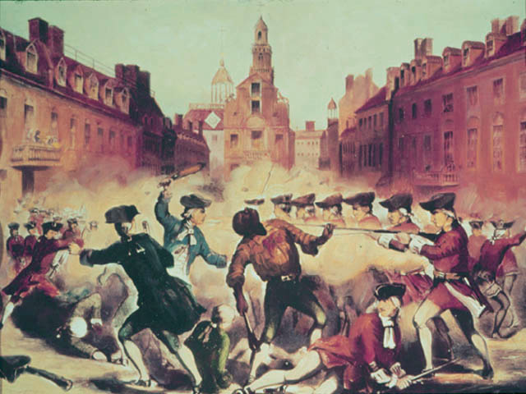
VI. Smuggling and the Boston Massacre

Slide 10
Warm-Up
Examine the discussion prompt and in the notes space write out one reason you have in support or one reason in opposition. (5 min)
Copy homework below:
Practice FRQ #3
Read p. 137 -144, Primary Sources
Literal and Analytical Notes
Agenda
Prompt (5 min)
Finish Lecture (10 min)
Discussion (30 min)

Slide 11
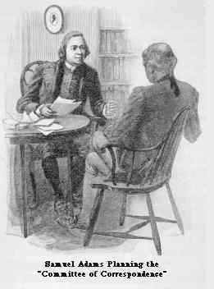
VII. Sedition in the Colonies
Lord North becomes new Prime Minister in 1770
Convinces parliament to repeal Townshend Act but not Tea taxes
Samuel Adams organizes Committees of Correspondence to maintain letter-based communication without following taxation rules
Would serve as foundation of exchanging seditious communication
Organizes Adams’ “Trained Mob”

Slide 12
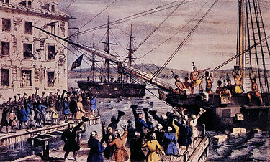
VIII. The Boston Tea Party
British East India Company obtains exclusive monopoly on colonial tea trade
Colonists resent effort to restrict trade by offering cheaper prices
Governor Thomas Hutchinson ordered ships to remain in Boston harbor until colonial merchants agreed to unload the cargo
Valued preservation of law and order over liberty
Boston Tea Party provokes both sympathy among colonists as well as complaints that such protests would result in anarchy
British reactions would only further frustrate colonists rather than try and appease the growing “mob”

Slide 13
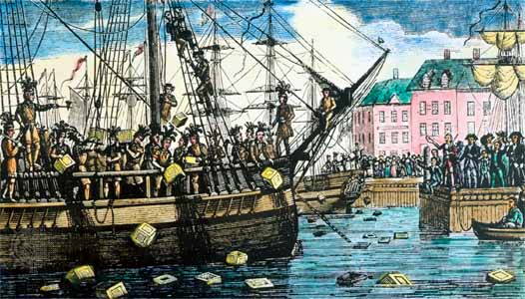
VIII. The Boston Tea Party

