Slide 1
Lesson # 2 – French and Indian War Consequences
10/10/2012

Slide 2
Warm-Up
Succinct Paragraph Practice: How did early French colonial development compare / contrast with English settlements (politically, socially, economically, and in terms of native relations)?
Copy homework below:
Read p. 116 – 124, “Statement of the Stamp Act Congress”
Literal and Analytical Notes
American Revolution Diary due Friday (for Discussion)
Agenda
Succinct Paragraph
Lecture

Slide 3
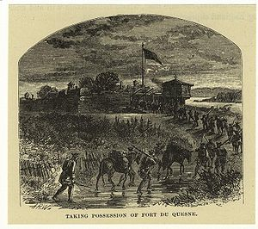
IV. French and Indian War
Fight over control of Ohio Valley
Gate to expansion
Control of Mississippi
British land speculators claimed control of 500,000 acres in Ohio Valley
French in process of fortifying the region
Fort Duquesne becomes site of first shots of war

Slide 4
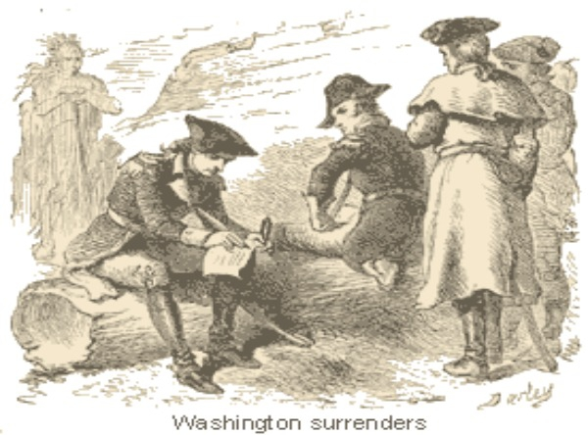
IV. French and Indian War
4. George Washington’s first force is repelled
Surrenders at Fort Necessity
5. British remove Acadians from Nova Scotia forcing them to settle in Ohio Valley territories
Origin of “Cajuns”

Slide 5
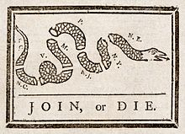
V. The Course of War
War in the Global Context
Known as the Seven Years War in Europe
France is so focused on European front of war that American colonies are ignored
Colonial Disunity
Albany Congress of 1754 is called to discuss unity and Iroquois alliance
Benjamin Franklin is key voice at Congress

Slide 6
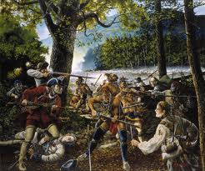
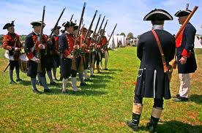
V. The Course of War
3. Combat
Early forces under command of General Edward Braddock
Used to British Regulars and not Buckskins
British defeats leave colonies vulnerable to attacks by natives
Focus on small wilderness battles dooms British invasion of Canada

Slide 7
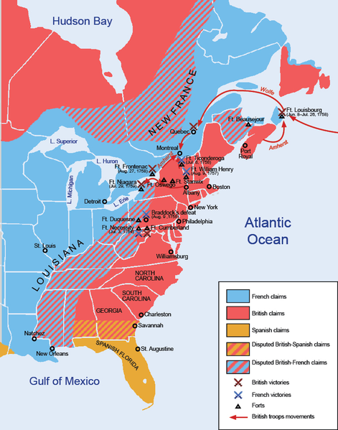
V. The Course of War
4. Pitt’s Plan for Victory
William Pitt, known as the “Great Commoner” and “Organizer of Victory”
Focuses efforts on Canadian invasions, specifically Fort Louisbourg
Brings in James Wolfe to lead campaing against Quebec
Defeats Marquis de Montcalm

Slide 8
V. The Course of War

Slide 9
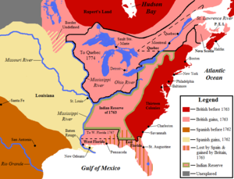
VI. Consequences of War
France is Defeated
Treaty of Paris 1763 Surrenders most territory to Britain and Spain
Colonial Mindset
Confidence in military strength
See weakness of British military
Conflict between the two groups
British Reactions
Condemn Americans for lack of support
Restrict trade to non-British colonies

Slide 10
VI. Consequences of War

Slide 11
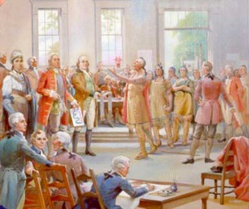
VI. Consequences of War
4. Shifts in Colonial Unity
Barriers to unity begin to disappear
Religious conflict
Sectional / Geographical
Social Class
Concept of America as coherent nation emerges

Slide 12
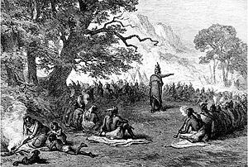
VI. Consequences of War
5. Native Conflicts Continue
Removal of Spain and France leaves natives with fewer options
Pontiac’s Uprising leads natives in revolt against settlers in Detroit
Americans respond by sending “small pox blankets” to leaders of the uprising
Proclamation of 1763 prohibits settlement beyond the Appalachian mountains
Colonists immediately oppose “oppressive” action

Slide 13
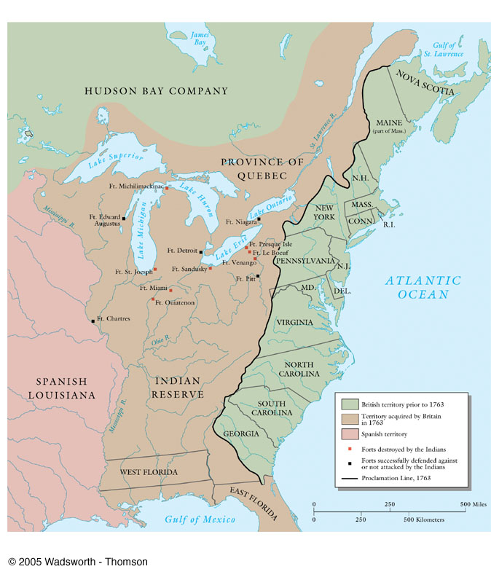
VI. Consequences of War

