Slide 1
Lesson # 1 – French and Indian War
10/9/2012

Slide 2
Warm-Up
Complete your review quiz by 11:07
Copy homework below:
Read p. 116 – 124
Literal and Analytical Notes
Finish Map Activity Questions
Agenda
Review Quiz
Lecture

Slide 3
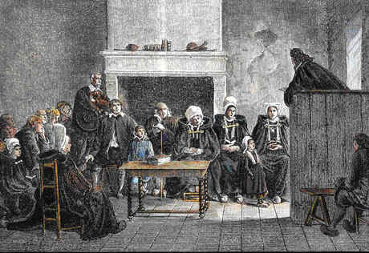
I. (Delayed) French Entrance into Colonization
Internal religious conflict
Catholics vs Huguenots
Edict of Nantes (1598) grants religious tolerance to protestants
Unification under King Louis XIV encourages exploration
Quebec founded in 1608
Samuel de Champlain becomes “father” of New France

Slide 4
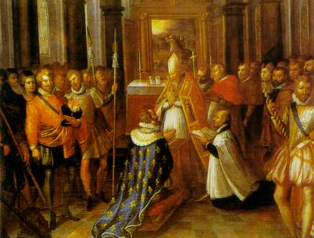
Analysis Question #1
How would the Edict of Nantes influence opinions of British colonists in the Americas?

Slide 5
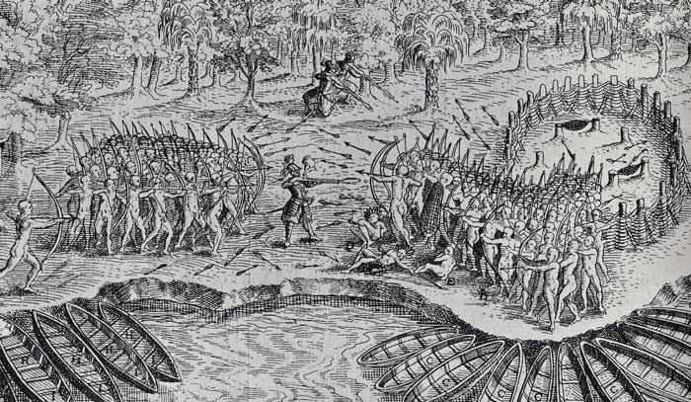
II. French Colonial Developments
Immediate alliance with the Huron Indians
Makes enemy of the Iroquois
Exposure to illness and European customs
No self-government, complete autocratic rule
Limited population growth
Land-shortages not a problem in France
Huguenots denied right to settle in New France
Focus on Caribbean colonies

Slide 6
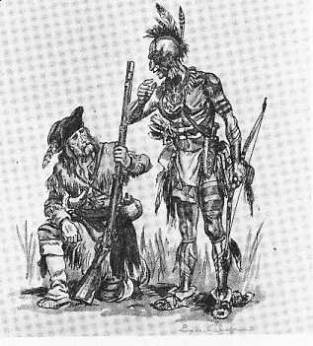
II. French Colonial Developments
4. Economic development as a result of the Fur trade
Coureurs de bois – Runners of the woods
Voyageurs recruited natives in the fur trade
Beaver almost becomes extinct
5. French Missionaries
Jesuits attempt to convert natives to Catholicism
6. Expansion of Influence
Robert de La Salle claims Louisiana for France
Establish trading posts along the Mississippi River

Slide 7
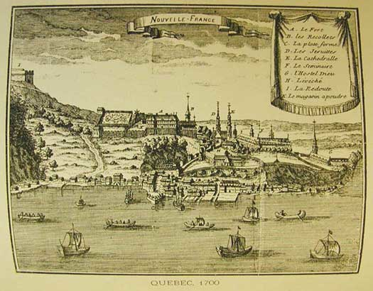
Analysis Question #2
How did early French colonial development compare / contrast with English settlements?
Politically?
Economically?
Socially?
Native Relations…y?

Slide 8
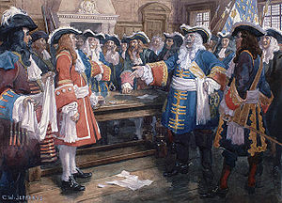
III. European Nations Fight Over Colonies
King William’s War and Queen Anne’s War pits British colonists against fur traders (Coureurs de bois)
Few soldiers involved
Foundation of anti-British sentiments at the heart of French-Indian relations
Spain joins France against British
Treaty of Utrecht (1713) gives Acadia, Newfoundland, and Hudson Bay to the British

Slide 9
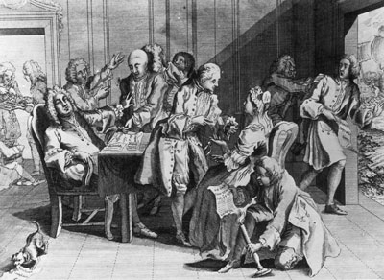
III. European Nations Fight Over Colonies
War of Jenkins’s Ear starts when Spanish revenue collectors attempt to stop British smuggling
Confined to Caribbean Sea and Georgia (buffer colony)
Conflict becomes part of King George’s War
British capture Fort Louisbourg
Returned to France in Treaty of 1748, remained threat to American colonies

Slide 10
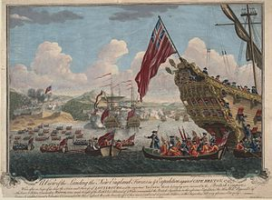
Analysis Question #3
How could these “old world” conflicts impact the lives of American colonists?

Slide 11
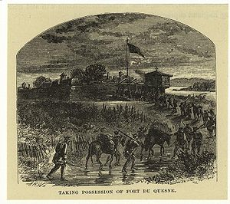
IV. French and Indian War
Fight over control of Ohio Valley
Gate to expansion
Control of Mississippi
British land speculators claimed control of 500,000 acres in Ohio Valley
French in process of fortifying the region
Fort Duquesne becomes site of first shots of war

Slide 12
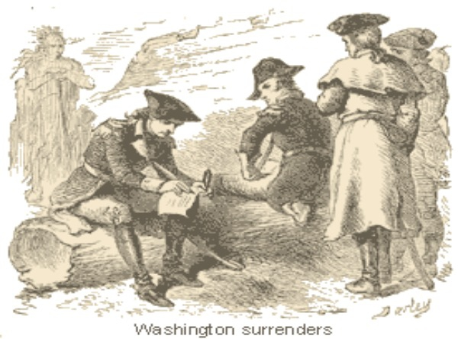
IV. French and Indian War
4. George Washington’s first force is repelled
Surrenders at Fort Necessity
5. British remove Acadians from Nova Scotia forcing them to settle in Ohio Valley territories
Origin of “Cajuns”

