Slide 1
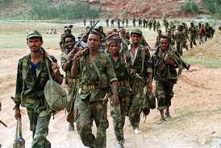
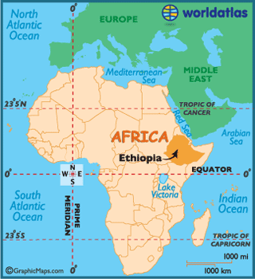
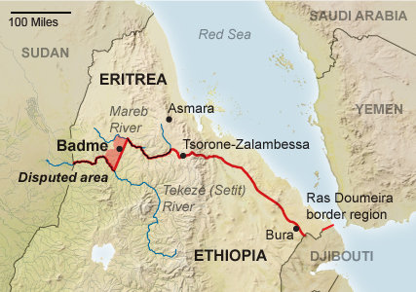
Ethiopian Civil War 1974-1991
By: Sadia Bashir
Notes:
Must include: Name of Conflict, Your Heading, Image Relevant to the Conflict
**Make sure you use a variety of images throughout your power point to support your description.
**These power points will be shared in class Thursday and Friday

Slide 2
Who Was Involved?
The groups/nations that were directly involved in this conflict were the Ethiopian government and people, nationalists from Eritrea (an Ethiopian area along the Red Sea) as well as other parts of the country, Somalia, US, and USSR.
Goals: The goal of the Ethiopian government was to have control over Eritrea, and the Eritrean people wanted independence from Ethiopia. The Ethiopian people wanted better living conditions, and government corruption to end. Somalia wanted to have control over the region of Ogaden which was conquered by Ethiopian Emperor Menelik .
Major leaders:
Mengitsu Mariam- He was a high ranking officer that grew in rank, and slowly took more and more power. He controlled the military.
Haile Selassie- He controlled Ethiopia and was in power for 14 years. He was removed from power.
The US was involved because it supported Ethiopia, and the USSR was involved because it supported Somalia and Ethiopia .
Notes:
Identify and Describe the groups/nations directly involved in conflict
Specifically explain the goals of each group participating in the conflict
Identify the major leaders involved in the different sides of the conflict
Explain how the US and USSR were involved

Slide 3
What Happened?
The first major event that shaped the fighting was the Revolution of 1974. In 1972, and 1973, there was a famine, and Mengitsu blamed Haile for ignoring the famine victims so, he led the military leaders to fight against Haile. Haile was then removed form power, and they took control.
Another event was when the Eritrean people asked for independence from the Ethiopian government and weren’t given independence.
The Ogaden region which was currently being controlled by Ethiopia was also a conflict because the Somalis wanted control over it. Somalis were living there and demanded for independence. Because of the Ogaden region, conflict started between Ethiopia and Somalia.
The military leaders under Mengitsu also led small genocides.
Notes:
Describe the major events of the conflict and how these events shaped the fighting

Slide 4
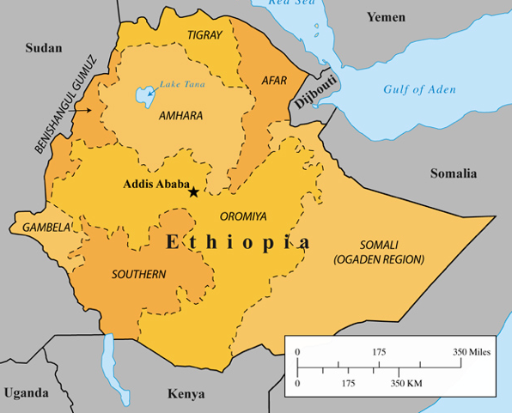
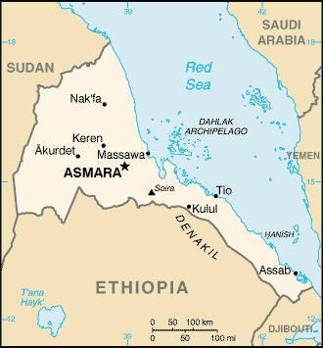
Where / When?
Revolution: 1974 in Ethiopia
Entrance through Port Assab since 1946
Ogaden Region, and Eritrea conflict.
Notes:
Provide an accurate time frame for the conflict
Demonstrate the location of the conflict on several maps

Slide 5
Why?
The major turning points in the conflict were:
The Revolution of 1974: when Mengitsu Mariam took power and started to change Ethiopia as a whole. After he took power he basically made Ethiopia a dictatorship.
When the Eritrean people weren’t given independence.
Eritrea got independence in 1993 because the UN came in and helped them.
Somalia has control over the Ogaden region now.
In 2006, Mengitsu was found guilty of genocide, and resides in an asylum.
Notes:
Analyze the major turning points in the conflict and how these turning points led one side to win the conflict (or why there was no conclusion to the fighting)

Slide 6
How – The impact on the balance of power b/w US and USSR
This conflict impacted the balance of power between the United Stated and the Soviet Union because one side didn’t win. The Ethiopian government had access to the Assab port, and Eritrea got independence.
The USSR helped Ethiopia keep control of Eritrea, and financed them for military weapons.
When Soviet Union collapsed, the United States were looked at for help.
It really didn’t impact their power because USSR collapsed, and the UN got involved so, the US didn’t have to.
Notes:
Explain how this conflict impacted the balance of power between the United Stated and the Soviet Union

