Slide 1
Lesson # 1 – The Articles of Confederation
11/7/12

Slide 2
Unit 3 Lesson 1: 11/7/12
Warm-Up: Copy the chart below onto a blank piece of loose-leaf, fill in at least 2 examples for each column
Positive Experiences with Government | Negative Experiences with Government

Slide 3
Notes: Articles of Confederation
Objective: (Copy under warm-up chart)
Unit 3 Lesson 1 - SWBAT evaluate the strengths and weaknesses of the Articles of Confederation and analyze why this government proved insufficient to meet the needs of the American people.

Slide 4
Notes: Articles of Confederation
II. America After the Revolution:
What major issues will Americans have to address at the end of the Revolution?
Economic:
Social:
Political:
Foreign Relations:
Territorial Expansion:

Slide 5
Independent Work: Reading the Articles of Confederation
Directions: Read the Articles of Confederation and complete the chart with information from the document.
As you read underline the powers given to the different parts of government under the Articles of Confederation
Circle the methods used to choose the people who were in power under the Articles of Confederation

Slide 6
Homework: (written on handout)
Read p. 172 – 186, Literal and Analytical Notes
Vocabulary Flash Cards:
- Society of Cincinnati
- Disestablished
- Virginia Statute for Religious Freedom
- Civic Virtue
- Articles of Confederation
- Old Northwest
- Land Ordinance of 1785
- Northwest Ordinance
- Shays’s Rebellion
- Lord Sheffield (p. 183)

Slide 7
Unit 3 Lesson 1: 11/8/12
Warm-Up: Independently complete the “Struggles” column of your Articles of Confederation Chart

Slide 8
Notes: Articles of Confederation
III. What necessary structures or powers of government were missing in the Articles of Confederation?
Weak Central Government
Cannot pay for army / navy
Cannot collect taxes
No enforcement of laws (no executive)
Cannot control intrastate commerce
Cannot command states
Cannot regulate currency

Slide 9
Notes: Articles of Confederation
IV. Limited Successes of the A of C
A. Managed the Revolutionary War
B. Negotiated Treaty of Paris
C. Established Northwest Ordinance of 1787
Western Territories became territory of central government and could be purchased
Territories could reach statehood after population growth
Slavery not allowed in new territories

Slide 10
Road to the Convention Timeline
Complete the Shays’s Rebellion reading activity as a class
Directions: Read the document(s) you were assigned
As you read underline the challenges to America’s government brought up in the document
In 2-3 sentences (on the document) answer the question below:
Would America’s government under the Articles of Confederation be capable of responding to this challenge? If yes, then how? If no, why not?

Slide 11
Warm-Up: Road to the Convention Timeline
On your index card write out:
When the event happened
Very brief statement about what happened
Specific way that the event points out the flaws of the Articles of Confederation

Slide 12
Road to the Convention Timeline

Slide 13
Mini-Quiz
Complete the mini-quiz in 5 minutes
We will review the MC process after.

Slide 14
Notes: Constitutional Convention
I. Objective: Unit 3 Lesson 2 SWBAT describe the sources of disagreement at the Constitutional Convention and weigh the success of various compromises in addressing these controversies.

Slide 15
Notes: Constitutional Convention
II. Setting of the Constitutional Convention
Who: 55 “Founding Fathers” from 12 colonies (not Rhode Island)
Delegates were primarily from aristocratic background
What: Convened to “revise” the Articles of Confederation
When: May – September 1787
Where: Independence Hall in Philadelphia
Why: Strengthen central government or union will fall apart

Slide 16
Notes: Constitutional Convention
III. Dispute: Representation in Congress
Virginia Plan | New Jersey Plan
Proposed by: Edmund Randolph (VA) Type of Legislature: Bicameral – Two houses of Congress Lower House – Chosen by the people Upper House – Chosen by the lower house Type of Representation: Proportional Representation – Number of representatives determined by population of the state. Supported by: Large states | Proposed by: William Patterson (NJ) Type of Legislature: Unicameral – One house of Congress selected by State legislatures Other Branches: Establish permanent executive and judicial branches Type of Representation: Equal Representation – All states have same number of representatives Supported by: Small States

Slide 17
Warm-Up: Constitutional Convention
Copy notes:
III. Disputes: Representation
a. Great Compromise – Would create a bicameral legislature with House of Representatives (using proportional) and Senate (using equal, 2 per state)
Also known as the Connecticut Compromise
Analysis Question:
Based on your Constitution chart and the notes above, do you think the Great Compromise successfully balanced power between large and small states?

Slide 18
Notes: Constitutional Convention
IV. Dispute: Slavery
Northern States | Southern States
Slaves should not be counted toward population when determining representation! Reasoning? | Slaves must count toward population! Reasoning?
a. 3/5 Compromise – Each slave would count as 3/5 of a person when determining representation for the House of Representatives
- Slaves could not vote

Slide 19
Notes: Constitutional Convention
I. Objective: Unit 3 Lesson 3 SWBAT assess whether the development of political parties in America was a positive or negative step in establishing a sound central government.

Slide 20
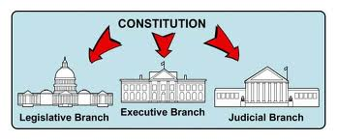
Notes: Constitutional Convention
II. Separation of Powers
Legislative | Executive | Judicial
- Congress makes laws House of Representatives: 435 members elected every 2 years - Senate: 100 members elected every 6 years | - President enforces the laws - Serves as commander in chief - Elected every 4 years through Electoral College | - Court system interprets the laws - President nominates judges with approval by Congress needed

Slide 21
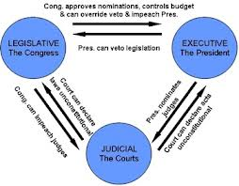
Notes: Constitutional Convention
III. Checks and Balances
Legislative | Executive | Judicial
- Can impeach and remove the president - Can reject judicial nominees | - Can veto laws passed by Congress - Nominate judges | - Can challenge the constitutionality of both President’s actions and Congress’ laws

Slide 22
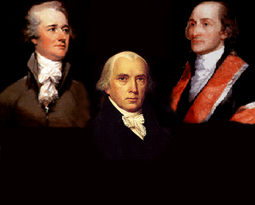
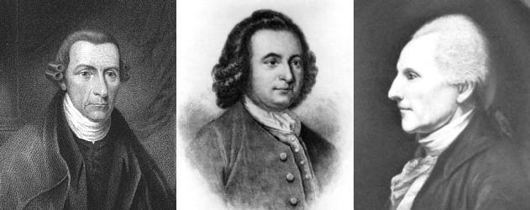
Notes: Constitutional Convention
IV. Federalists vs Anti-Federalists
Ratification – To give formal approval
9 of 13 states needed to ratify Constitution
Federalists – Wanted strong central government
Alexander Hamilton, James Madison, John Jay
Anti-Federalists – Opposed Constitution, favored individual rights
George Clinton, Robert Yates, Richard Henry Lee
Each create their own newspapers to persuade voters

Slide 23
Homework: (written on handout)
Homework: Notes on p. 186 – 195
Vocabulary (written on Handout)
Federalist/Anti-Federalist Paper Reading Annotation and Questions

Slide 24
Federalist vs Anti-Federalist Papers
Directions:
(1) Read the document(s) and annotate the document
Underline the reasons they give for supporting / opposing ratification
Sum up the major idea of each section in the margins
Circle key vocabulary terms
(2 Answer the questions using information from the documents
*What you don’t finish in class you need to finish for homework. We will be using these documents first thing tomorrow.

Slide 25
Warm-Up: Federalist vs Anti-Federalist Papers
Move into your group based on your reading: Federalists (wants strong central government) or Anti-Federalists (opposed to strong central government)
Text Analysis Protocol
Each person shares the name of their document and summarizes the key message of the document
On chart paper: identify and explain the major arguments presented by you group in support of or opposition to the Constitution
Make sure you define key terms needed to understand the arguments (ex: faction)

Slide 26
Federalist vs Anti-Federalist Papers
Each group picks 2-3 people to present their arguments
While each group is presenting write down their main arguments on the top of your handout
After the presentations, independently answer the questions at the bottom of the page

Slide 27
Warm-Up: The Bill of Rights
(1) Finish your questions from the Federalist Activity
(2) Complete your Bill of Rights Worksheet by identifying which Amendment (I – X) is being described in the situation

Slide 28
Notes: Federalism
I. Objective: Unit 3 Lesson 4 SWBAT judge if ideas of federalism as found in the Constitution sufficiently balanced power between the central and state governments.

Slide 29
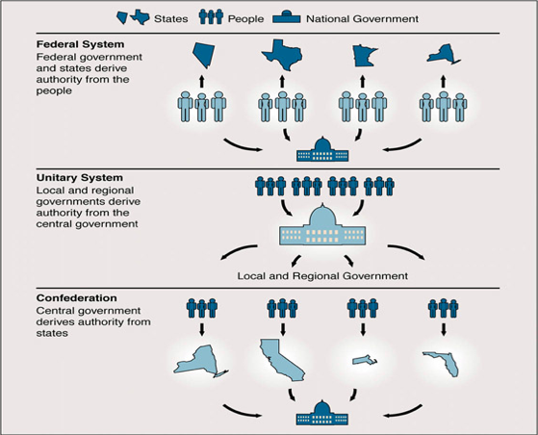
Notes: Federalism
II. Roots of the Federal System
a. Federalism – A political system in which power is divided and shared between the central government and the states.
b. Anti-federalists agree to support Constitution with Bill of Rights
Also want more power given to states
c. Prevention of tyranny
d. Attempt to increase participation by the people
e. Use states as “testing grounds” for federal policies

Slide 30
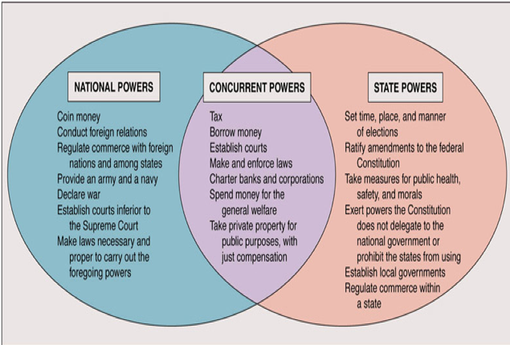
Notes: Federalism
III. Division of Power
a. Exclusive powers – Belong to states OR central govt.
b. Concurrent powers – Shared by both
c. Denied powers – Specific powers prohibited
d. Enumerated powers – found in Article I, Section 8 of Constitution
e. Implied powers:
i. Central govt. has authority to make all laws necessary and proper
Found in the Elastic Clause
i. State govts. Derive power from Amendment 10

Slide 31
Evolution of Federalism
States --------------------------------------------National
Directions: Research each of the 14 influences (documents, events, groups, and individuals) on federalism listed below and use your findings to fill in right side of the chart. Then place the influence on the “tug of war” seen above.

Slide 32
Warm-Up: Mini-Quiz
Answer the questions independently (7 min)
We will review the answers as a class

Slide 33
Notes: The Washington Presidency
I. Objective: Unit 3 Lesson 4a - SWBAT evaluate the impact of the Washington and Adams presidencies on the stability of America’s national government.

Slide 34
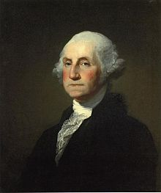
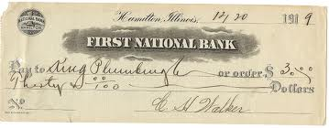
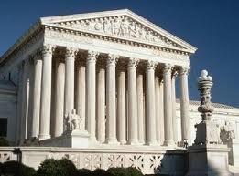
Notes: The Washington Presidency
II. Washington and the “Unwritten” Constitution
The Cabinet – Heads of government departments
Judiciary Act of 1789 – Establishes Supreme Court
Assumption – The central government assumes state debt
Excises – taxes on certain goods
Hamilton starts National Bank in 1791

Slide 35
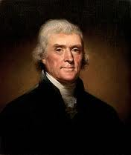
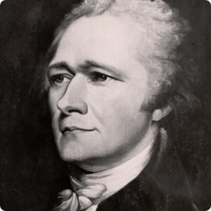
Notes: The Washington Presidency
III. Bank Controversy leads to Formation of Political Parties
a. Strict Constructionists (Jeffersonian Republicans)
i. Limit govt. to powers in Constitution
b. Loose Constructionists (Hamiltonian Federalists)
i. Govt. can do anything not denied by Constitution

Slide 36
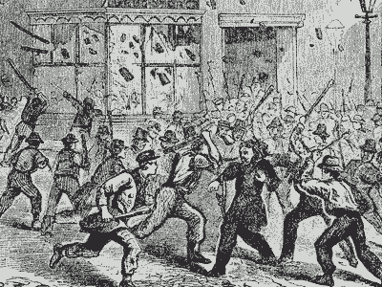
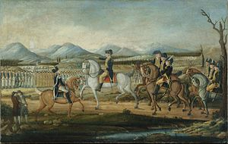
Notes: The Washington Presidency
IV. Whiskey Rebellion of 1794
a. Farmers protest Whiskey Tax in Pennsylvania
b. Washington organizes militia of 13,000, ends revolt

Slide 37
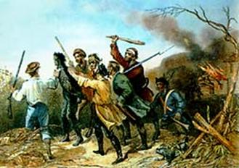
Whiskey Rebellion Diary
Directions: Follow the steps on the handout to research and complete your Whiskey Rebellion Diary.
http://gwpapers.virginia.edu/documents/whiskey/october.html

Slide 38
Unit 3 Lesson 4a: 11/19/12
Warm-Up: Read the document and as you read underline Washington’s statements showing his position on getting involved with other nations.
Then answer the questions on the back of the handout

Slide 39
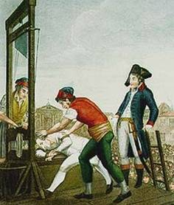
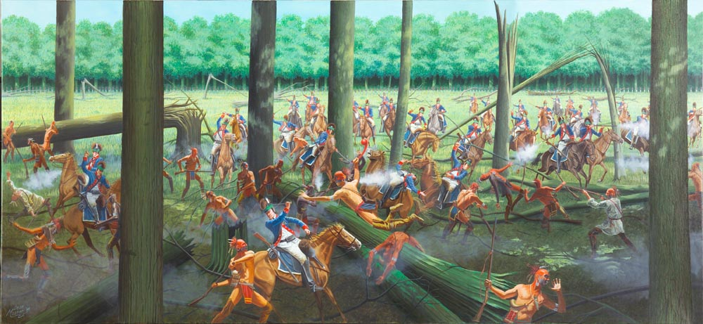
Notes: The Washington Presidency
V. Influences on American Neutrality
a. French Revolution
i. Reign of Terror
b. Anglo-French Conflict
c. British presence in Northwest Territory
i. Battle of Fallen Timbers
ii. Treaty of Grenville, 1795

Slide 40
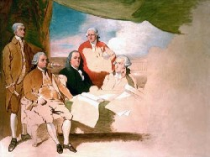
American Foreign Relations Activity
Directions: In your pair / group of three read the document and underline the reasons given in support of neutrality or supporting war/relations with European nations.
- Then answer the questions on your handout.

Slide 41
American Foreign Relations Activity
Directions: Move to the poster in the room that reflects the positions of your documents (neutrality or war/relations)
- As a larger group list all of the reasons given in the documents for your position about relations between the US and Europe.

Slide 42
American Foreign Relations Activity
Directions: Choose one person from the other group and complete the “silent debate” handout by filling in an argument for your side then swapping the paper with your “opponent”
- Continue the “debate” until both sides have run out of arguments.

Slide 43
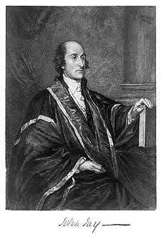
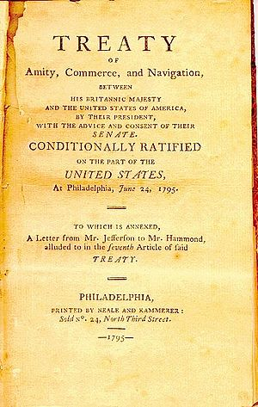
Jay’s Treaty Activity
Directions: Read Jay’s Treaty and summarize the idea of each article in the space provided.
- Read the documents opposing Jay’s treaty and underline their reasons for opposing the treaty.
- Fill in the T-Chart with reasons to support and reasons to oppose Jay’s Treaty

Slide 44
Jay’s Treaty Homework
Vocabulary:
Literal and Analytical Notes on p. 205 – 214
Finish Jay’s Treaty Readings / Chart
Jay’s Treaty Cartoon: Students will create a political cartoon either supporting or opposing Jay’s Treaty with the specifications found at the bottom of the handout.

Slide 45
Unit 3 Lesson 4b: 11/20/12
Warm-Up: Move into your “silent debate” groups, take 10 minutes to finish your debate SILENTLY
When you finish return to your seat and start reading you copy of THE JAY TREATY (Activity 3: An offer you can’t refuse?)

Slide 46
Jay’s Treaty Activity
Directions: Read Jay’s Treaty and summarize the idea of each article in the space provided.
- Read the documents opposing Jay’s treaty and underline their reasons for opposing the treaty.
- Fill in the T-Chart with reasons to support and reasons to oppose Jay’s Treaty

Slide 47
Unit 3 Lesson 4b: 11/21/12
Warm-Up:
Read Washington’s Farewell Address and underline his statements on foreign policy
Answer the questions on the back in complete sentences

Slide 48
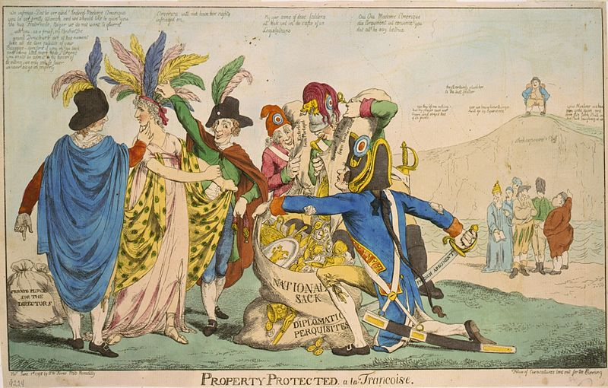
Notes: The Adams Presidency
Foreign Affairs
Jay’s Treaty infuriates France
XYZ Affair angers Americans
Blames Jeffersonian Republicans (JR’s)
Quasi War with France
Naval conflict
Convention of 1800 ends Franco-American alliance

Slide 49
Notes: The Adams Presidency
Foreign Affairs
Jay’s Treaty infuriates France
XYZ Affair angers Americans
Blames Jeffersonian Republicans (JR’s)
Convention of 1800 ends Franco-American alliance

Slide 50
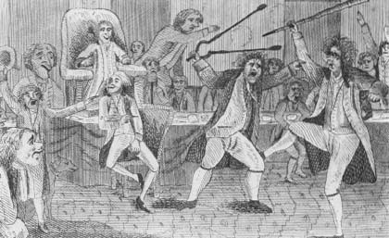
Notes: The Adams Presidency
II. Tensions between Federalists and JR’s
Adams as President (F), Jefferson as VP (JR)
Alien and Sedition Acts seek to silence opposition
Worry JR’s will side with France
Virginia and Kentucky Resolutions
Nullify A&S Acts
Uphold states rights
Sets stage for election of 1800

Slide 51
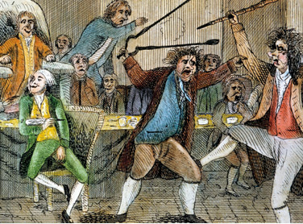
Alien & Sedition Acts Foldable
Directions: Follow the steps on your handout to complete your Alien & Sedition Acts Foldable

Slide 52
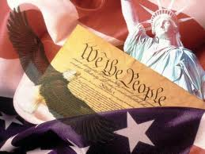
Living Constitution Project
Due Date: December 21, 2012
START COLLECTING ARTICLES NOW! Then assign them to specific parts of the Constitution / Bill of Rights.

Slide 53
Unit 3 Lesson 5: 11/26/12
Warm-Up:
Move back into your groups for your Sedition Acts foldable
You have 15 more minutes in class to finish
Stay at lunch / after school to complete foldable, due by 4:30 pm today!

Slide 54
Notes: The Election of 1800
I. Federalists Lose Support
a. Sedition Acts unpopular
b. Buildup to war seen as waste
i. Debt and taxes
ii. Unused navy
iii. No “satisfying” war with France

Slide 55
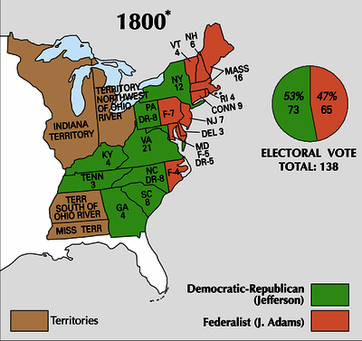
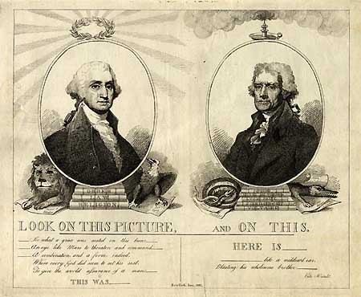
Notes: The Election of 1800
II. Results of the Election
a. First real campaign
b. Electoral tie broken by H of R
Jefferson becomes President, Burr is VP
Results in 12th Amendment
c. Peaceful transition of power between parties
i. End of Federalist party
d. Proved stability of American government

Slide 56
Most Important Year!
Around the room 5 dates are posted:
1607
1776
1786
1787
1800
Silently move to the year that you believe best answer the question below:
At what point was a democracy established in the United States?

Slide 57
Most Important Year!
On your index card:
Back (blank side): List in bullet points 4-5 pieces of outside information you can use to support your choice
Front (lined side): Write a paragraph using your outside information to answer the question below
Why do you believe _____ was the year democracy was established in America? Why were the events of this year more important to American democracy than the Election of 1800?

Slide 58
Unit 3 Lesson 6: 11/27/12
Warm-Up:
Trade index cards with the person next to you
Silently grade their paragraph based on the following scale:
8 – 10: Develops a specific argument, supported with 5 pieces of outside information, analyzes reasoning and consequences of their position
5 – 7: Only 3 – 4 pieces of outside information, explains relevance of this information
2 – 4: Only 1 – 2 pieces of outside information, describes outside information
0 – 1: Lacking an argument or outside information
Write their grade on the back of the index card

Slide 59
Most Important Year!
Around the room 5 dates are posted:
1607
1776
1786
1787
1800
Silently move to the year that you believe best answer the question below:
At what point was a democracy established in the United States?

Slide 60
DON’T FORGET!
Our US History Trivia Contest Starts TODAY!!!
Eat lunch quickly! Then come upstairs by 12:05 for trivia!
Winning peer groups get prizes!

Slide 61
DON’T FORGET!
Due to timing we will not have the quizzes for the unit…
Instead we will have an exam that covers all of Unit 3. This exam will take place next Wednesday 7th period.
We will have a review quiz on Friday to practice more Multiple Choice questions.

Slide 62
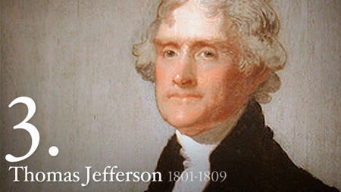
Notes: The Jefferson Presidency
Objective: Unit 3 Lesson 6 - SWBAT assess the impact of domestic and foreign policy decisions on national growth in the early 1800’s.

Slide 63
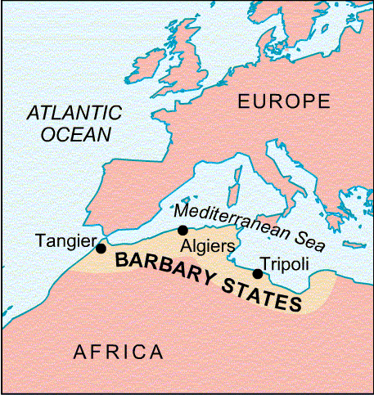
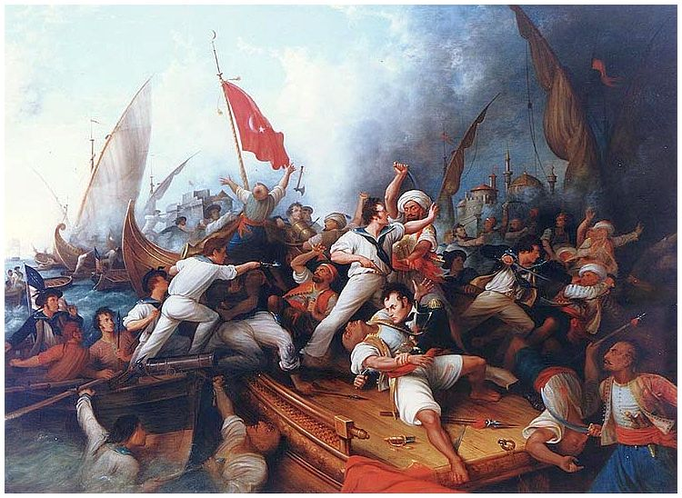
Notes: The Jefferson Presidency
I. Believed in strict neutrality
II. Refusal to use patronage system limits support
III. Reduced national debt
a. Shrank army
b. Small navy used in Tripolitan War

Slide 64
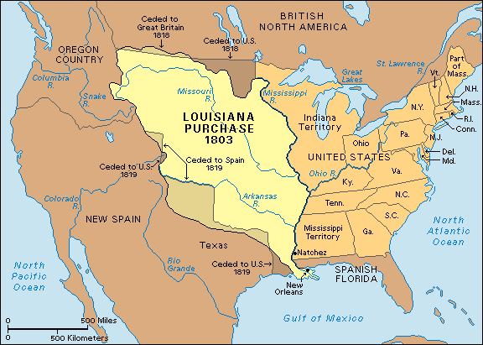
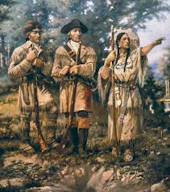
Notes: The Jefferson Presidency
IV. Effects of the Louisiana Purchase
a. Access to Mississippi river
b. Eliminated European presence
c. Opened the West

Slide 65
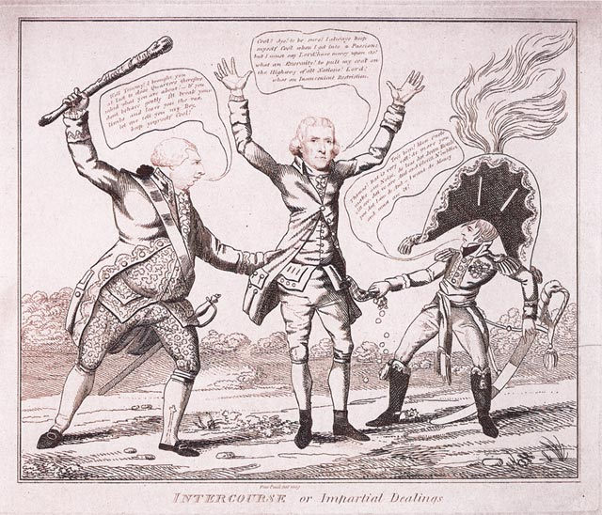
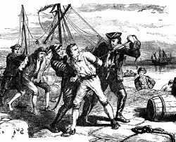
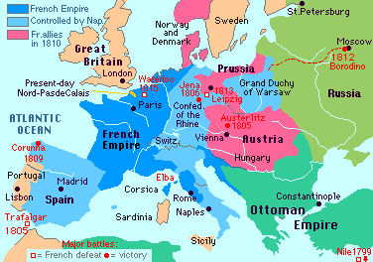
Notes: Unstable Neutrality
I. Napoleonic Wars put US between Britain and France
II. Both nations block American trade
a. British Orders in Council
b. Napoleon’s blockade
III. Impressment angers Americans
IV. Jefferson supports Embargo Act of 1807
a. Bans all foreign trade
b. Replaced by Non-Intercourse Act of 1809
i. Bans trade with Britain and France

Slide 66
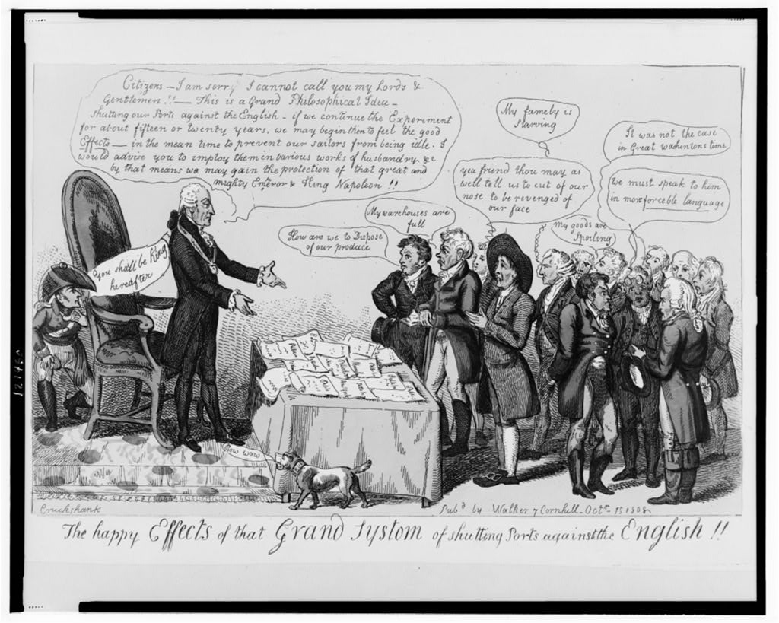
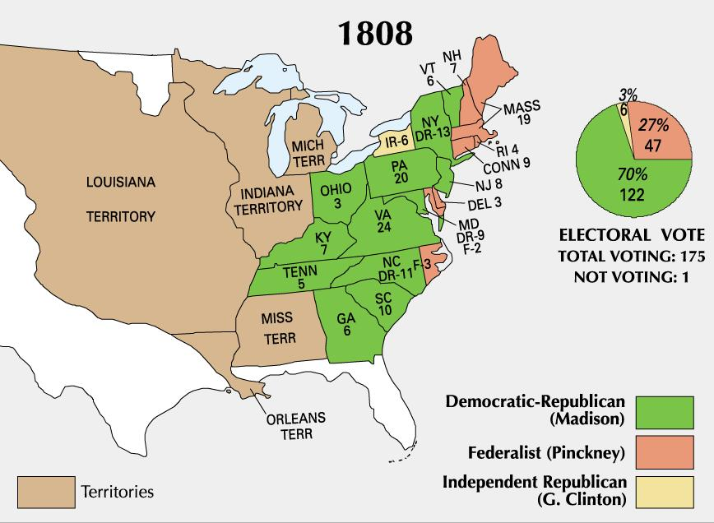
Notes: Madison as President
I. Madison becomes President in 1809
a. Congress passes Macon’s Bill No. 2
b. If either Britain or France open trade, America will bring back the embargo against the other country

Slide 67
Embargo vs Macon’s Bill No. 2
Use your documents and the American Nation text to complete the worksheet.
Tomorrow we will use this worksheet as the basis of a mini-debate so finish it for homework if it is not finished in class!

Slide 68
Unit 3 Lesson 7: 11/28/12
Warm-Up:
Move into the groups below:
You have 5 minutes to decide
Who will speak for your group
What main points you will make about why your act was the better option
**The people who spoke yesterday during the warm-up cannot be your representatives today!
Embargo Act of 1807 | Macon’s Bill No. 2 (1810)
Manahil Aurora Lina Sara Devonique Tayyaba Shanel | Marium Urwah Sadia Deeba Yana Hira Susie

Slide 69
Embargo vs Macon’s Bill No. 2
2 minutes – Embargo Act speaker explains value of this act
1 minute – Embargo Act group is questioned by the other group
2 minutes – Macon’s Bill speaker explains value of this act
1 minute – Macon’s Bill group is questioned by the other group
1 minute – Embargo act group explains why their position is better
1 minute – Macon’s Bill group explains why their position is better

Slide 70
Notes: Election of 1800
Objective: Unit 3 Lesson 5 - SWBAT judge whether the election of 1800 should be considered “revolutionary” in the foundation of American democracy.

Slide 71
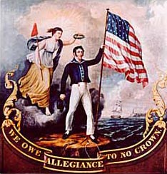
Notes: The War of 1812
Objective: Unit 3 Lesson 7 – SWBAT argue whether the War of 1812 was inevitable and if it should be judged as a success or failure for the American people.

Slide 72
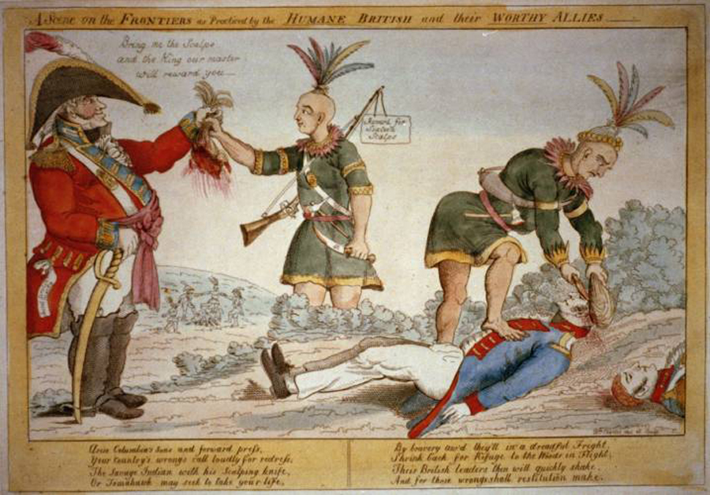
Notes: The War of 1812
Causes of War
I. Napoleon re-opens trade
America resumes embargo with British
II. Warhawks demand war with British
Are a minority, but a loud group
III. Shawnee ally with British after Battle of Tippecanoe
William Henry Harrison becomes a hero
IV. Madison asks Congress for war
a. June 1, 1812
b. Protect interests and image of America
c. War will prove virtue of Republicanism

Slide 73
Homework
Literal and Analytical Notes for p. 248 – 255
Complete index card paragraph:
Back: Bullet point 4-5 pieces of outside info
Front: Write the paragraph
Prompt: Should the War of 1812 be judged as a success or a failure?
Vocabulary – On handout

Slide 74
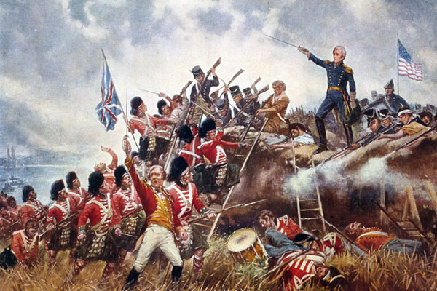
War of 1812 DBQ Poster
Move into peer groups
Use p. 185 – 197 in your American Nation text, your at-home notes, and the steps on your handout to create your DBQ poster
You have the rest of class and 7th period to finish!
*If you do not complete the task by the end of 7th period it is up to you to stay after school to finish!

Slide 75
Unit 3 Lesson 8: 11/29/12
Warm-Up:
Trade index cards with the person next to you
Silently grade their paragraph based on the following scale:
8 – 10: Develops a specific argument, supported with 5 pieces of outside information, analyzes reasoning and consequences of their position
5 – 7: Only 3 – 4 pieces of outside information, explains relevance of this information
2 – 4: Only 1 – 2 pieces of outside information, describes outside information
0 – 1: Lacking an argument or outside information
Write their grade on the back of the index card and give the reasoning for the score.

Slide 76
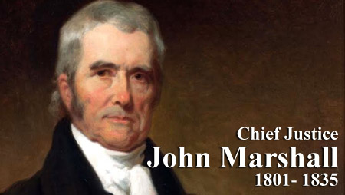
Notes: Legacy of John Marshall
Objective: Unit 3 Lesson 8 - SWBAT compare the impact of John Marshall on the development of America’s government with America’s other “Founding Fathers.”

Slide 77
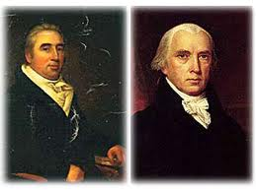
Notes: Role of the Supreme Court
Establishing the Courts
Case of Marbury v. Madison (1803)
Establishes Judicial Review
Supreme Court has last word in questions of constitutionality

Slide 78
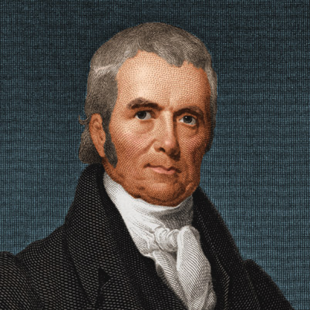
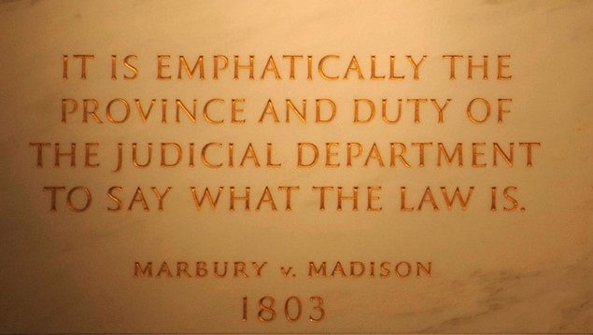
Notes: Role of the Supreme Court
The Marshall Court
John Marshall appointed as Chief Justice of Supreme Court (1801)
Loose constructionist
II. Broadens powers of central government
III. Upholds right of court to review government decisions
Could invalidate state laws as well

Slide 79
Homework
Use pages 263 – 265 to complete worksheet “Major Cases of the Marshall Court”
Create vocabulary card for each case, John Marshall, and Judicial Review
Quiz tomorrow covering notes and reading from the unit

Slide 80
War of 1812 DBQ Poster
Move into peer groups
Use p. 185 – 197 in your American Nation text, your at-home notes, and the steps on your handout to create your DBQ poster
You have the rest of class and 7th period to finish!
*If you do not complete the task by the end of 7th period it is up to you to stay after school to finish!

Slide 81
Unit 3 Discussion: 11/30/12
Warm-Up:
Clear off desk for quiz.
Must be completed by 11:25

Slide 82
Discussion
Take 5 minutes to add 1 bullet point to each part of your chart based on how your character would feel about American government following the War of 1812
Discussion Norms:
Only 1 person speaking at a time
When you finish speaking you select the next participant (raise your placard to be recognized)
If you are not speaking you are either tracking the speaker or taking notes on their opinions

Slide 83
Homework
DBQ Essay
Images of your DBQ posters will be on the website by the end of the day
Organize binder:
Lessons organized by lesson # / date
Page numbers
Fill out table of contents
Exam on Wednesday
Create and study all flash cards (list online)
Answer essential questions in complete sentences

